Slide 1
Addressing Common Insurance Access Challenges
Patient Advocate Foundation
Pat Jolley, RN, Director, Clinical Initiatives

Slide 2
OUR MISSION
Patient Advocate Foundation (PAF) is a national 501(c)3 non-profit organization which provides case management services and financial aid to Americans with chronic, life-threatening and debilitating illnesses.
OUR HISTORY
PAF was founded in 1996 by Nancy Davenport-Ennis and Jack Ennis
to help address the issues faced by patients like their friend Cheryl Grimmel who had to battle not only her breast cancer but for access to affordable treatments. In PAF’s first year Nancy and a part-time volunteer staff of 2 provided case management assistance to 157 patients with access barriers to prescribed care. Fast-forward to 2018, we’ve helped a cumulative total of more than 1.2 million patients nationwide with support provided by more than 200 staff.

Slide 3

IT STARTS WITH THE PATIENT
“High quality healthcare is not just about treatment; it’s about a care plan that considers challenges to daily life – transportation, housing, food security, employment, childcare and self-care.”
Alan J. Balch, PhD
Chief Executive Officer

Slide 4
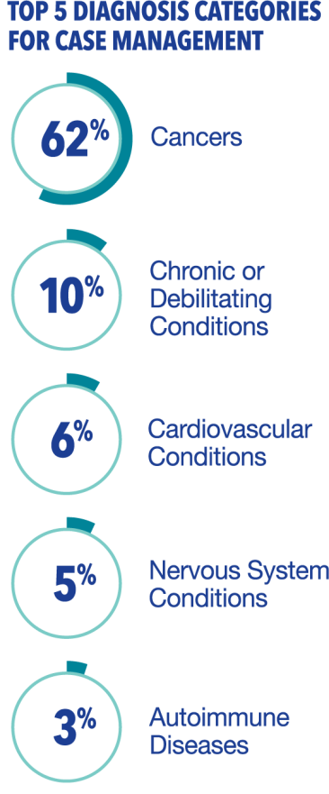
CASE MANAGEMENT
Our professional patient advocates assist tens of thousands of patients each year, enabling them to connect with and maintain access to prescribed healthcare services, overcome insurance barriers, locate resources to support cost-of-living expenses, evaluate and identify insurance coverage and manage out-of-pocket expenses
SUMMARY OF PAF CASE MANAGEMENT PATIENT CASES AND CONTACTS IN 2018
Total PAF Case Management Cases 24,804
Total PAF Case Management Contacts 402,545
Average Contacts Per Case 16.14
Average Issues Per Case 1.75

Slide 5
Case management

Slide 6
Roadblocks to Access & Affordability
Insurance Access
Lack of insurance, insurance with
high out-of-pocket requirements and/or service limitations and low insurance literacy contribute to routine and significant access barriers.
Employment Protections & Workplace Entitlements
Commonly insurance benefits are provided through employers, as are income replacement policies (STD/LTD) and are jeopardized if the employee cannot work. Patients often lack knowledge about employee protections and how to access them: FMLA, ADA, COBRA.
Medical Debt & Ability to Pay
Patients receive healthcare services from a multitude of providers/facilities and there are costs associated with each. Medical debt mounts quickly, at the very time when their ability to pay is hardest.
Emotional Distress
Patients’ inability to access and afford necessary healthcare and maintain their financial stability creates emotional trauma that impacts their overall health.
Cost-of-Living Impacts
When people become ill, or live with a chronic disease, their income is almost always impacted. Many patients cannot sustain their basic needs such as housing, transportation, food and utilities.

Slide 7

DRUG FORMULARY
A drug formulary is a continually updated list of medications, created by your insurer, representing clinical judgments from experts in diagnosis, prevention, or treatment of disease and promotion of health, used to further identify specific pharmaceutical benefits delivered outside of a provider's facility.
Each formulary is specific to a distinct insurance plan
published and made available by insurer to plan enrollees
Can be called many different things, vocabulary can be different
from insurer to insurer and plan to plan.
  Preferred Drug List
  Select Drug List
  Closed Formulary/Closed Drug List
  Covered Medications List/List of Covered Drugs

Slide 8

WHAT YOUR FORMULARY CONTAINS
Each medicine considered to be COVERED by the plan
"Tier" that the drug is placed on
Indicators for use: (called utilization management)
  Prior Review /Prior Authorization (PA)
  Quantity Limitations (QL)
  Restricted Access or Step Therapy
  Specialty Drugs
  Specific dosage, forms and/or strength limitations
A "legend" to identify specific abbreviations and markers
Assume delivery via an IN-NETWORK pharmacy provider within your plan, whether local retail, mail-order or specialty pharmacy

Slide 9
COMMON MEDICATION CHALLENGES
Insurance Tiers
Tiers are reviewed by the insurance pharmacy manager and updated annually
Medications can be moved from one tier to another at any point throughout the plan year
Co-payments and co-insurance increase substantially with higher tier levels - varies by policy
Step Therapy
May require try and fail other medications before approving newer drugs
  Provide documentation as to why you can’t take a recommended medication
  Provider concerned about potential drug reactions
  Already tried and failed the medication(s) being recommended
Prescription Drug “Cap”
Monthly or Annual limit or “cap” on benefits your insurance company will pay for prescription
drugs or medications
Prior Authorization
Submit request to insurance company along with supporting medical documentation
Coordinate with providers office to ensure submission is being tracked
Submit an appeal if denied, or discuss treatment options with provider

Slide 10
COMMON MEDICATION CHALLENGES (continued)
Separate Prescription and Medical Plan Deductible
May have a drug-specific deductible to meet before insurance begins to cover their portion
Pharmacies require total payment upfront before dispensing or releasing medications to patient
Know your plan- review pharmacy options including drug formulary, mail-order service, local pharmacy or specialty pharmacy requirements
No Drug Coverage or Limited Drug Coverage
Generic only coverage
Limited brand-name coverage
Short Term “catastrophic” Plans- only 29% of these plans cover prescription medications
Be aware of prescription drug exclusions written in policy language
Medicare Part D “donut hole” or Coverage Gap
Higher rate of abandonment of new specialty drug prescriptions
Reductions and delay initiating treatment following a new diagnosis or disease progression
In 2019, brand name drugs covered at 75% & generics covered at 63% during coverage gap

Slide 11
ON AND OFF LABEL MEDICATIONS
On-label Medications:
  FDA approved indication on drug label, includes dosage, route of administration, frequency of administration, and population to whom the drug would be administered
  FDA determined benefits of using drug for a particular use outweighs the potential risks that is supported by strong scientific data
Off-Label Medications:
Drug being prescribed for an unapproved use or indication (age, dose or diagnosis)
  Need to submit evidence to insurance that using drug in this manner is an “accepted standard of medical practice”
  Supportive data and clinical documentation, journal articles or clinical trial results supporting the use of a specific drug can be submitted to the insurance plan for review
  Off label does not mean the drug is unsafe but hasn’t undergone clinical trials for effectiveness in treating a specific diagnosis
  May require evidence of effectiveness or failure with conventional treatments, especially if the drug is expensive for insurance to consider coverage.
  Insurance is not required to cover costs for the use of an off-label drug, patient may be held responsible for costs of treatment – Be sure to read the Policy Plan Exclusions

Slide 12

USING THE KNOWLEDGE OF YOUR FORMULARY TO YOUR ADVANTAGE
If you're currently taking a specific medication, research the formulary of other plan options during open enrollment
If your medication is on a high tier -- work with your doctor to see if a different medication or generic is available on a lower tier would be an option for you
Know when to explore options for requesting a formulary change or exception from your insurance company
For new medications, ask for a reduced initial prescription quantity so you do not pay for medications that you do not use if med doesn't work. *high tier drugs especially
Ensure Prior Authorizations and Quantity Limits are met to avoid situations with no coverage of medication, delays from pharmacy filling prescription, or high costs at checkout.

Slide 13

INSURANCE DENIALs
Initially notified verbally from a Pharmacy or Medical Provider of request being denied
Should receive a written denial letter from insurer responding to a specific request
Includes reason cited as basis for decision
Must include statements with your appeal rights, the process and timeline for submission of an appeal.
Contact insurance company to find out why your request for coverage was denied
Talk to your doctor about how they can and if they will support an appeal on your behalf
If care already received, notify the provider that you are appealing denial to avoid being sent to collections
Be sure to take notes on all conversations, including the date and time of the phone call, the names of the people you spoke to and what was discussed.

Slide 14

WHAT IF I’M UNINSURED?
Seek out free drug programs from manufacturers
Look for pharmacy savings programs or savings clubs
Medication specific coupons, rebates, or discount cards
Ask for complimentary medication samples from provider
Look for financial assistance in other budget areas to help offset costs and free up money for medications

Slide 15

Choosing the best HEALTH plan
When you are enrolling in a health insurance plan, do your research before you buy....like you would when shopping for other big purchases.
  Plan Type (HMO, PPO, POS, High Deductible, etc.)
  Network Providers (includes doctors, labs, facilities, and pharmacies and mail order)
  Deductibles (medical care deductibles, pharmacy deductibles or combined)
  Cost Sharing Rates (copayments and coinsurance, max out-of-pocket)
  Formulary (medication costs and covered drugs)
  Review Non-Covered Benefits or Exclusions
  Premium
*Cost Comparison: Keep in mind that your annual total cost of care goes beyond the monthly premium

Slide 16
Your Right to a Second Opinion
  It is your right to research and be knowledgeable about your condition
  Second opinions are consultations with a different doctor or specialist. May be virtual or in-person
  Empowering and allows you to make informed decisions about your treatment options
  Allows you to benefit from advances in medicine, new techniques and technologies, less invasive options or reduced side-effects
  There is no reason to ever feel guilty or ashamed for asking for another medical opinion, even if you trust your doctor and agree with recommendations
  Second opinions generally do not include treatment
  Should be provided by a board-certified provider or credentialed specialist in that field
  Helps put the patient, family, and friends at ease and increases comfort level with healthcare decisions

Slide 17
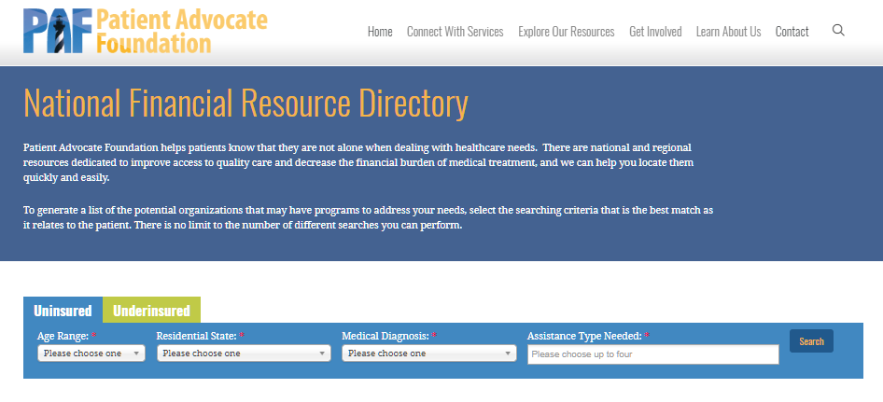
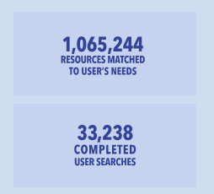
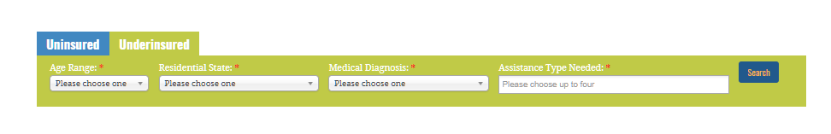
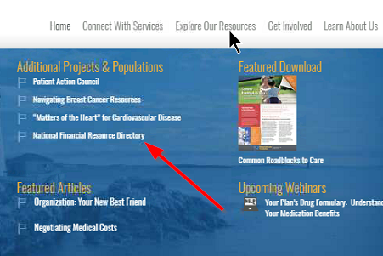

National Resource Directories
With over 35 categories of assistance, the National Resource Directories can help providers serve a wide range of patient needs

Slide 18
Thank You!

Slide 19
The Myositis Association
September 07, 2019

Slide 20

About UBC
PATIENTS FIRST. POWERED BY EVIDENCE.
Our Mission:
Deliver evidence of safe & effective use of medications
Ensure appropriate access to therapy
Demonstrate real world value of products
Our Vision:
Be the leading provider of late stage and patient support services, focused on safety, access, and value for the biopharmaceutical industry.
2003
>1900
12
Pharma & Biotech
Year Founded
Employees
Offices Globally
Our Clients

Slide 21

Patient Journey
Symptoms
Diagnosis
Specialists
Primary Care
Treatment
Lab

Slide 22
Unique BUT COMPLEX PATIENT experience
Patient
Support
Prescriber
Coverage and Cost
Manufacturer
Nursing
Services
Insurance
Patient Assistance Programs
Foundation
Pharmacy
Copay

Slide 23

A Simplified, consistent Patient Services experience
Stakeholders
Prescriber
Nursing
Support
Patient Assistance
Programs
Pharmacy
Insurance
Home Health
Patient Focused
Solutions
Adherence & Compliance
Copay Support
Foundation
Manufacturer
Injection Training Services
Bridge &
Quick Start Programs
Customer Service
Payer

Slide 24



Creating AN INDIVIDUALIZED AND OPTIMAL patient journey for best in class outcomes
Medication Administration Support
Ongoing Patient Engagement
Medication Reminders
Enrollment
PA/Appeal Support
Summary of Benefits to patient/HCP
Starter/Bridge
Benefit Investigation
Triage
Physician Fax/eEnroll
Expedited through eSign & Real Time Benefit Checks
ePA and
Appeal Tools
Copay Card
Foundation
PAP

Slide 25

UBC Patient Support Services
Benefit to Patient
Solutions we Offer
How we Deliver
Access
  - Reimbursement
  - Benefit Verification
  - PSP Enrollment
  - Financial Assistance
  - Pharmacy Solutions
Speed to
Therapy
Nursing Support
  - Disease Awareness
  - Product Education
  - Field & Call Center Support
  - Adherence Solutions
Outcomes & Value (Data/Analytics)
Our People, Culture, and Values
Educate &
Empower
UBC Pathways Connected Health
Guiding Patient Journeys,
driving faster access and
optimal outcomes
Care Coordination
  - Home Care Coordination
  - Site Care Coordination
  - Transition of Care
  - Injection Training Support
Remove
Barriers
to Care

