Slide 1
Nutrition for
Autoimmune Diseases
Jacilyn Mikels ARNP, FNP-C, IIN Health Coach
Co-Founder of FollowYourGutMDNP
www.followyourgutmdnp.com

Slide 2
Disclaimer: The information I am supplying is evidenced-based and for educational purposes only. Any suggestions I make today please discuss and review with your physicians/medical team prior to incorporating into your daily routine.

Slide 3
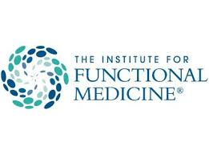
www.followyourgutmdnp.com

Slide 4
Presentation Overview
What is an Anti-Inflammatory Diet
Review of Macronutrients
Specific sources/triggers that induce inflammation
Anti-inflammatory Supplements
Auto-immunity and Gut Health
Auto-immunity and Ketogenic Diet

Slide 5
What is an Anti-Inflammatory Diet (AID)?
No single, conclusive definition
For the most part, agreed that the basis of AID surrounds the concept of whole foods
NO processed foods
NOTHING from a box, can or bag—for the most part
Shopping the perimeter of the grocery store or visit local farmers markets

Slide 6
Basis of AID
Avoid processed foods
Eat more whole foods
Avoiding sugars
High in vegetables
Bone-based broth
Moderate amounts of proteins

Slide 7
What are “whole foods”?
Fruits
Vegetables
Proteins
Healthy fats (monounsaturated or polyunsaturated)
Prebiotic and Probiotic affects
All fresh—no additives

Slide 8
Why an AID for Myositis?
In 2007, Rose Mary Istre discovered that patients with Myositis diseases who followed an AID for a 12 week period showed improvement in:
Grip
Arm and Leg strength movements
Improvement of activities of daily living
Decreased severity of depressive symptoms

Slide 9
Secondary diagnoses to consider with Myositis
Diabetes
Cancer
Alzheimer’s
Heart Disease
Additional Auto-immune diseases
Notes:
Cancers associated Colon, Breast, Melanoma. 2013 study published in Intl Journal of Derm (even though a small cohort) showed a 3:1 relation of nasopharyngeal carcinoma in Chinese patients with dermatomyositis than caucasian patients

Slide 10
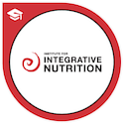
“One person’s food is another person’s poison”
-Joshua Rosenthal
Founder and Primary Teacher of Institute of Integrative Nutrition (IIN)

Slide 11
Bio-Individuality
What works for one might not work for another
Everyone responds differently
LISTEN TO YOUR BODY and how it responds (positively or negatively) to certain foods and supplements
Keep a food diary

Slide 12
Macronutrients

Slide 13
Carbohydrates
There is a difference between GOOD and BAD carbs
GOOD Carbs
Quinoa
Brown rice
Fruits
Vegetables
Legumes*
BAD Carbs
“White” carbs
High fructose corn syrup
Syrup/sugar of any kind
Refined/Processed

Slide 14
Carbohydrates
What should you be careful with them?
Inflammation
Increasing weight/obesity
Increase glucose
Gut dysbiosis/imbalance—leaky gut syndrome

Slide 15
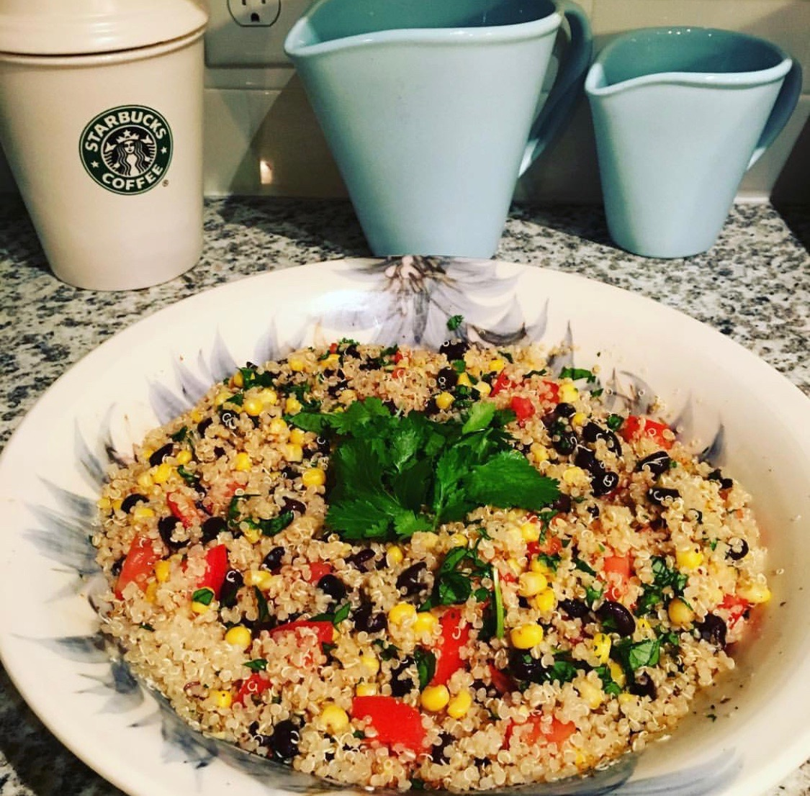
GOOD Carbohydrates
Quinoa
Brown Rice
Fruits
Vegetables
Legumes

Slide 16
BAD Carbohydrates
High fructose corn syrup
Refined/processed sugars
Anything WHITE
Artificial sweeteners

Slide 17
Proteins
Unknown amount of protein recommended for Myositis but it is necessary
Dietary Recommended Intake of protein is 0.8grams per kilogram of body weight
Example: Weight 200 pounds. Divide 200 by 2.2 x 0.8 = rounded up 73 grams daily
Aim for 15-20g/meal
Proteins to consider
Eggs
Steak
Chicken
Plant based proteins (pea-protein)
Fish
Quinoa (est. 8gram/cup)

Slide 18
Fats
Good Fats vs Bad Fats
Omega 3s are ANTI-inflammatory
Ex: Flaxseeds and walnuts
EPA and DHA: oily fish and eggs
Rec: Wild-caught oily fish 1-3x/week
Supplements: fish oil EPA + DHA; fungal sources have DHA
Omega 6s induce inflammation
Ex: Sunflower oil, Safflower, Soy, Corn

Slide 19
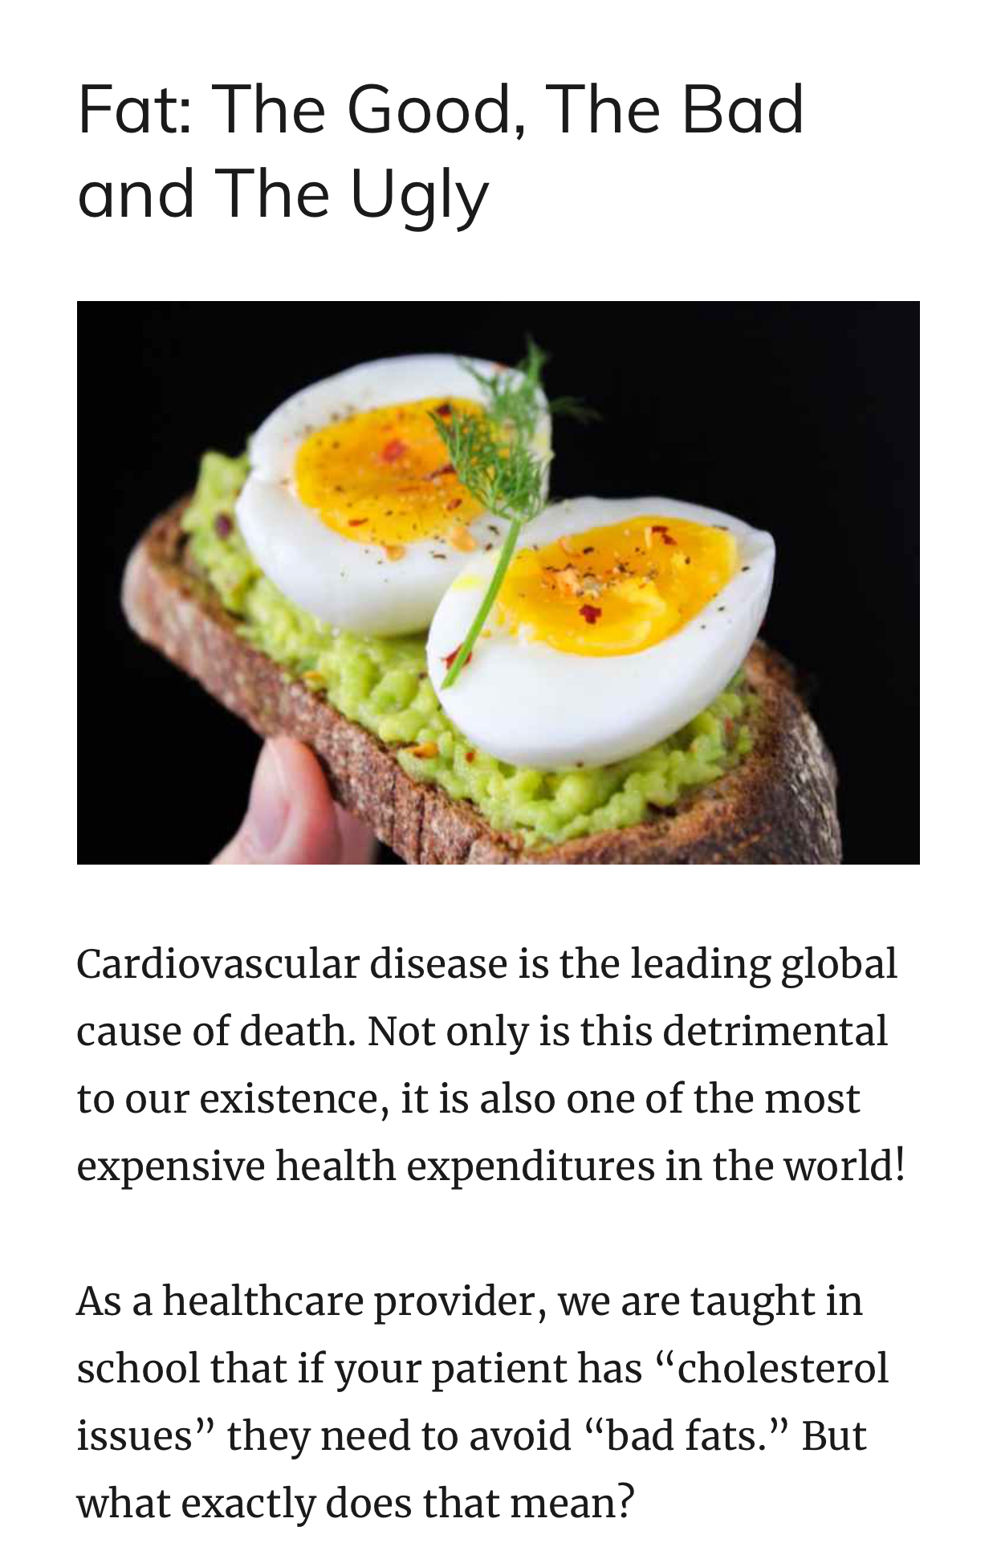
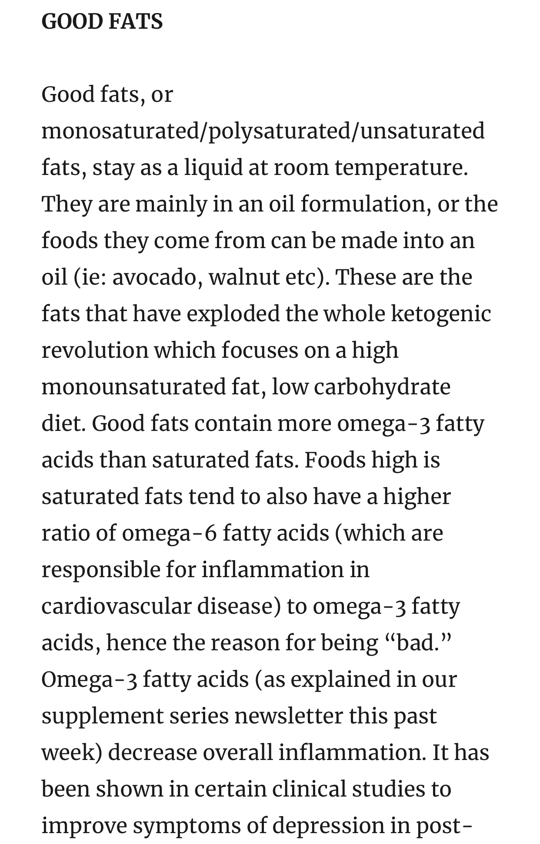
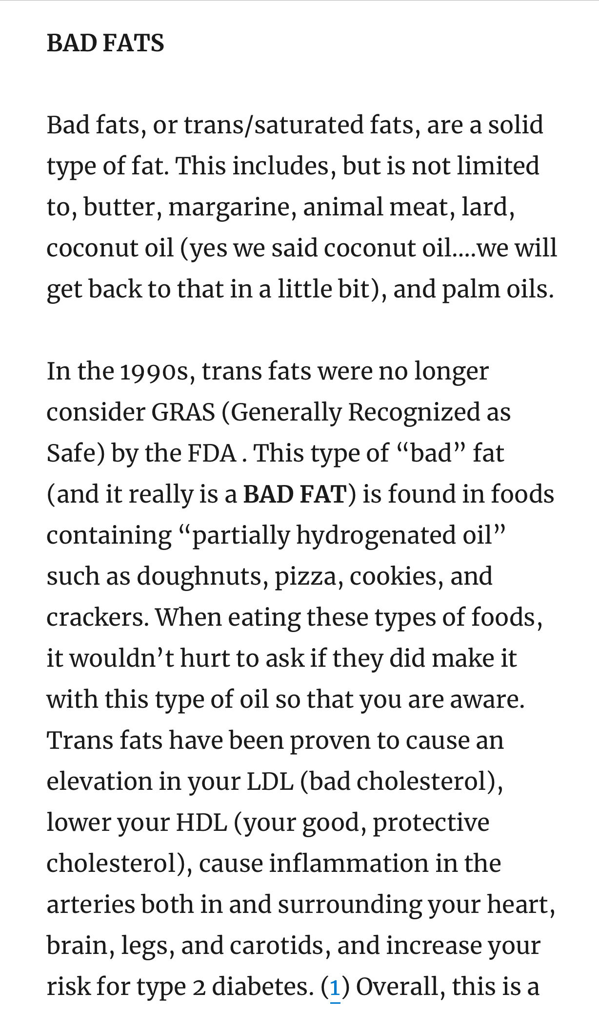
Cats and Dogs can live together…..
Why can’t we incorporate good fats into our dietary regimen?
https://www.followyourgutmdnp.com/blog/fat-the-good-the-bad-and-the-ugly

Slide 20
Examples of GOOD Fats
Oily fatty fish: salmon, sardines, trout, mackerel
Grass-fed (preferably organic) beef and pork
Omega-3 fortified eggs (preferably pastured raised, organic)
Chia seeds, flax seeds
Nuts: walnuts, cashews and almonds are highest
AVOCADOS!!!!
Ghee—clarified butter
Oils such as avocado, coconut, EVOO

Slide 21
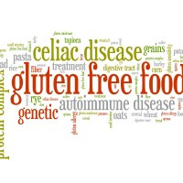

Slide 22
Gluten
According to the Celiac Disease Foundation
Protein found in wheat, rye, barley and triticale that helps maintain the shape of certain foods
Wheat
Barley
Rye
Triticale
Oats
Celiac Disease Foundation- great resource of what foods are best for gluten-free diet, recipe options, support etc
https://celiac.org/live-gluten-free/glutenfreediet/what-is-gluten/

Slide 23
Gluten
Question the relationship between celiac/gluten sensitivity and Myositis disease
Anti-gliadin found with increased frequency in patients with myositis. Celiac disease should be considered in patients with myositis who experience intestinal problems such as diarrhea or weight loss that cannot be explained otherwise.
(Loell, I., & Lundberg, I. (n.d.). Nutrition and Polymyositis and Dermatomyositis. In Nutrition and Health: Nutrition and Rheumatic Diseases (p. 202).

Slide 24
Gluten
In June 2014, International Ophthalmology reported first case of Orbital Myositis and Celiac disease in a 26 year old patient
More reports of orbital myositis and celiac diseases being associated with one another
What is Celiac disease?
“Celiac disease is a malabsorption syndrome resulting from a small-bowel enteropathy related to the intake of dietary gluten in susceptible individuals (2–4). Gluten is thought to cause both direct and immune-mediated toxicity.”
Song, M. S., Farber, D., Bitton, A., Jass, J., Singer, M., & Karpati, G. (2006). Dermatomyositis associated with celiac disease: Response to a gluten-free diet. Canadian Journal of Gastroenterology, 20(6), 433–435.

Slide 25
Gluten
Leaky Gut and Autoimmune Disease
In 2000, Dr Alessio Fasano discovered protein Zonulin
Damages tight junctions
We will talk more about the Gut Microbiome in a little bit and in my other talk

Slide 26
Dairy
Recommend to avoid to rule out trigger
Lactose (sugar) and Casein (protein)—difficult to digest for patients with autoimmune diseases, including Myositis (Celiac disease?)
Non-dairy sources of Calcium: Almonds, Kale, Oranges, Collard greens, Broccoli, Figs, Spinach, Rice/Almond/Hemp/Coconut milk, Sesame seeds, and Tofu

Slide 27
Sugar
FDA recommends less than 50g daily (4 tbsp) though average American consumes double that
Elevates levels such as CRP (c-reactive protein).
In one study, consuming 50 grams of fructose caused these levels to spike within 30 mins and remain elevated for over 2 hours!
Diet high in sugar—low grade chronic inflammation-worsens inflammatory markers—worsening a chronic inflammatory condition such as Myositis

Slide 28
Your brain on SUGAR….
https://mic.com/articles/88015/what-happens-to-your-brain-on-sugar-explained-by-science#.KONXiaFiK

Slide 29
Sugar
Increases gut permeability
Causes weight gain/ obesity
Causes LDL (bad cholesterol) to increase
Good Sugars
Whole Foods
Fructose in fruits
Firebrand protein
Bad Sugars
Taken out of its original source and added back into foods and drinks
High Fructose Corn Syrup (HFCS)
Corn Sugar
Glucose
Evaporated cane sugar (hidden in Kombucha!)

Slide 30
Alcohol
QUESTION: Is this a friend or a foe?

Slide 31
Alcohol
Red wine
Contains polyphenols
Raise HDL
Lower LDL
Increase insulin sensitivity
Improve blood pressure
MYOSITIS PATIENT CONCERNS
Interacts with medications ie: (methotrexate, cyclosporine, prednisone etc)
Worsening inflammation and dehydration
Increased feelings of depression
Increased fatigue
Elevation of CPK levels

Slide 32
Soda
Soda Stroke Study (April 2017 Stroke Journal)
Published April 2017 in STROKE journal
Linked with increased cardiovascular and neurological events
“2888 participants aged >45 years for incident stroke (mean age 62 years; 45% men) and 1484 participants aged >60 years for incident dementia (mean age 69 years; 46% men).”
Conclusion: Increased risk of stroke, all-cause dementia and Alzheimer’s dementia
Meaning people who are drinking diet sodas on a daily basis have a 3x higher incidence of developing dementia or having a stroke
Journal of Nutrition in January 2018 showed a
Direction association between elevated CRP (C-reactive protein) and soda consumption in Mexican Women
825 Mexican women free of diabetes, cardiovascular disease and cancer
Premenopausal women had 56% higher CRP when compared to women in lower category
(Pase, M. P., Himali, J. J., Beiser, A. S., Aparicio, H. J., Satizabal, C. L., Vasan, R. S., . . . Jacques, P. F. (2017). Sugar- and Artificially Sweetened Beverages and the Risks of Incident Stroke and Dementia. Stroke, 48(5), 1139-1146. doi:10.1161/strokeaha.116.016027)

Slide 33
Anti-Inflammatory Supplements

Slide 34
Curcumin
Active ingredient: Turmeric
Curry spice; Chinese medicinal herb
Inhibits inflammation, cell growth and cell death in most chronic inflammatory conditions
Alleviates oxidative stress
Molecules 2015 concluded Curcumin “therapeutic potential for various chronic inflammatory diseases”
Anti-inflammatory and anti-oxidative properties
Worry is the bioavailability
(He, Y., Yue, Y., Zheng, X., Zhang, K., Chen, S., & Du, Z. (2015). Curcumin, Inflammation, and
Chronic Diseases: How Are They Linked? Molecules, 20(5), 9183-9213. doi:10.3390/molecules20059183)

Slide 35
Curcumin
Things to consider before taking this supplement
Increases bleeding risk
Need to combine with piperines (black pepper) for better absorption
May increase risk for cardiac disease (inhibits effect on Cox-1 to Cox-2–increases cardiac inflammation)
Make sure your cholesterol is controlled due to this risk

Slide 36
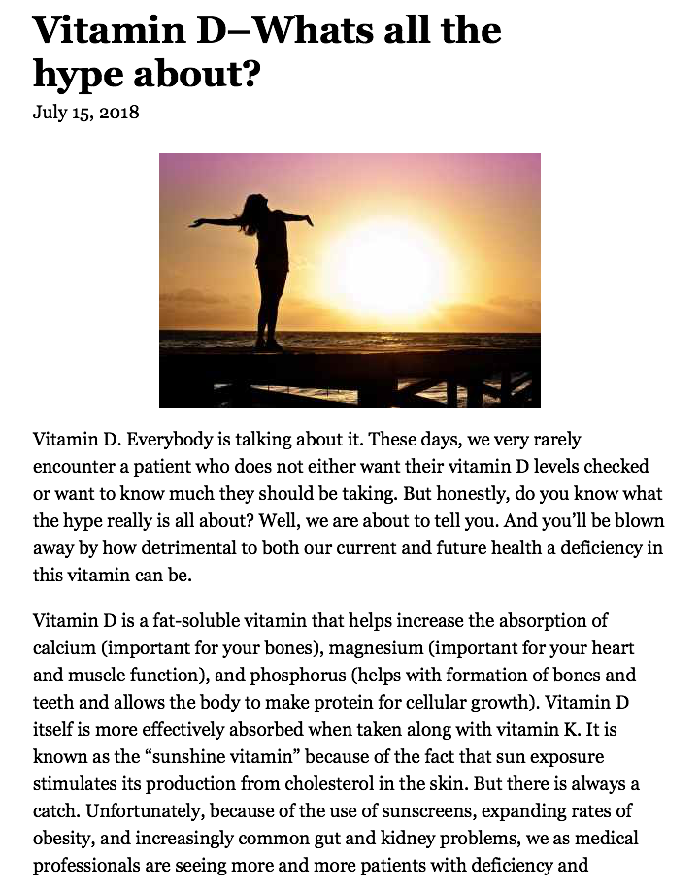
Vitamin D
https://www.followyourgutmdnp.com/blog/vitamin-d-whats-all-the-hype-about

Slide 37
Vitamin D
Important for bone health but also..
Cardiovascular disease (deficiency linked)
Type 2 diabetes
Gestational issues (diabetes, preeclampsia etc)
Multiple autoimmune diseases
Colorectal and Breast Cancer (deficiency linked)
Migraine treatment (still questionable)
Major depressive disorder—meta analysis (top notch study type) showed supplementation had a favorable effect with a moderate effect size (just scratching the surface)
Ideal range varies provider to provider—speciality to speciality (I use the range of 50-90 being ideal)
Clinical studies showing Vitamin D “benefits” with range > 35
Has been studied in so many different disease processes including Myositis disease

Slide 38
Vitamin D
2013 Study published in Annals of Rheumatic Diseases
Correlation between low serum Vitamin D levels and patients with idiopathic inflammatory myopathies (PM, IBM, & DM)
76 PM, 52 DM, 15 IBM and 6 JDM
IIM patients avg serum (38) vs patients without IIM (68)
No significant difference between myositis subgroups
IBM (68%) DM (65%) and IBM (53%) had deficient levels (<50) when compared to non-IIM patients (21%)
This questions if low vitamin d levels may be risk factor for adult myositis diseases, as like other autoimmune diseases

Slide 39
Vitamin D
In regards to the main food sources of vitamin D, the following foods contain the highest levels:
Fish oil (400–1000 IU/spoon of oil)
Wild caught salmon (600–1000 IU/100 g)
Eel (1200 IU/100 g)
Herring in oil (400–800 IU/100 g)
Sardines (300 IU/100 g)
Salmon in a tin can (300–600 IU/100 g)
Herring in a tin can (250 IU/100 g)
Tuna in a tin can (230 IU/100 g)
Shiitake mushrooms (100 IU/100 g) E
Egg yolk (20–50 IU/1 egg yolk)
Cow milk (0.4–1.2 IU/100 mL)
Mothers milk (1.5–8 IU/100 mL)
Cheese (7–28 IU/100 g)

Slide 40
Vitamin D
What to discuss with your GP or Specialist
Side effects/Adverse reactions
Contraindications
Goal for supplementation
Monitoring

Slide 41
Fish Oil
Omega-3 EPA and DHA
Reduces inflammation
HOLD prior to surgery per recommendation of physician/medical practitioner due to blood thinning side effect
Usually eating wild-caught oily fish 2-3 times a week is enough (salmon, albacore tuna, mackerel, herring, sardines) Most high in mercury!
No concrete data in regards to treating myositis symptoms/disease
Not recommended for cardiovascular protection
No evidence
Can lower triglycerides but “makes labs look good”

Slide 42
Folic Acid
Supplement needs to be mentioned as it is important while taking Methotrexate
Avoid hair loss, GI symptoms, low WBCs, lung/liver toxicity
Usually rec 1mg daily but again, per recommendation of your specialist
Take in conjunction with B12
Sublingual liquid or IM formation only
Good food sources: red meats, dark green leafy veggies, eggs

Slide 43
Supplements to be leary of
Glutamine
Whey protein
Vitamin C
Vitamin E
L-carnitine

Slide 44
Probiotics
Definition “live microorganisms which when administered in adequate amounts confer a health benefit to the host” (WHO)
Contribute to treating autoimmune diseases but not forefront
Prebiotic versus Probiotic foods
If probiotics are “live cultures” they do need to be refrigerated
What to look for in a “good”probiotic
High CFUs (colony forming units) Amount
Strains (should be diversified)
Stability (refrigerated vs dry storage)

Slide 45
80% of immunity is produced in the GUT
90% serotonin produced in the GUT
Gut-Brain Axis
Relationship between gut health and autoimmune diseases

Slide 46
Auto-immune diseases and Gut health
“Leaky Gut and Autoimmune diseases”
Classic paradigm of autoimmune activation
Specific genetic makeup
Exposure to environmental triggers
Adding Intestinal Barrier Functional “Leaky Gut Syndrome”
Gluten was removed—serum zonulin levels returned to normal—intestines went back to baseline barrier—autoantibody titers normalized, autoimmune process shut off and intestinal damage healed completely
Study mentioned T1DM, Crohn’s, Asthma, IBD, heavily on Celiac disease and being associated with these diseases
Celiac disease has a VERY HEAVY presence with Myositis diseases as well
This study questions autoimmunity, CD, and other autoimmune diseases association with one another
(Fasano, A. Clinic Rev Allerg Immunol (2012) 42: 71. https://doi.org/10.1007/s12016-011-8291-x)

Slide 47
Autoimmune diseases and Ketogenic Diet
Main source of energy is fat vs carbs.
Many studies have been performed or are being performed in benefit of ketogenic diet in autoimmune diseases
Has been proven to improve epileptic activity in children (used for almost a century!)
Improved cognition and memory in mice with autoimmune encephalomyelitis (https://www.ncbi.nlm.nih.gov/pubmed/22567104)
Potential therapy to use in patients with Parkinson’s and Alzheimer’s
Ketogenic diet and improving strength with Alzheimers
Can improve secondary diagnoses
Always discuss with healthcare provider

Slide 48
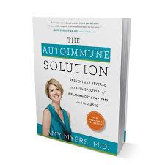
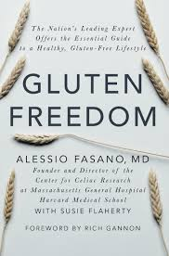
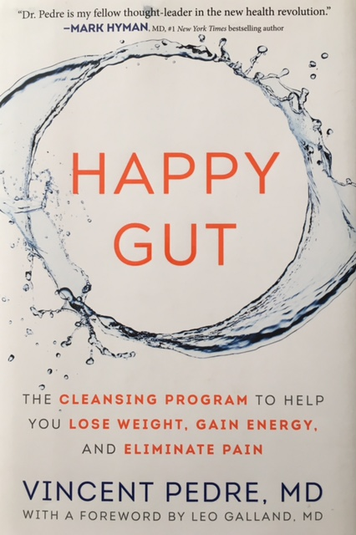
Books I recommend

Slide 49
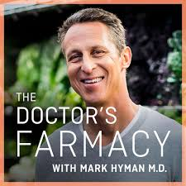
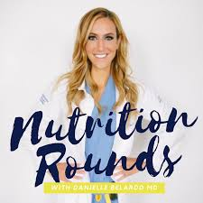
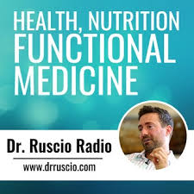
Podcasts I recommend
@drmarkhyman
@theveggiemd
@drruscio

Slide 50
Summary
AID (Anti-Inflammatory diet) overall consists of fresh, whole fruits and vegetables, leans proteins, good healthy fats, minimal to no carbohydrates
Avoid processed foods, HFCS, increased amount of carbohydrates (if you have carbs make sure complex)
Always remember “One person’s food is another person’s poison”
Gluten has been shown to be a high trigger in regards to inflammation—correlation between CD and myositis
Supplements to consider: Curcumin, Vitamin D, Fish Oil, folic acid
Probiotics and Probiotics
Your GUT contains 80% of your immunity (and possibly even more..)
Ketogenic diet and inflammatory diseases
In the end, ALWAYS DISCUSS WITH YOUR HEALTHCARE PROVIDERS any of these suggestions prior to starting any new dietary or supplemental regimen

Slide 51
And always remember to….

Slide 52
@followyourgutmdnp
@FYGMDNP
@healthandwellnessarnp
Email: info@followyourgutmdnp.com
www.followyourgutmdnp.com

