Slide 2
Myositis Doesn’t Stop My Life
Bitsy Anderson
John McClun
Chris Dotur
TMA Annual Patient Conference 2019
Minneapolis, MN

Slide 3
Bitsy Anderson

Slide 4
Food For Thought
Our Happiness is not Set in Stone
Our genes influence 50% of our happiness
Circumstances like income, environment, etc.10%
Our daily activities and the conscious
choices we make account for 40%
Therefore our thoughts and actions make a difference
Notes:
Think about that for a minute and let it sink in.

Slide 5
Elite Group of people
IBM = 5 to 9 cases per one million
The male-to-female ratio is 3:1
DM and PM, 2 per 100,000 per year in general public
Female-to-male predominance of 2:1
You have to educate your doctor more times than not
Everyone seems to be different as to how the disease progresses
WE ARE NOT MEANT TO WALK THIS JOURNEY ALONE
Notes:
Unless you have a specialist who deals directly with Myositis patients you may have to explain exactly what Inclusion Body Myositis, Dermatositis or Polymyositis is. I use Myositis 101 for physicians.
You don’t have to be without support … that’s why we are here to share our story and maybe it will resonate with someone here. Take advantage of all the resources available to you the next 4 days.

Slide 6
HOW I WANT YOU TO SEE ME
See the heart not the chart
IBM does not mean my life is over
It is totally my responsibility to create my happiness
I am determined to stay as active and positive as possible, by setting reasonable goals
Yes, at times my body experiences technical difficulties
Notes:
1. When you see me coming I want you to see my zest for life, my compassion, the fact I care about you. Also that I am blessed to be alive enjoying your company and my super friends and family.

Slide 7
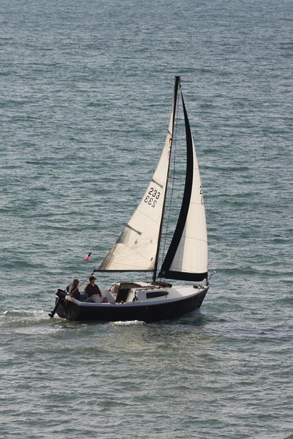
I CAN’T GIVE UP
“She stood in the storm and when
The wind did not blow her way,
she adjusted her sails.”
Elizabeth Edwards, American Attorney, Author
Notes:
That is what we are constantly called to do. Adapting to the situation.
In our home, cooking, showering
How we drive
How we travel
How we entertain
Going out with friends

Slide 8
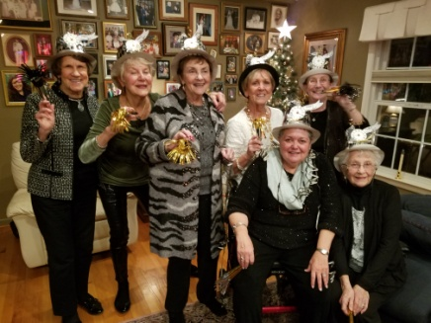
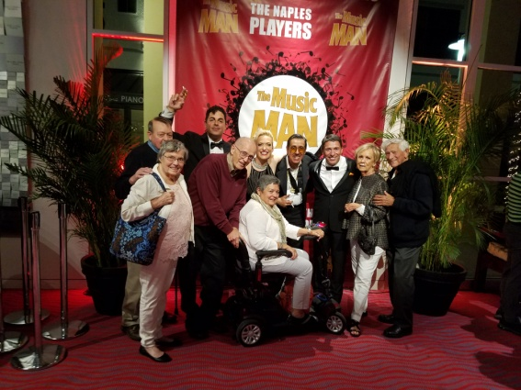
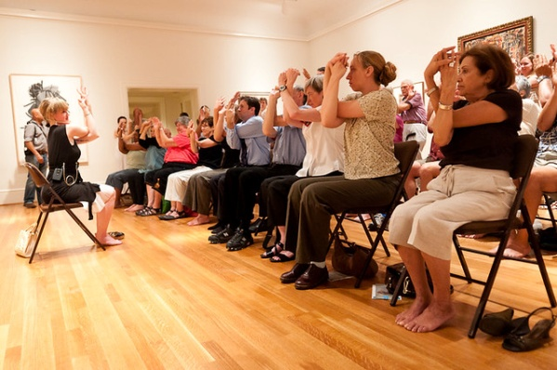
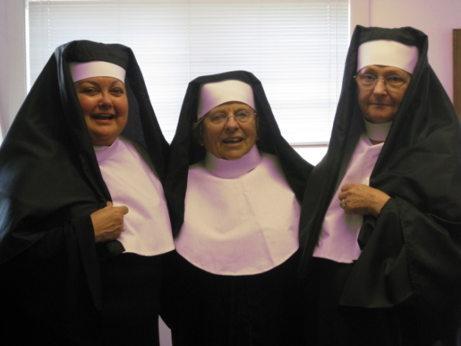
How Do I Find Enjoyment
People
Book Clubs
Social gatherings
Plays
Classes from the Community College
Alternative PE
Wheelchair Yoga
Computer Classes
Notes:
There are five types of people that are enjoyable to be with
The ones who care
The fun loving
The motivated
The grateful
And the open minded
These people present a nurturing environment.
Always learning … history local as well as national.
Loved the class on cultural influence within the United States.
Apple Watch
Our Church has a variety show and I did a dance routine as a nun with We Are Family by Sister Sledge. Only to be topped by the next year’s moon walk with Billie Jean by Michael Jackson.
I’ve embarrassed my kids more than once
Grand kids love it!

Slide 9
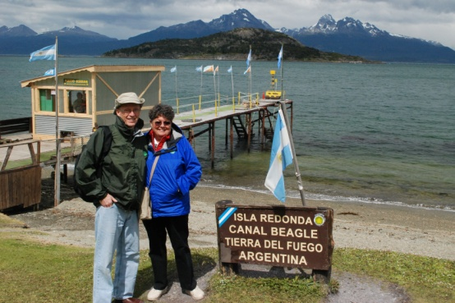
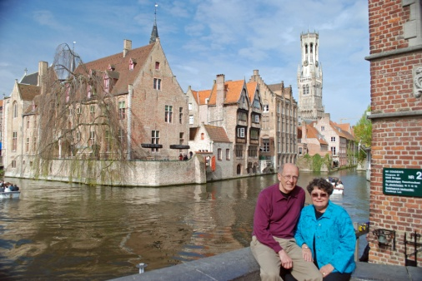
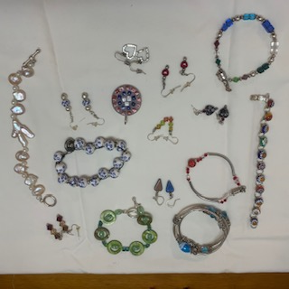
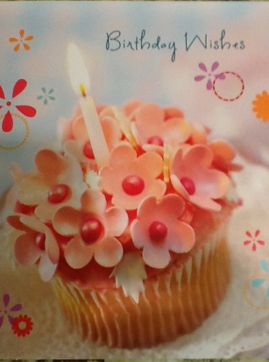
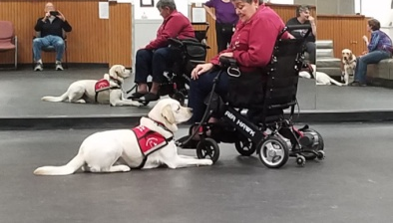
Finding Enjoyment
Travel
Making Jewelry & Greeting Cards
Training for a service dog
Notes:
Yes, it has to be accessible but things are changing and becoming easier.
MDA’s Accessible Air Travel Resource Center helps you find important information about airports, airlines and your rights as a traveler. Visit cqrcengage.com/mda/accessibleairtravel
Since my diagnoses we’ve been to Belgium, Holland bike trip, South America Cruise, Hawaii, South Dakota, The Holy Land and Marco Island, FL in the winters
Jewelry
Some things I can’t do now but there is a lot I can do.
Walk, I Love making jewelry, greeting cards, riding stationery bike, sight seeing etc
I want a cure so I invest time in raising money

Slide 10
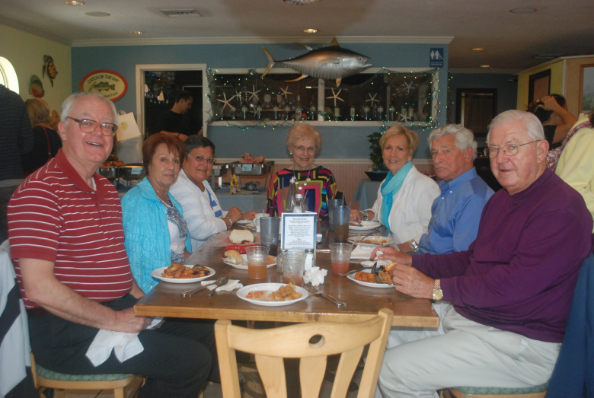
Brings Purpose
PFAC (Patient Family Advisory Council) For Johns Hopkins Neurosciences Department
Chipotle
Notes:
One of my easy attempts. Everybody has to eat.
Went to the local Chipotle and talked to the manager.
Filled out the application and was approved.
I only had to advertise for the specific evening
Chipotle gave me ads and coupons to send out.
TMA received 50% of the proceeds brought in by those who
stated they were there to support TMA or brought in a flyer.
We sent TMA $600

Slide 11
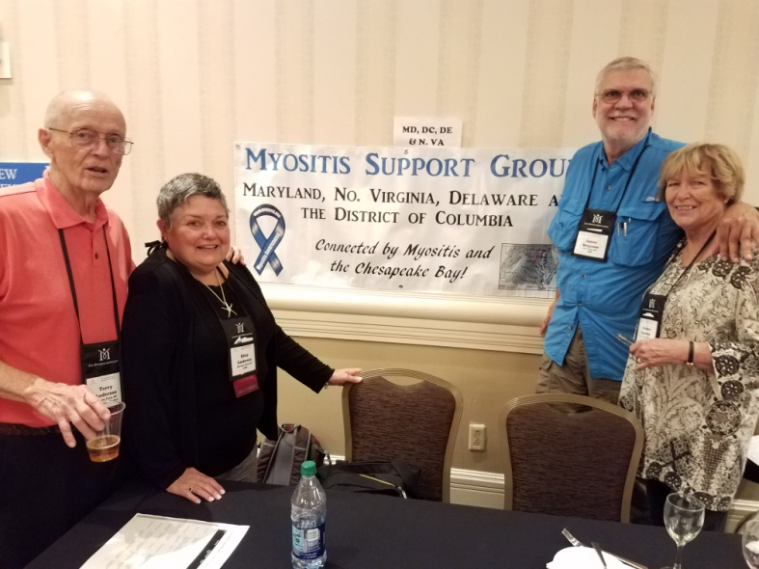
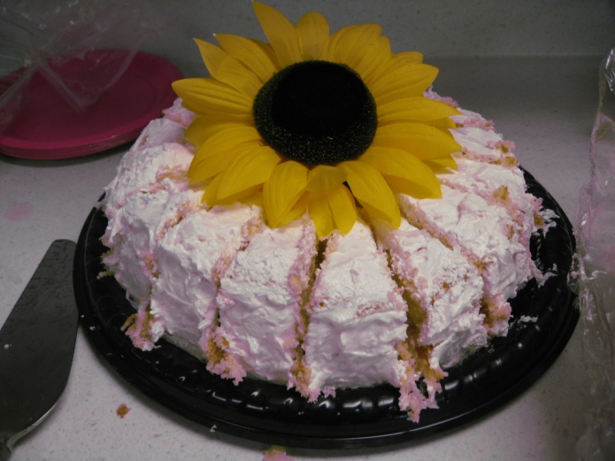
Brings Purpose
Support Group Leader
Education
Friendship
Food
Support
Notes:
Originally used a library … problem was we only found out at the last minute if it was available.
Moved to our church classrooms
Accessible
Plenty of parking
Allowed to bring in food
Audio visual set up
Can reserve the room a year in advance
We meet 4 times a year on the 3rd Saturday of February, May, August, November.
We have a time we share where we are on the journey today. Our speakers have been
Dr. Tae Chung , professor of Physical Medicine and rehabilitation with expert ties in Neuromuscular disorders.
Dr. Schifenbauer with NIH who attended the Global conference on Myositis in Berlin,
Germany. We heard first hand
Vickie Starr, RN Clinical Specialist with Medpro who walked us through the process of getting treatments and accessible items covered by insurance.
August we had Mary Chaput with the department of aging and disabilities helping us deal with living with a chronic disease.
Someone registers with TMA and LaDonna sends their name to me and I contact them.

Slide 12
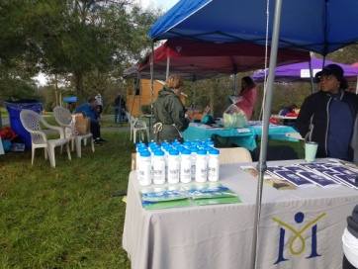
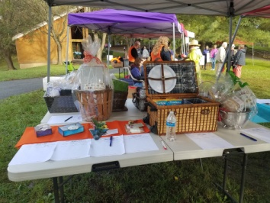
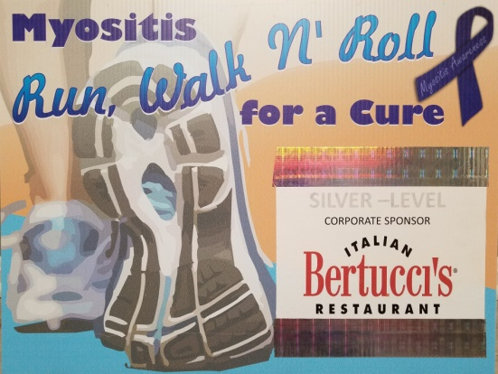
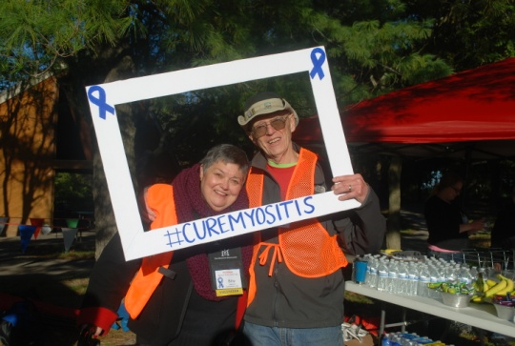
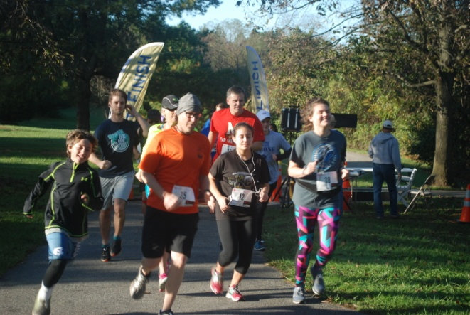
Brings Purpose
Coordinating a Myositis 5K Run, Walk, and Roll to raise money for Johns Hopkins' and The Myositis Association’s research projects.
My Faith and Terry my biggest supporter
Notes:
This is our 10 Anniversary
Started as a walk held at Centennial Park in Ellicott City, beautiful lake, leaves changing rainbow of color surrounds the lake.
Great playground
Friends come from the mountains of N.C., Pittsburg, PA, Manassas, VA to participate.
Now official 5K so times are official
Certified route
Food, Silent Auction, vendors, massage, this year face painting, lots of laughs and reunions.
Last year over 217 runners/ walkers.
We’ve raised $300,000

Slide 13
Everyday holds the possibility of a Miracle!
Notes:
Time for Question and Answer later. Also I have a business card available if you want to contact me at another time.

Slide 14
John McClun’s Journey
1993 to Present

Slide 16
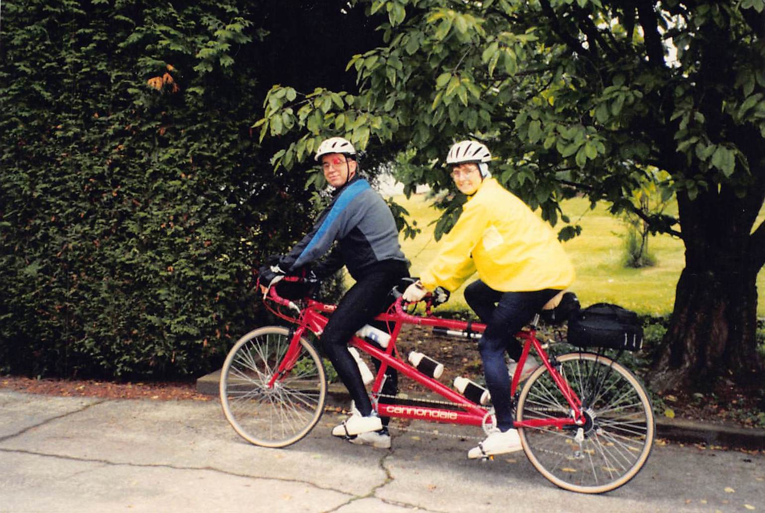

Slide 17
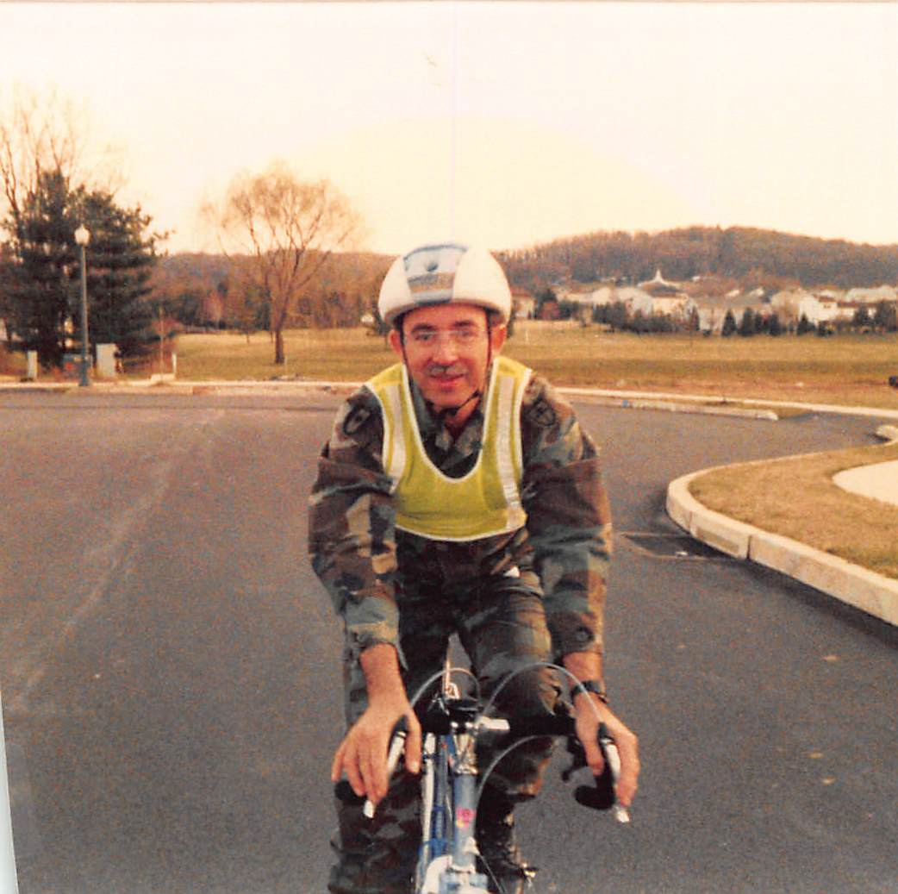

Slide 18
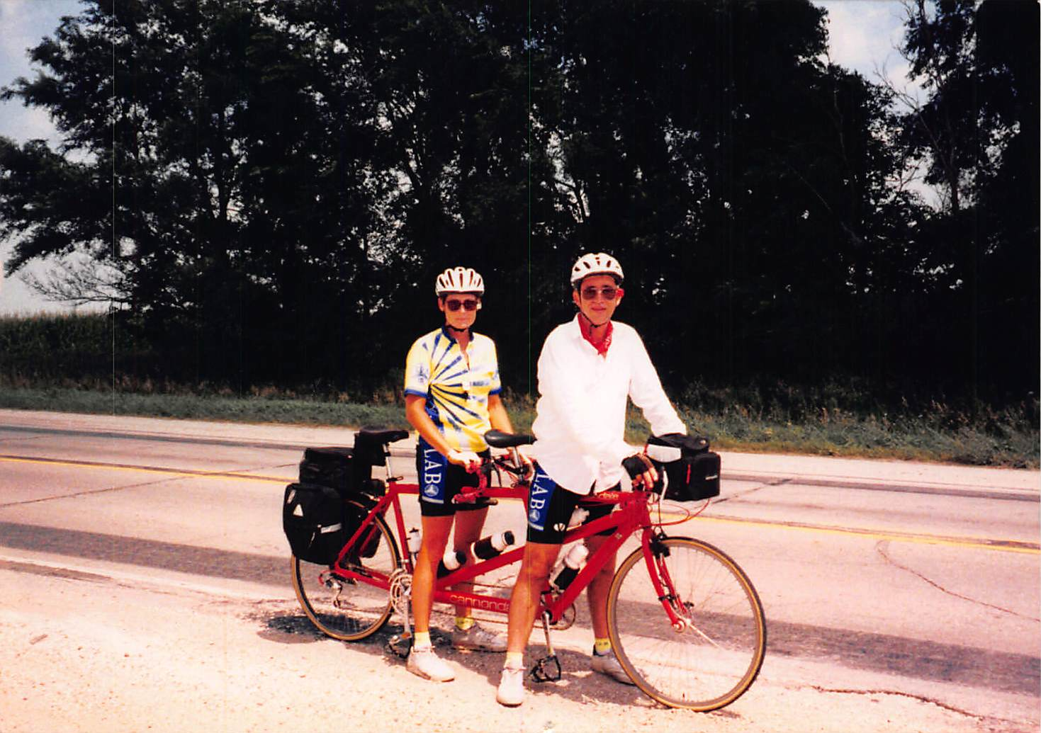

Slide 19
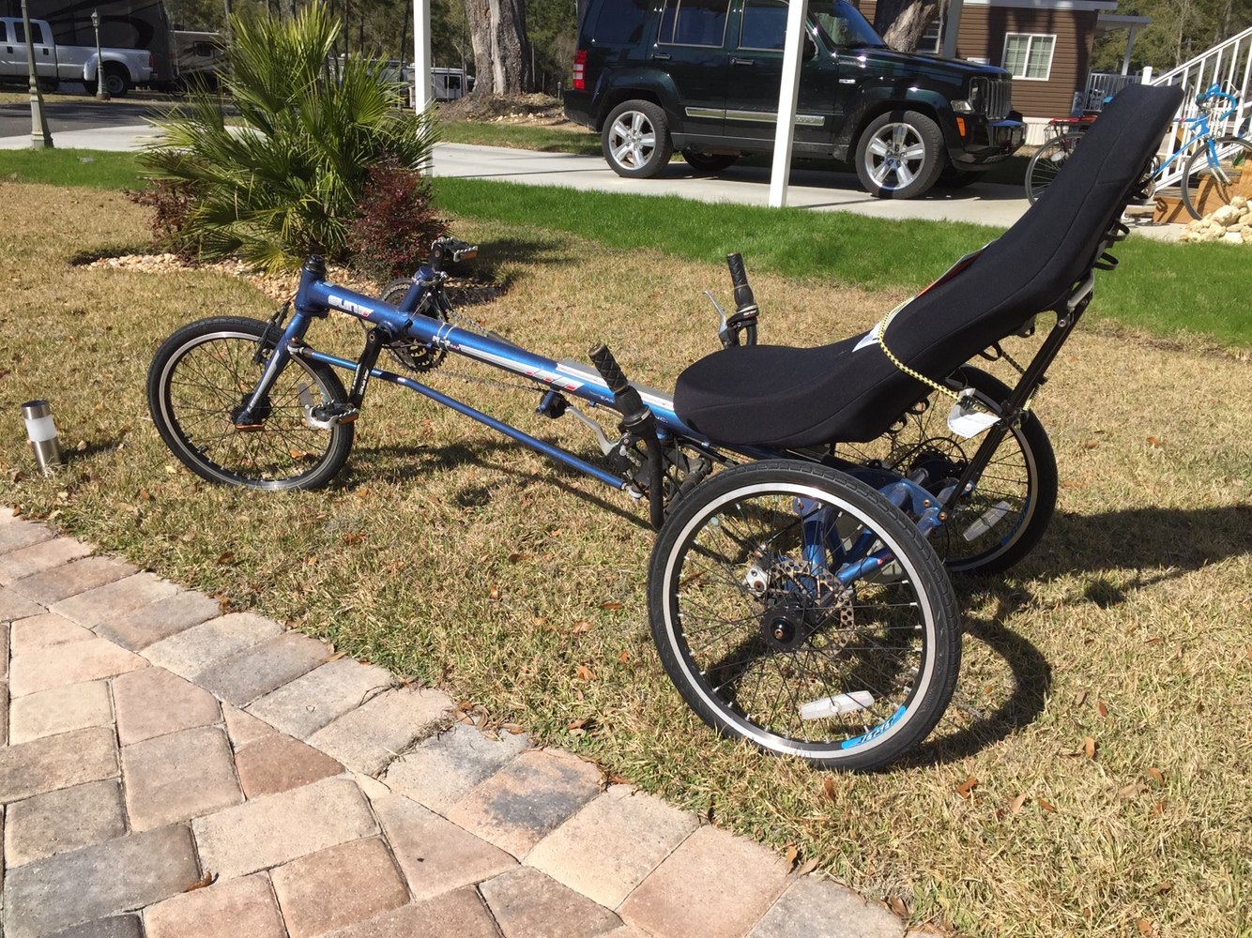

Slide 20
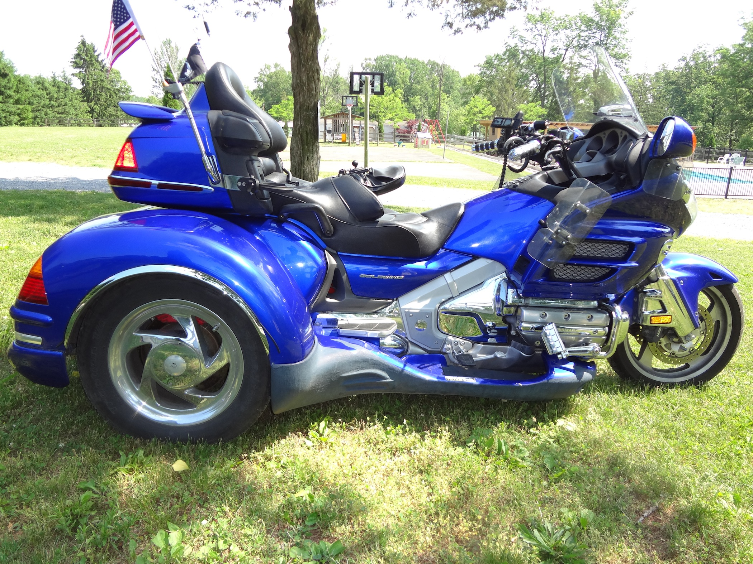

Slide 21
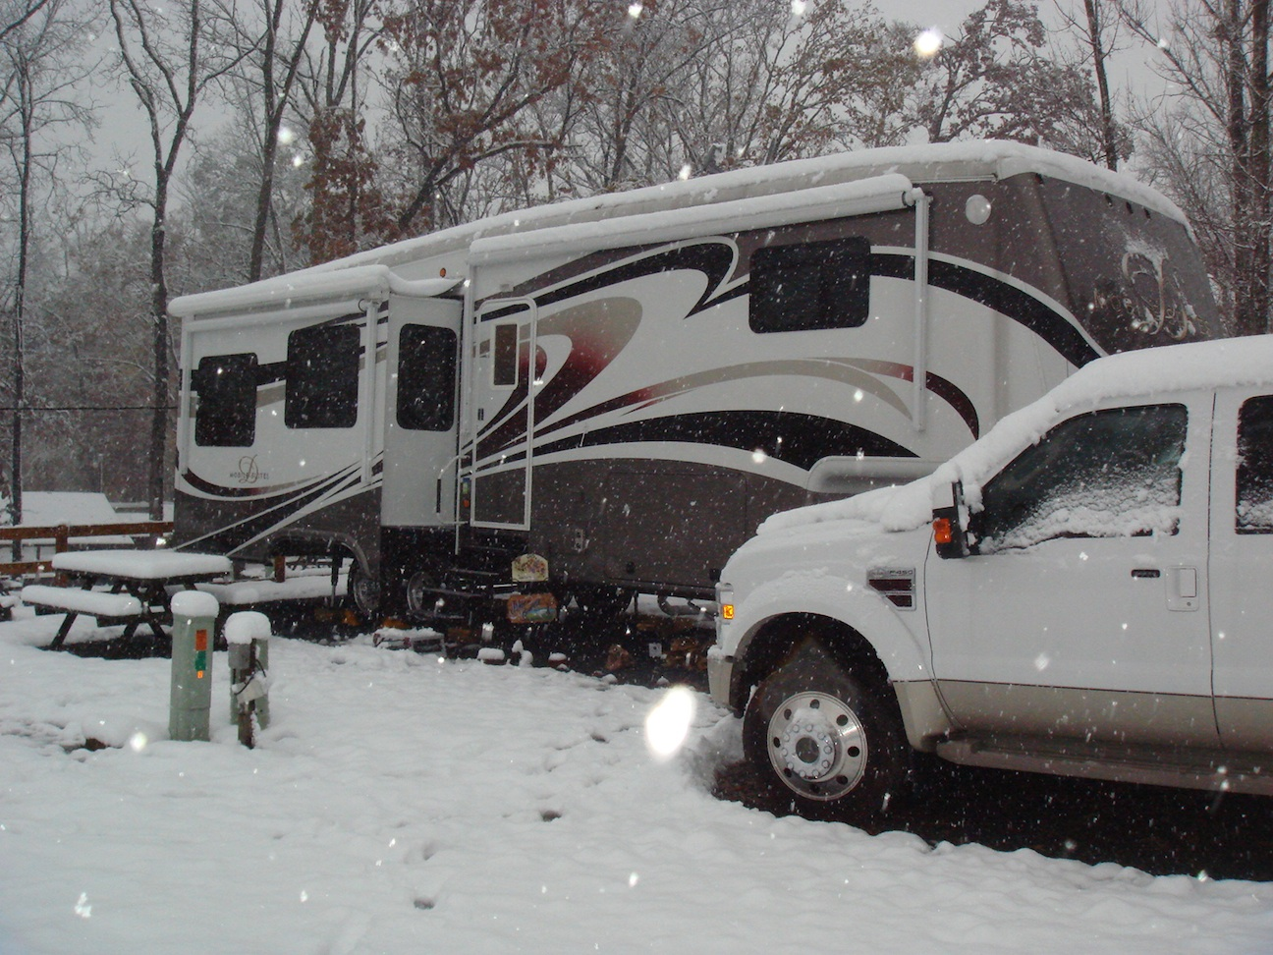

Slide 22
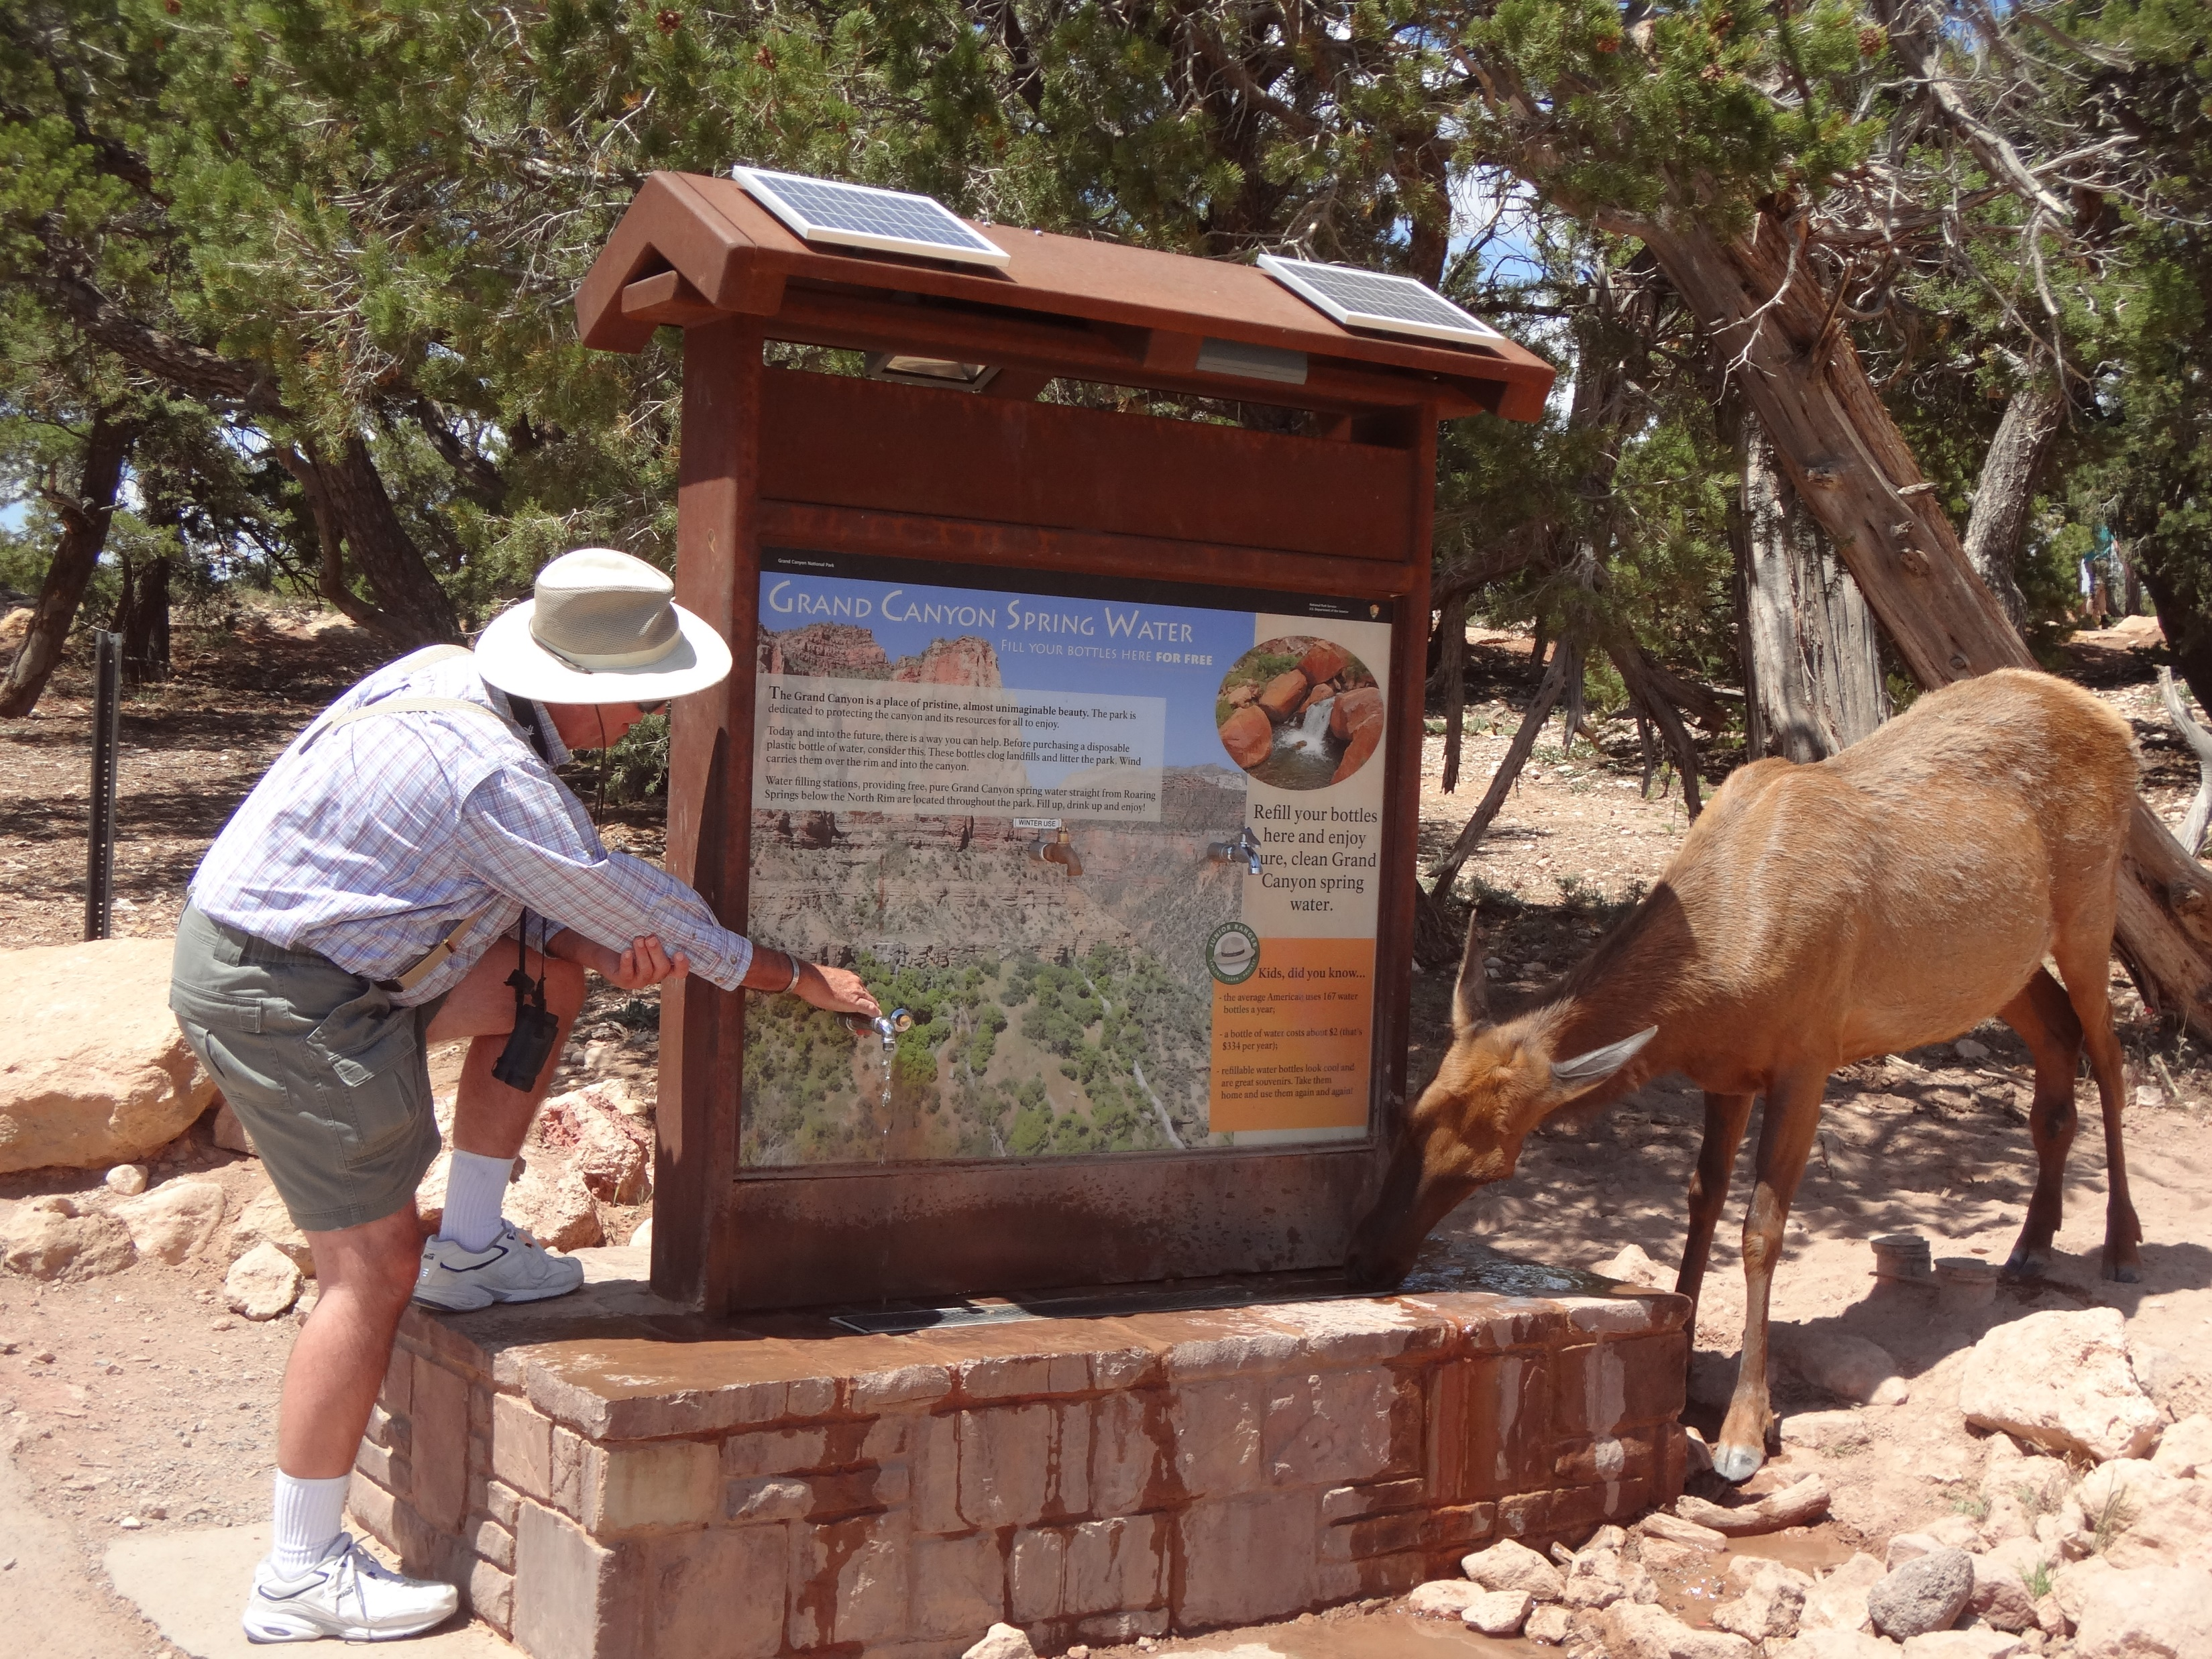

Slide 23
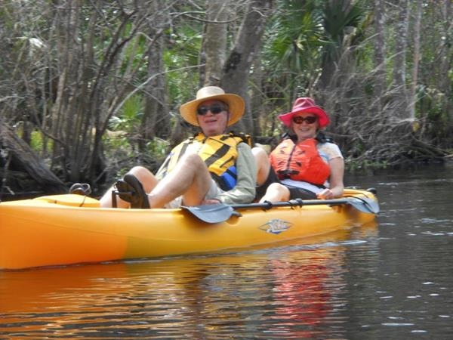

Slide 24
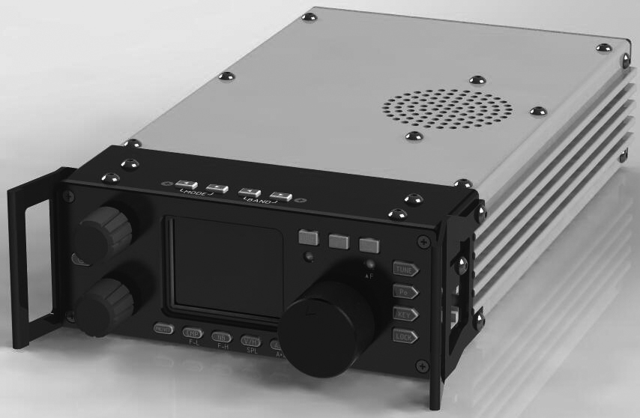

Slide 25
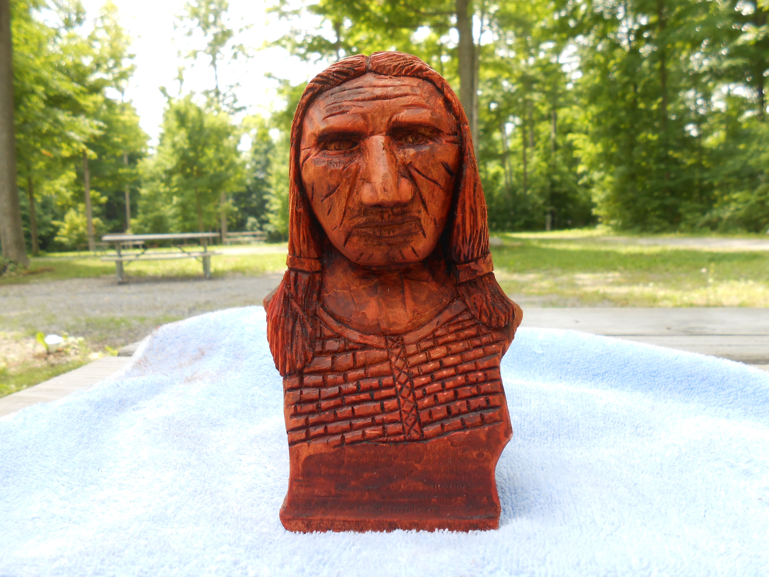

Slide 26
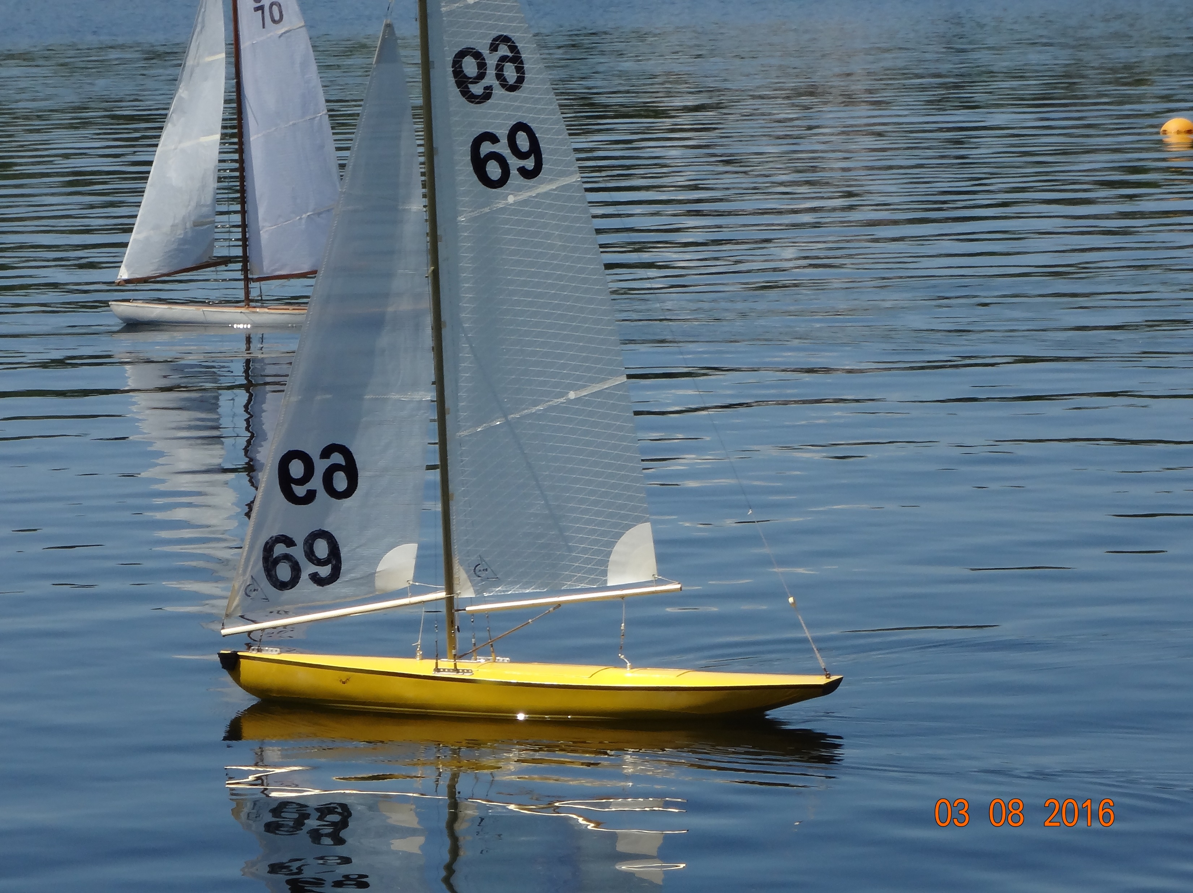

Slide 27
Chris Dotur

Slide 28
Chris Dotur - Machu Picchu Climb, Peru

Slide 29
Too many steps? Too expensive?
Determination!
Trekking poles--Not just for hiking
Slow and steady pace
One step at a time!

Slide 30
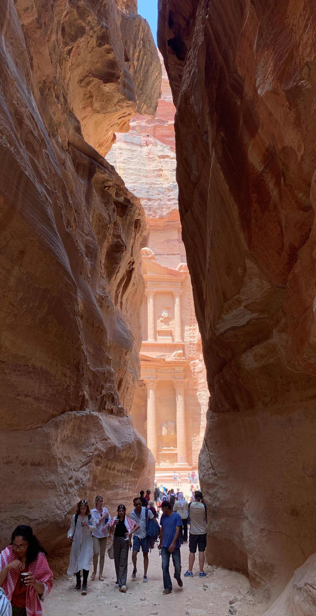
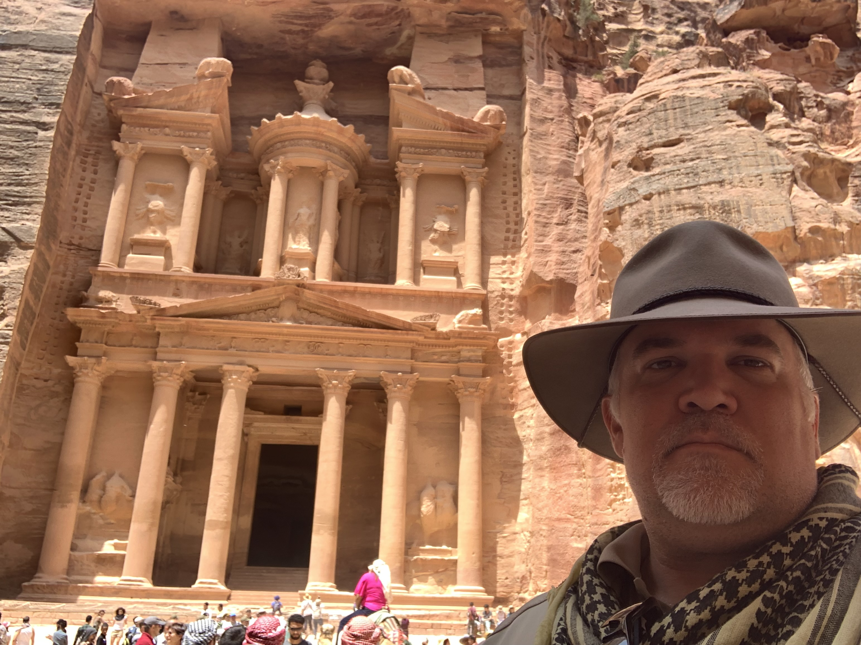
New 7 Wonders of the World Petra, Jordan

Slide 31
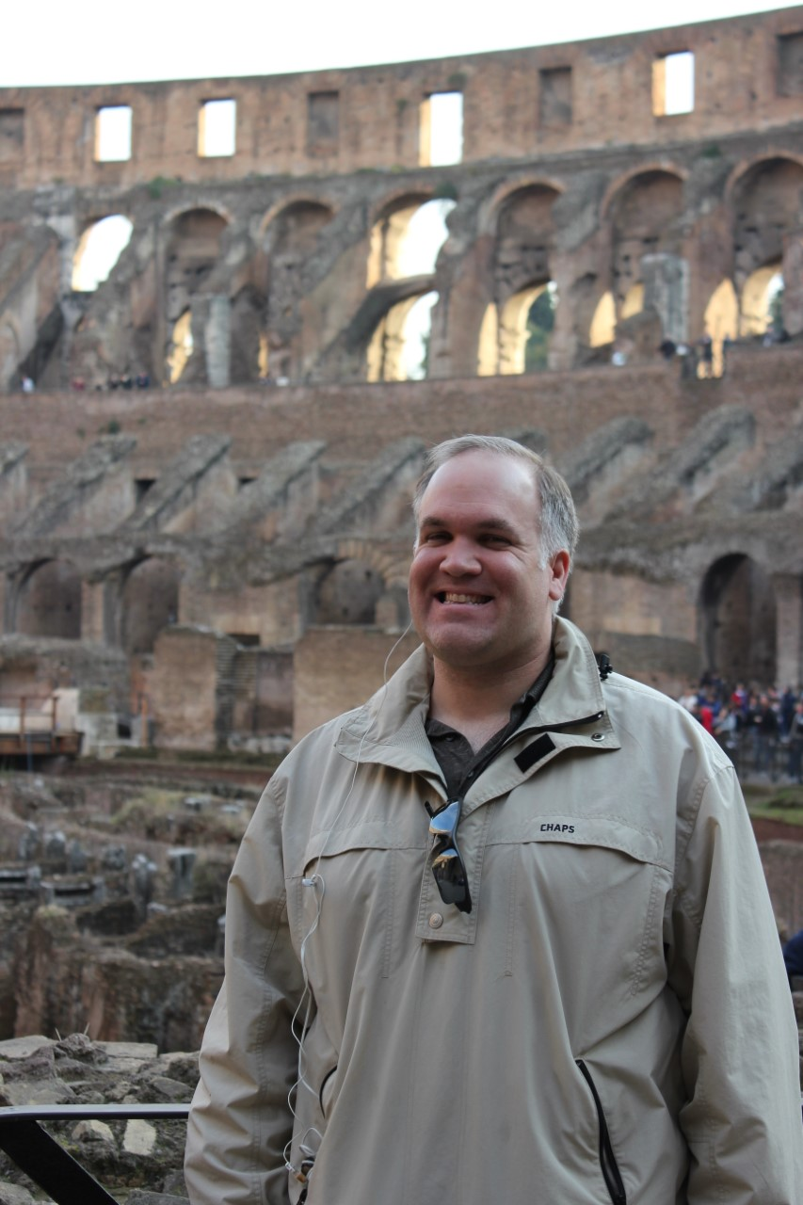
7 Wonders – Roman Colosseum, Italy

Slide 32
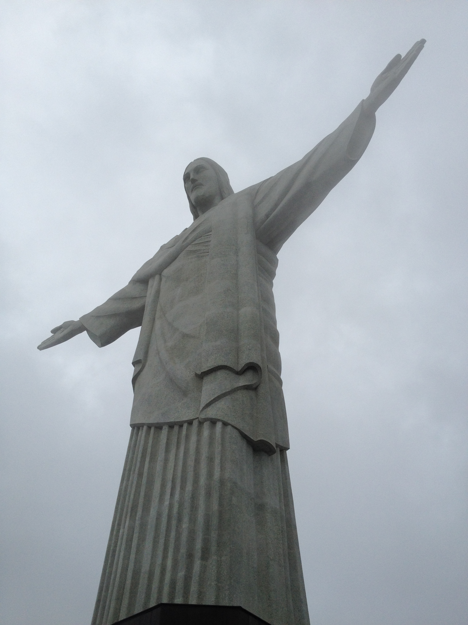
7 Wonders – Cordovado Statue Rio de Janiero, Brazil

Slide 33
7 Wonders – Chichen Itza, Mexico

Slide 34
7 Wonders – Great Wall of China

Slide 35
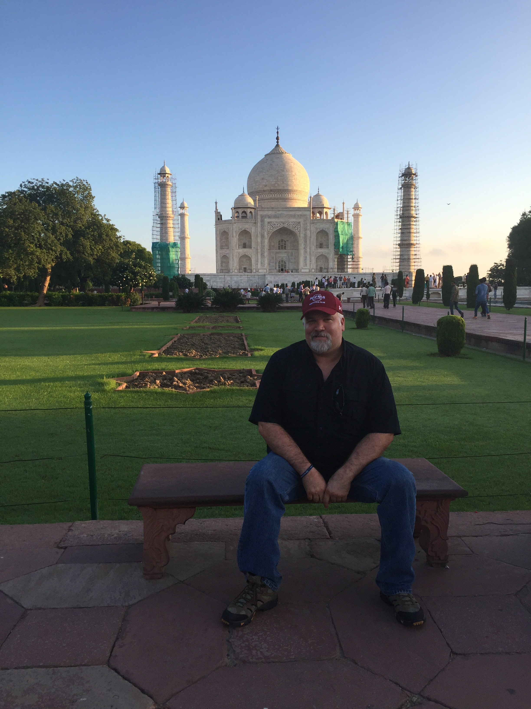
7 Wonders – Taj Mahal, India

Slide 36
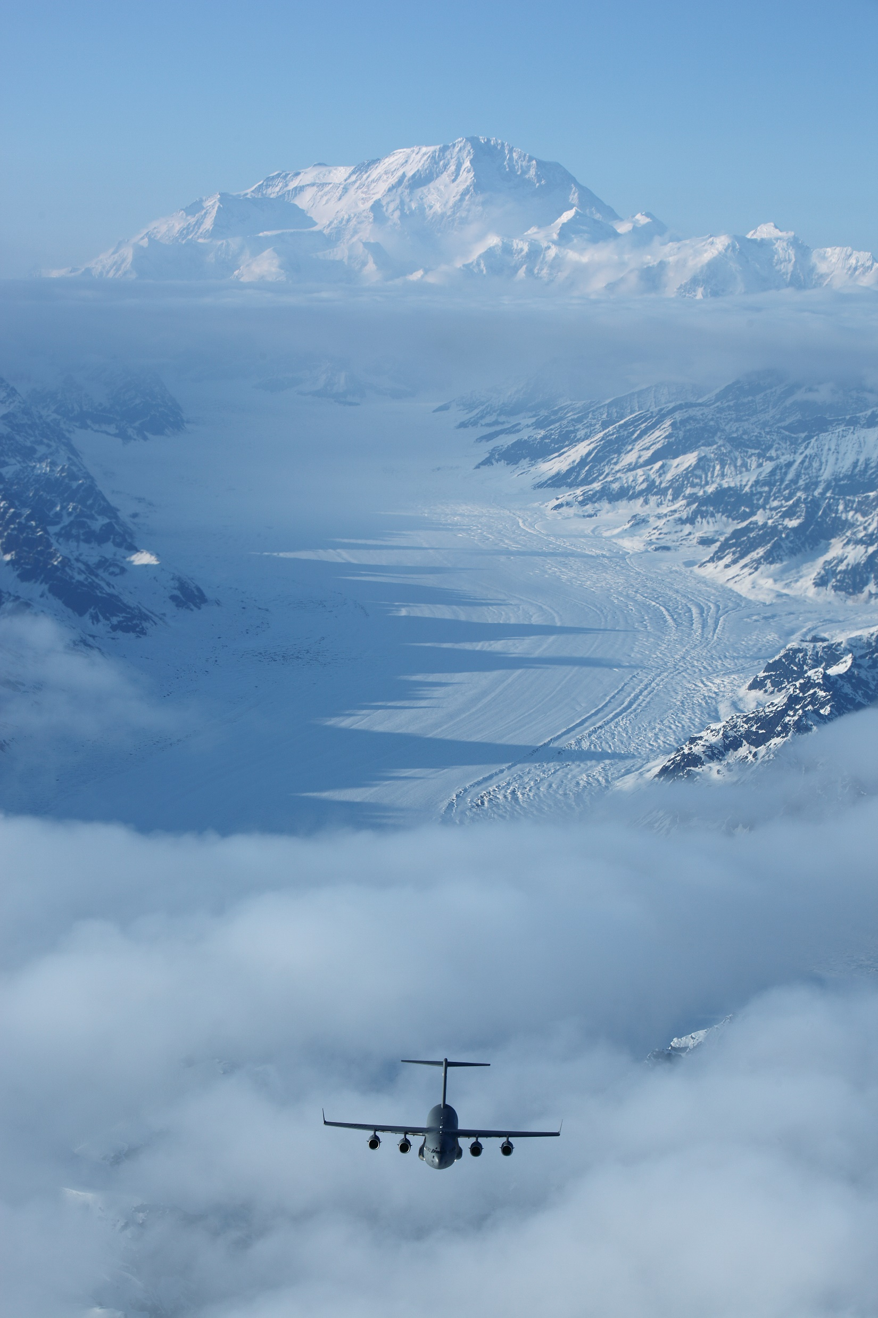
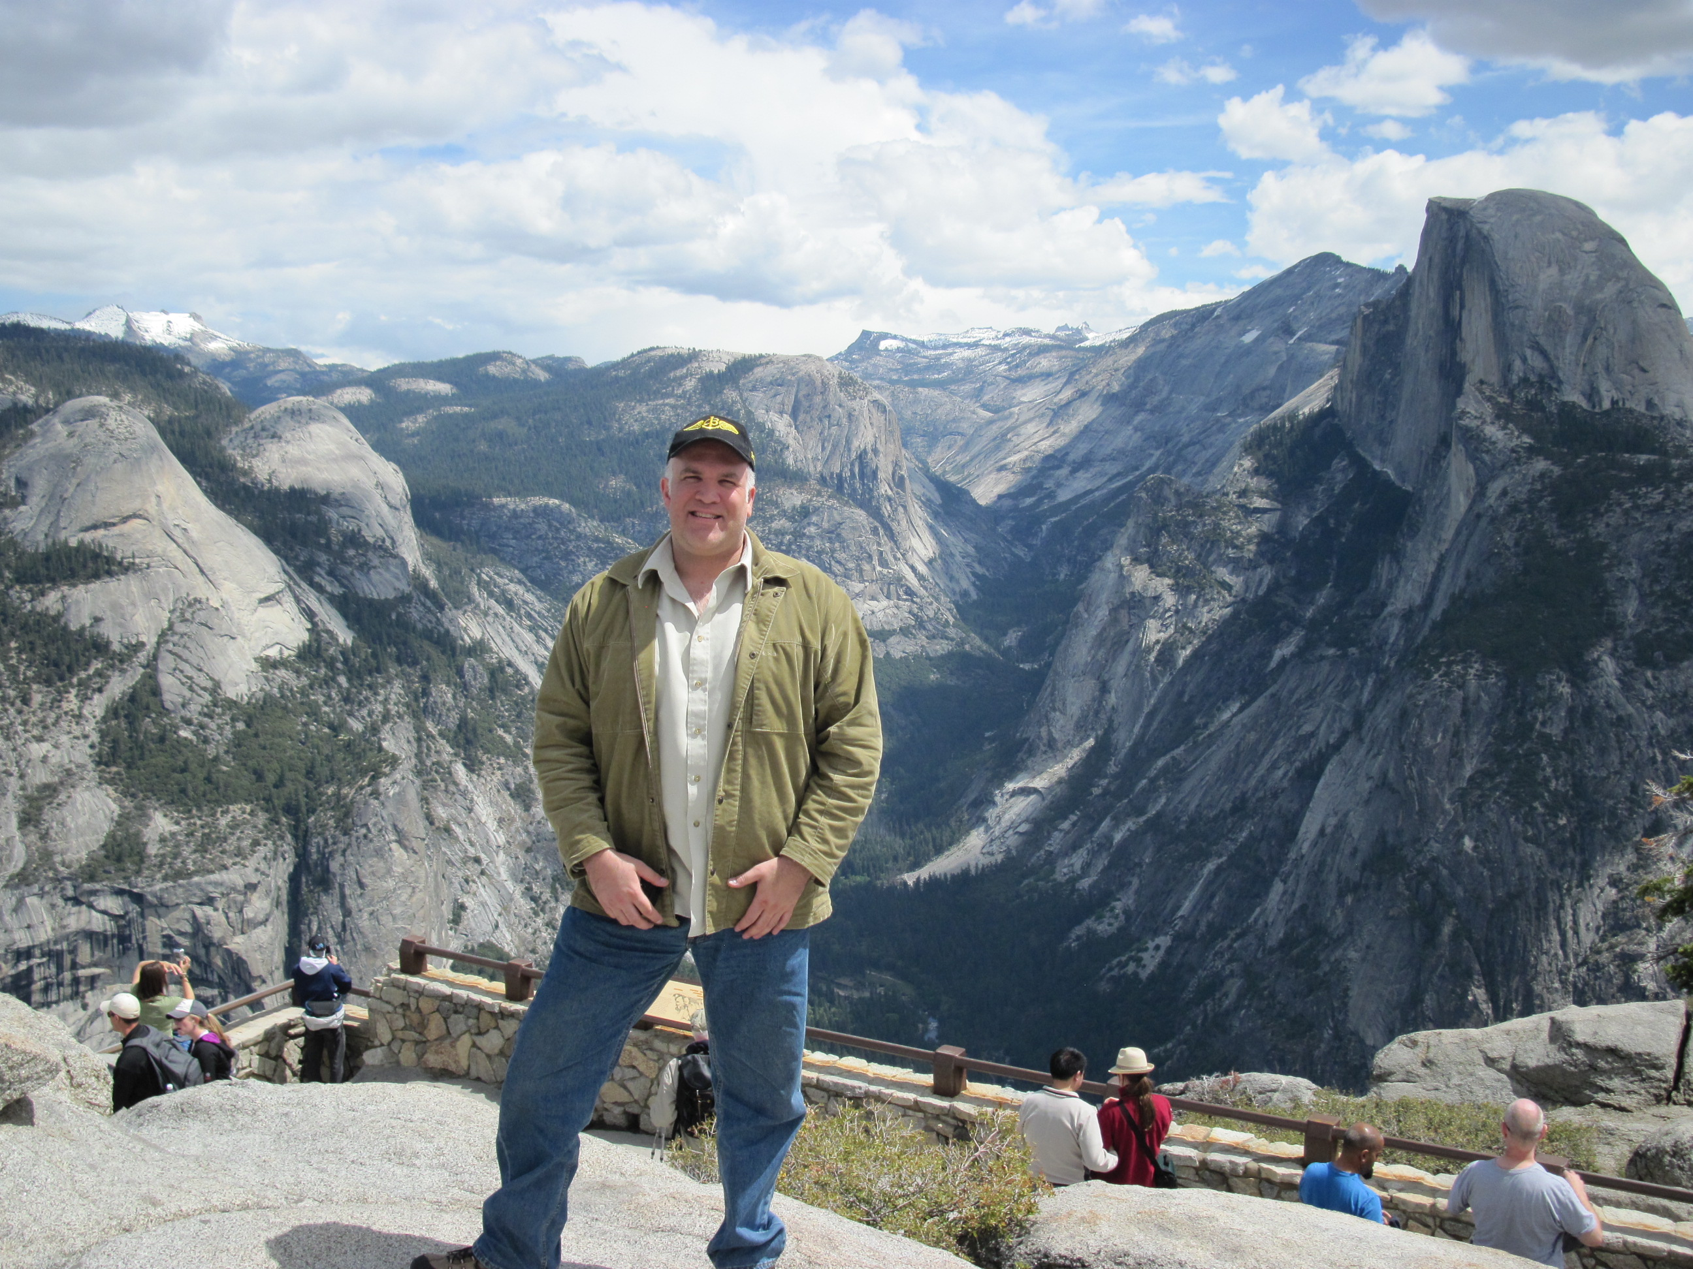
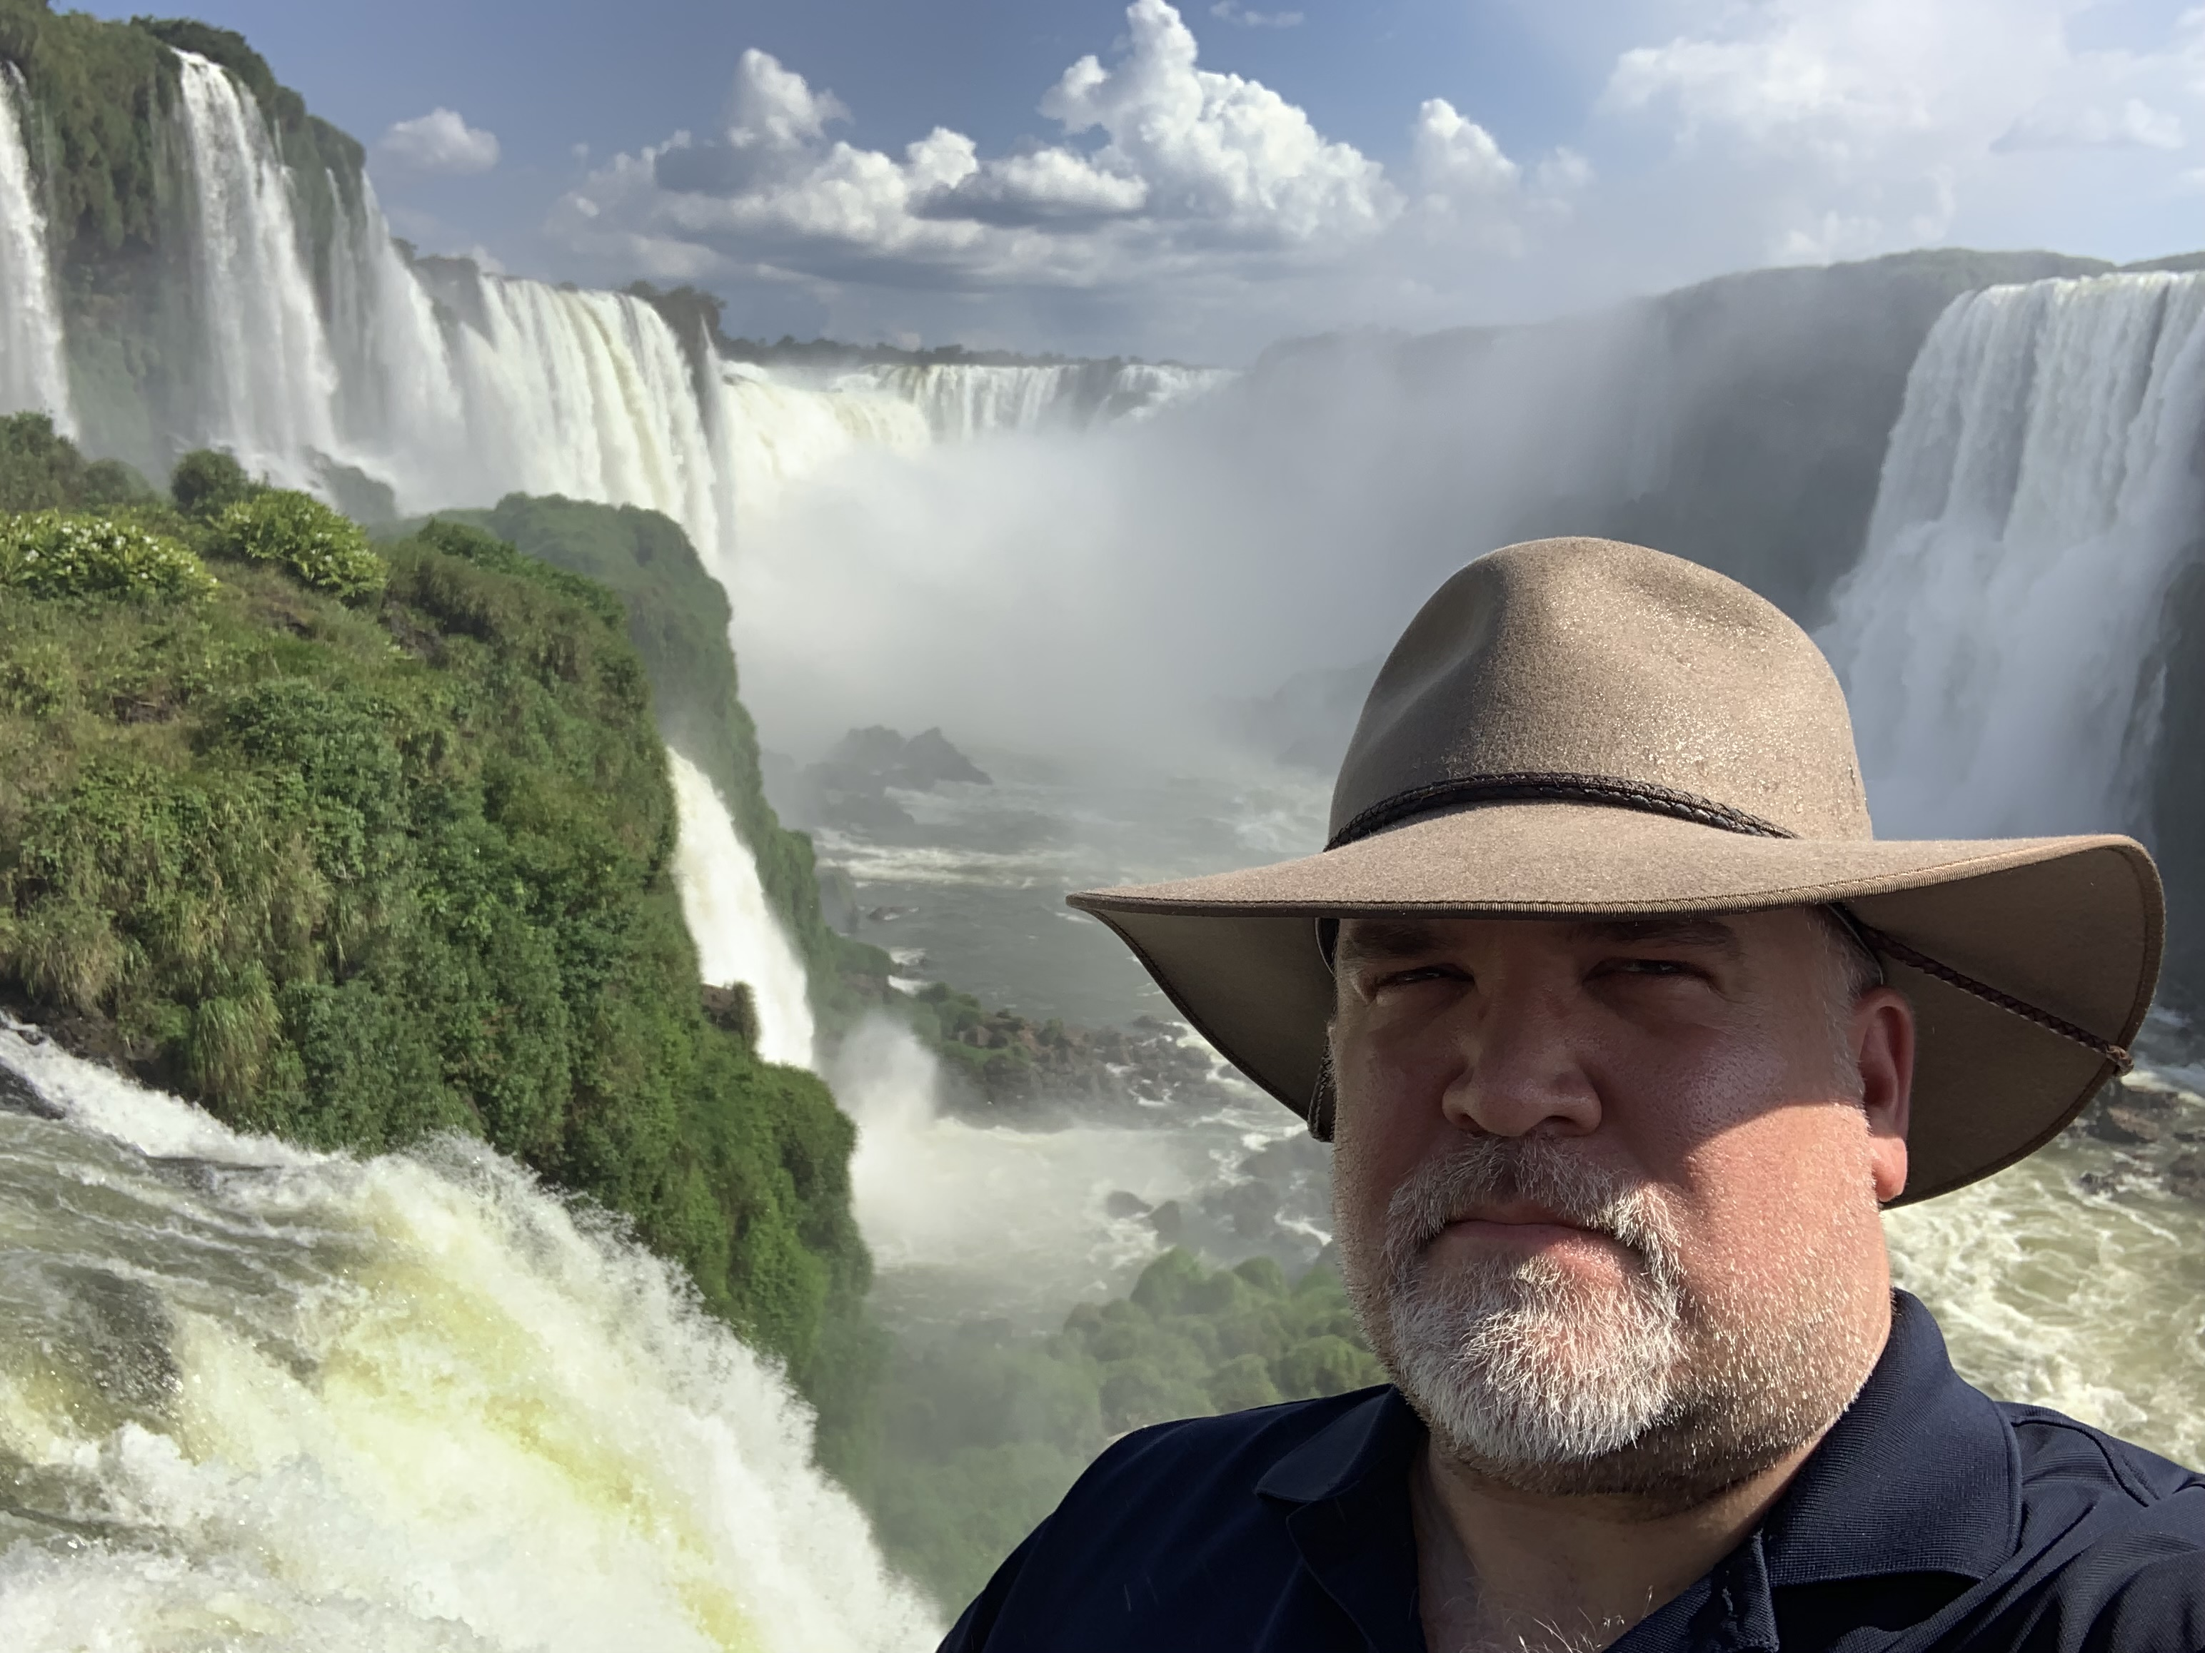
Summary
All I ever wanted to be was a pilot,
Air Force officer
End of career—identity?
Redefine identity
What is really important?
Find alternate activity as Flight Instructor
“Do what I can, while I can do it”

Slide 37
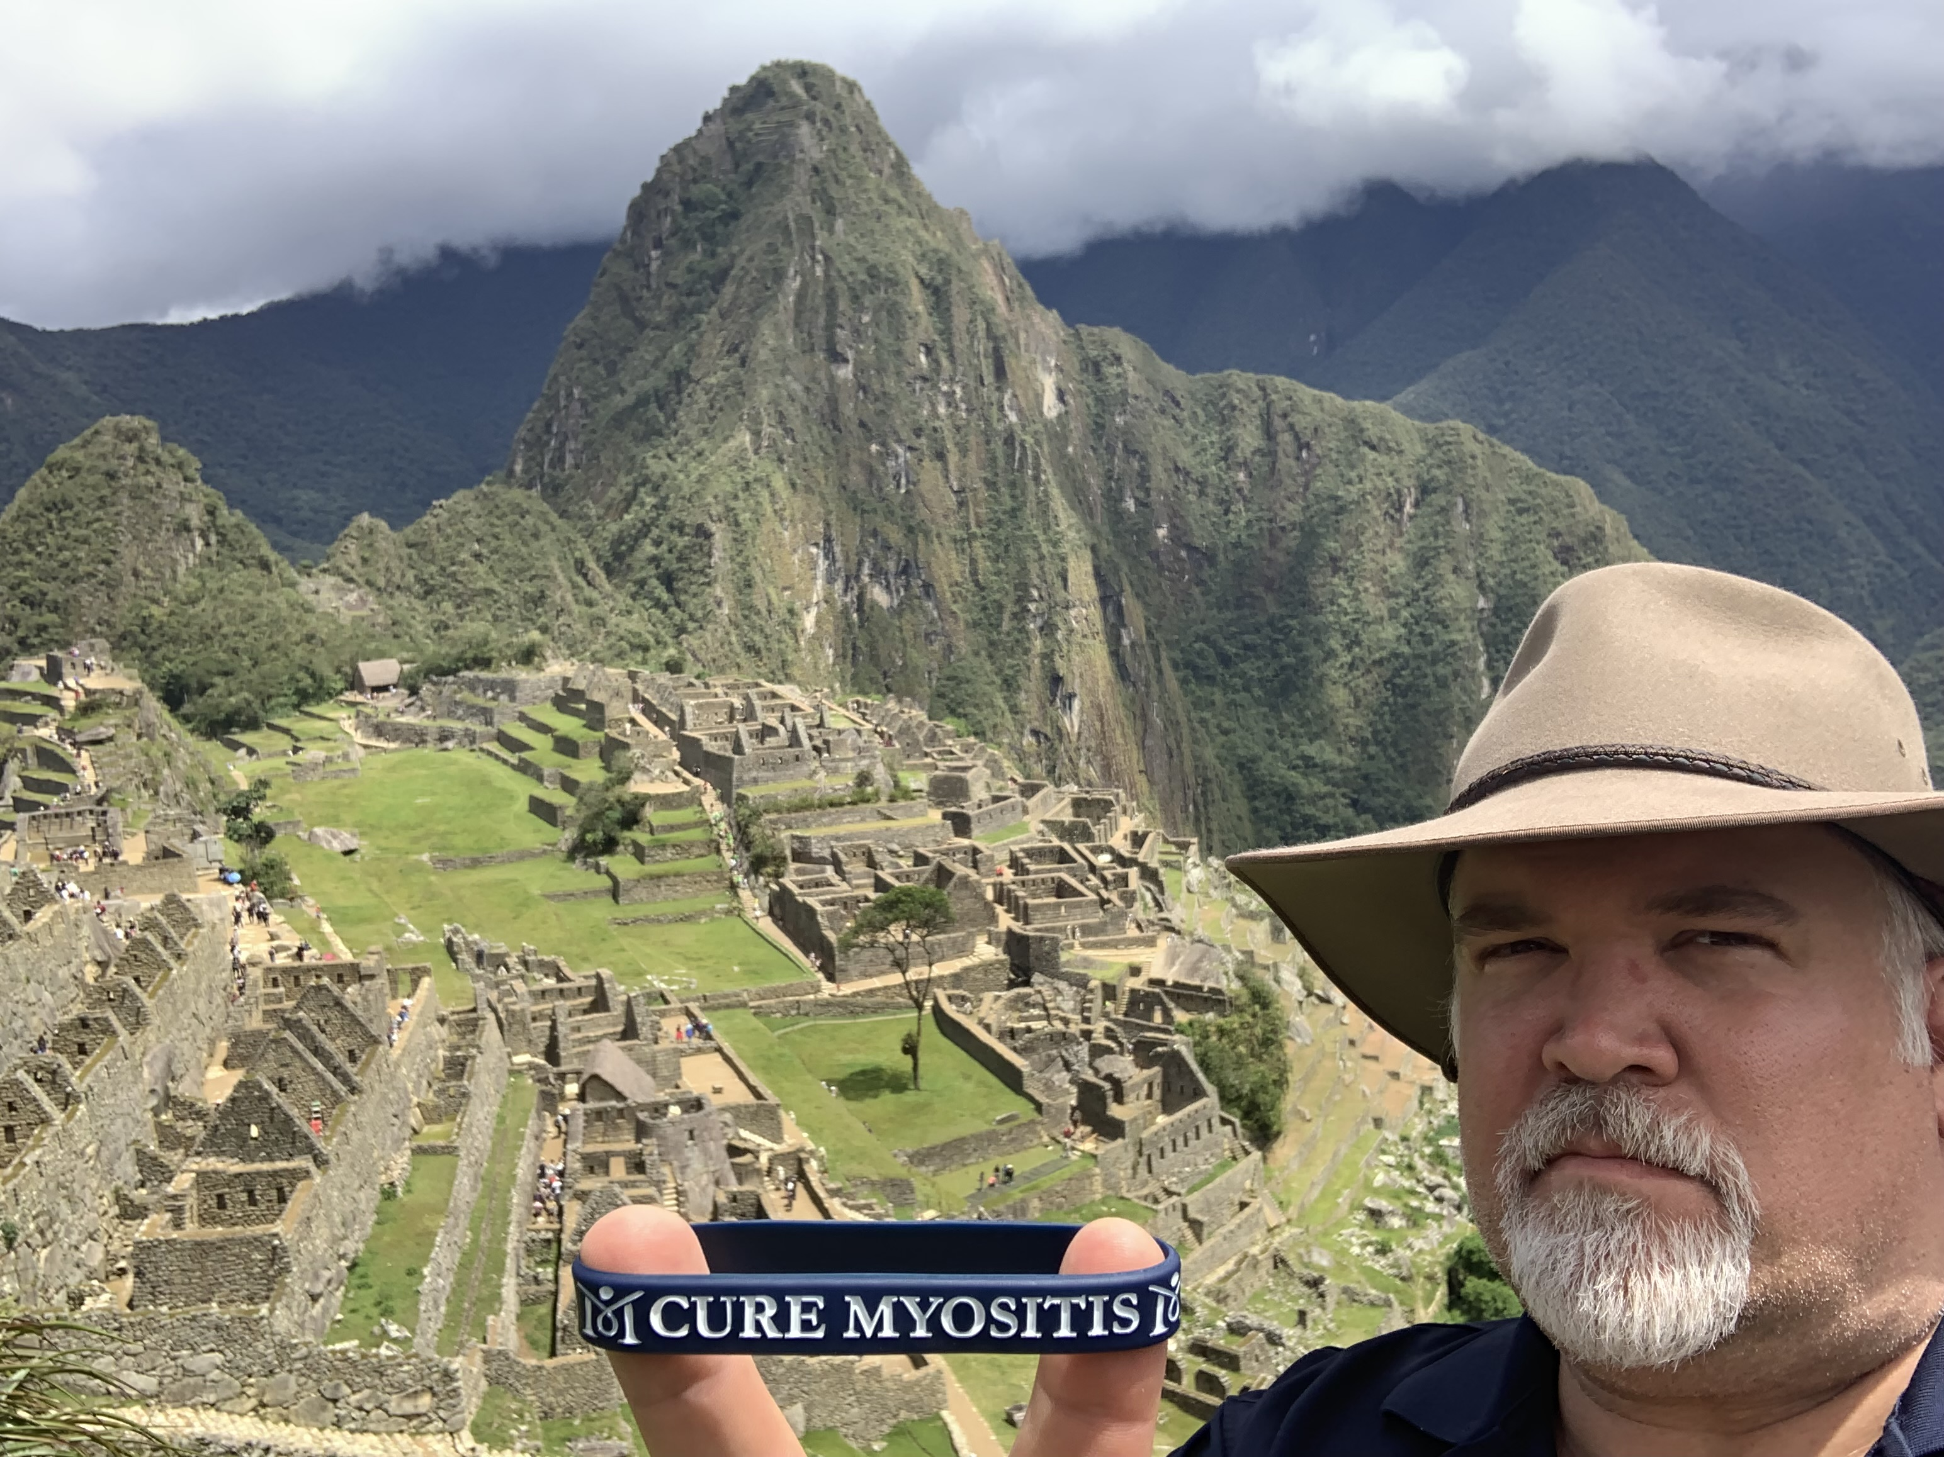
Questions?

