Slide 1
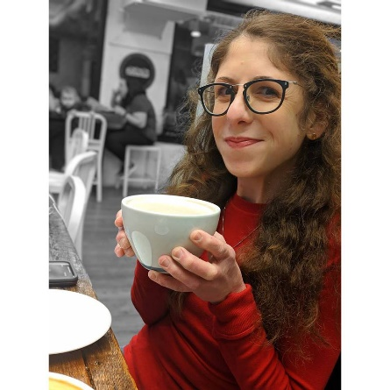
Caring for the Care Partners
The Myositis Association Annual Patient Conference
September 6, 2019
Nichole Goble
Program Coordinator, CAN
(202) 454-3965
NGoble@CaregiverAction.org

Slide 2
CAN’s Mission is to:
promote resourcefulness and respect for the more than 90 million family caregivers across the country.

Slide 3
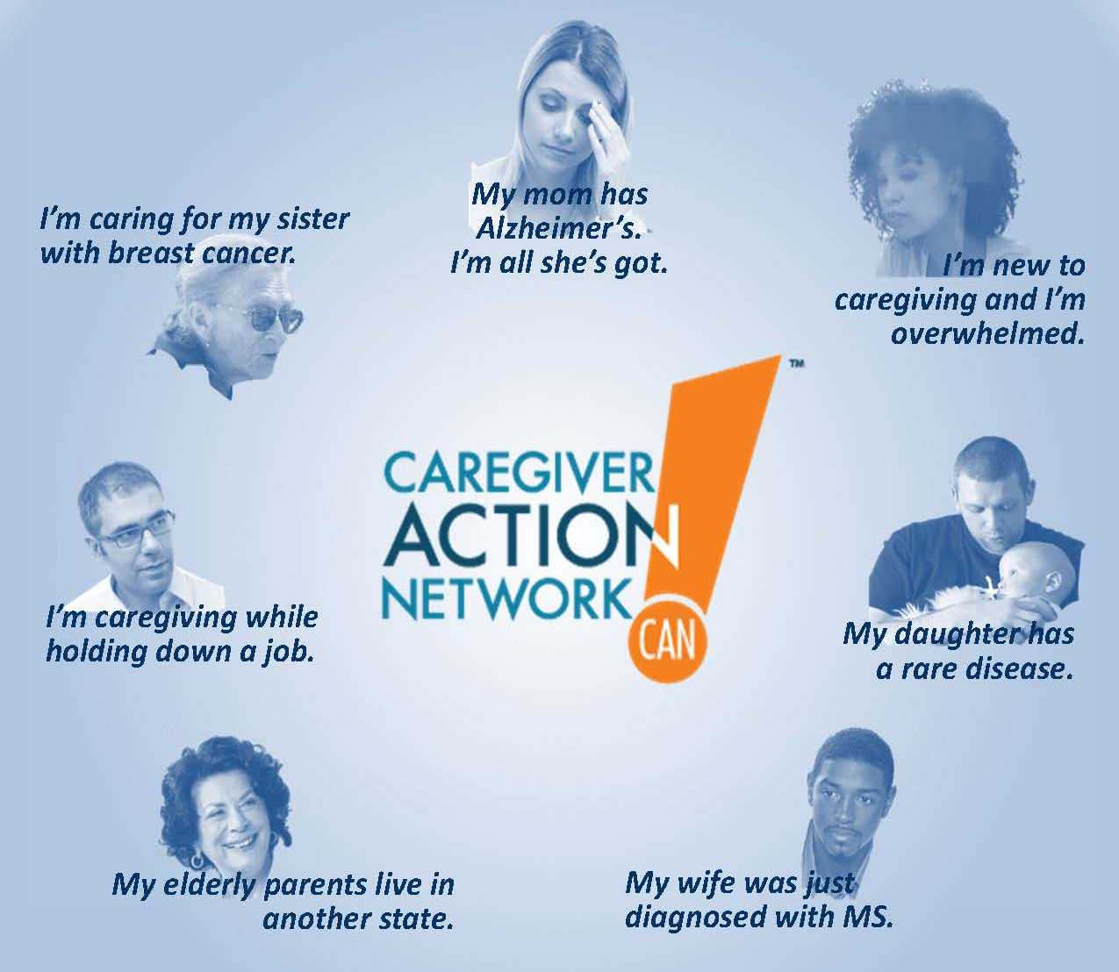
Who Comes to CAN?

Slide 4
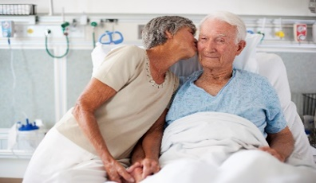
I’m new to caregiving.
I’ve been a family caregiver for years.
I am a long-distance family caregiver.
I’m balancing work and my duties as a caregiver.

Slide 5
RareCaregivers.Org

Slide 6
Notes:
Let’s go to RareCaregivers.org and take a look.
This is what the homepage of the website looks like.
We couldn’t capture the whole front page here, but you get the idea.
Lots of different languages. This is actually available internationally.
Lots of different features along the top and the side based on what you might need. We’ll look at some of these in greater depth.

Slide 7
Taking Care of the Caregivers

Slide 8
Taking Care of the Caregivers

Slide 9
Notes:
Seek support from other caregivers. You are not alone!
Take care of your own health so that you can be strong enough to take care of your loved one.
Accept offers of help and suggest specific things people can do to help you.
Learn how to communicate effectively with doctors.

Slide 10
Notes:
Caregiving is hard work so take respite breaks often.
Watch out for signs of depression and don't delay in getting professional help when you need it.
Be open to new technologies that can help you care for your loved one.

Slide 11
Notes:
Organize medical information so it's up to date and easy to find.
Make sure legal documents are in order.
Give yourself credit for doing the best you can in one of the toughest jobs there is!

Slide 12
Ten Tips
How do I ask for help?

Slide 13
Try These Tips
Recognize that caregiving is far too big a task to undertake alone!
List of all of the things that need to get done and categorize them.
Household chores
Medical appointments
Personal care

Slide 14
More Tips
Review your list!
Which items on it you do you hate doing?
Which ones do you enjoy?
Which ones you believe that you really must continue to do yourself?

Slide 15
BEWARE!
If you decide that you can't possibly allow someone else to do any of the tasks on the list, then review it again. The idea isn't to prove how indispensable you are, but rather to help you improve the quality of your life, and that of your loved one as well.

Slide 16
Ten Tips
How Do I Talk to My Loved One About their Disease?

Slide 17
Understand that your loved one may have difficulty talking about their feelings.
People express their emotions differently:
Some talk things out.
Some focus on other things.
Some express emotions by doing things, such as walking, doing the dishes, or fixing things.
And some focus inward.

Slide 18
Recognize the common points of stress that family caregivers experience:
Knowing how to best support each other.
Dealing with new feelings.
Dealing with guilt.
Talking about their negative feelings.
Making decisions about care and treatment.
Juggling lots of roles, such as childcare, housekeeping, work, and caregiving.
Coming to terms with “new normal.”
Changes in the daily routine and social life.

Slide 19
Resources
Nichole Goble
www.CaregiverAction.org
CaregiverAction.org/resources/blueprint
Caregiveraction.org/resources/schizophrenia
Stay Connected:
Twitter: @CaregiverAction Facebook.com/CaregiverActionNetwork

