Slide 1

Advocacy 101
Kristen Angell, Associate Director of Advocacy
National Organization for Rare Disorders (NORD)
Maria Null, Volunteer Community Engagement Liaison
NORD Minnesota Rare Action Network

Slide 3
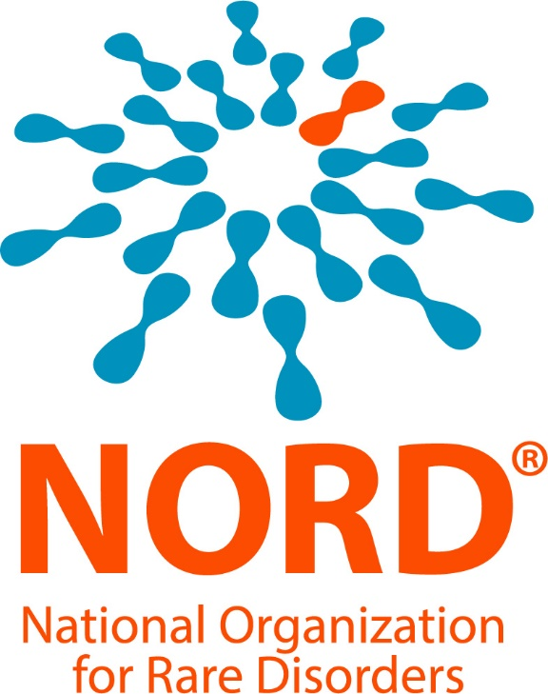
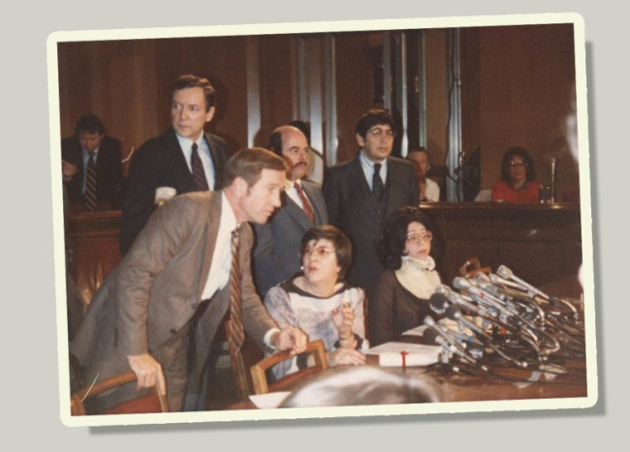

Founded by patients, caregivers, and
patient organization leaders in 1983 to
unify the voice of rare disease patients,
caregivers, and advocates.
1983 Orphan Drug Act

Slide 4
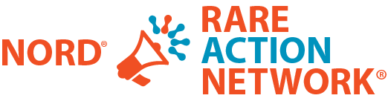
Join the Rare Action Network Today!
RareAction.org
State Ambassador Program
Regional meetings
Rare Action Center
Policy education
Legislative (hill) days
Rare Disease Day®
Social media hosting
Education & awareness
State Specific Components
NORD State Policy Report Card
State Profiles
RareAction.org

Slide 5
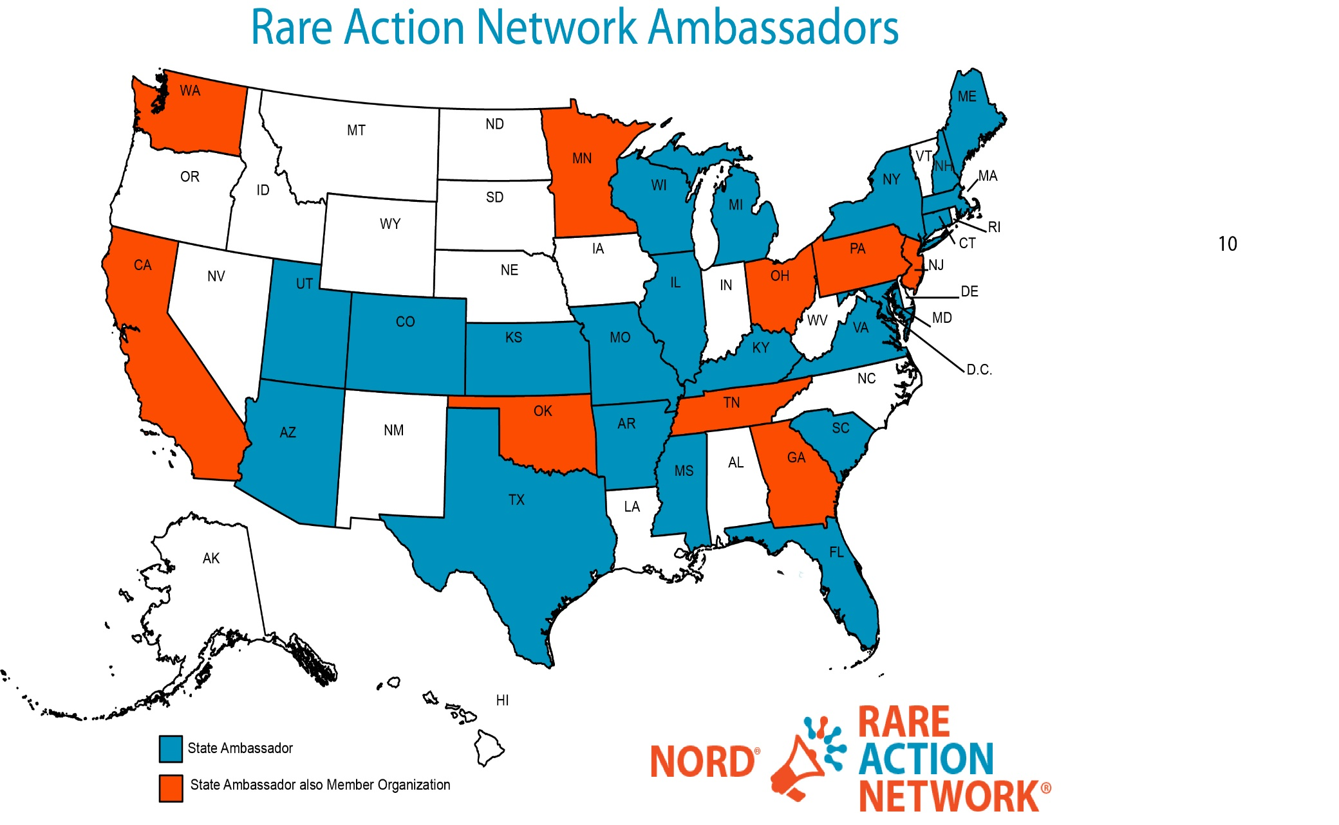
State Ambassador Program

Slide 6
What is an advocate
An advocate is a person who uses their
voice to raise awareness or push for a change
You do not need to have any specific experience
Advocates have a powerful voice when standing together
You can weigh in on policy matters regardless of multiple factors
If you voted and/or who you voted for
If you receive government services
If you donate money to campaigns

Slide 7
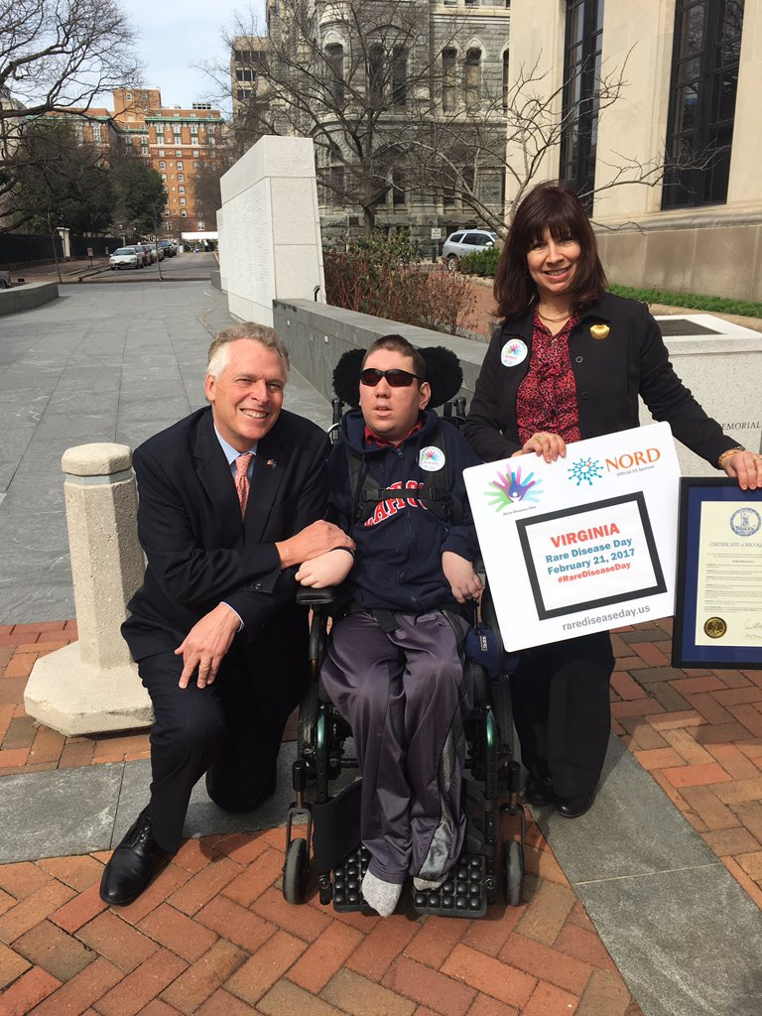
Why is Advocacy Important
Believe it or not, policymakers actually
want to help the people they serve, and they cannot
do that without hearing from you
Change cannot occur without the support of the people:
Advocates represent others
Advocates offer support
Advocates rally for change
Advocates educate others

Slide 8

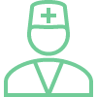
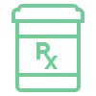
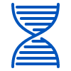
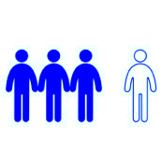
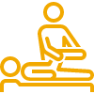


Common Challenges for Rare Patients
Average of 5-7 years for diagnosis
Over 90% of rare diseases do not have a FDA approved treatment or therapy
Extensive, life-long medical needs
High cost of care and treatment
Few medical experts
Little research or known about diseases
Social Isolation
Small, scattered patient populations
rareaction.org
Notes:
There are approximately 7000 rare diseases.
It’s estimated that 25-30 million Americans (almost 1 in 10) have a rare disease.
More than 90% of rare diseases are without an FDA approved treatment.
Most rare diseases are genetic or have a genetic component.
There are more than 500 types of rare cancers.
All pediatric cancers are rare.

Slide 9
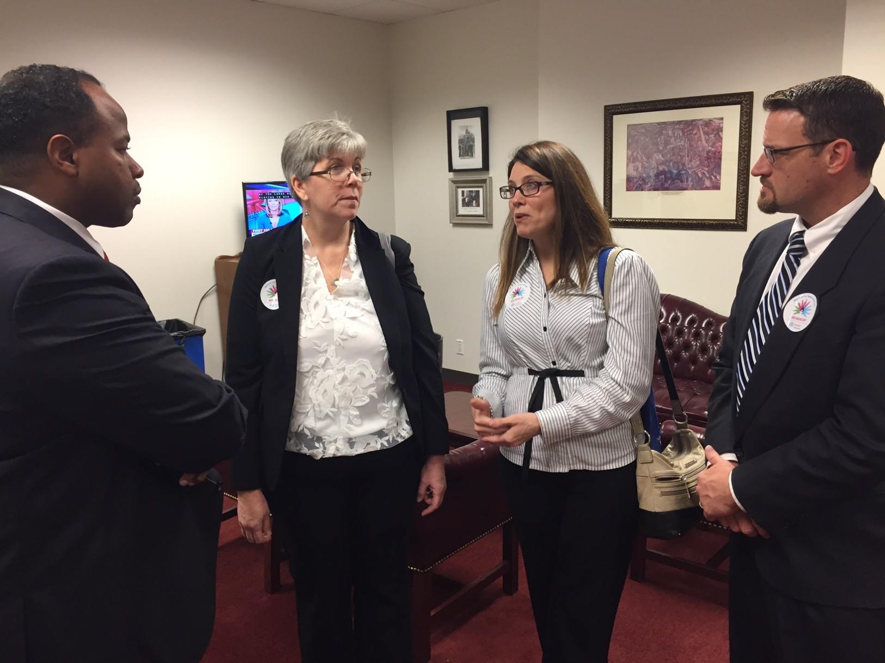
What Can You Do?
Share Your Story
Meet with your legislators
Bring awareness to your local community
Work with The Myositis Association on public policy issues impacting the community
Sign up for the Rare Action Network in your state
Notes:
There are approximately 7000 rare diseases.
It’s estimated that 25-30 million Americans (almost 1 in 10) have a rare disease.
More than 90% of rare diseases are without an FDA approved treatment.
Most rare diseases are genetic or have a genetic component.
There are more than 500 types of rare cancers.
All pediatric cancers are rare.

Slide 10
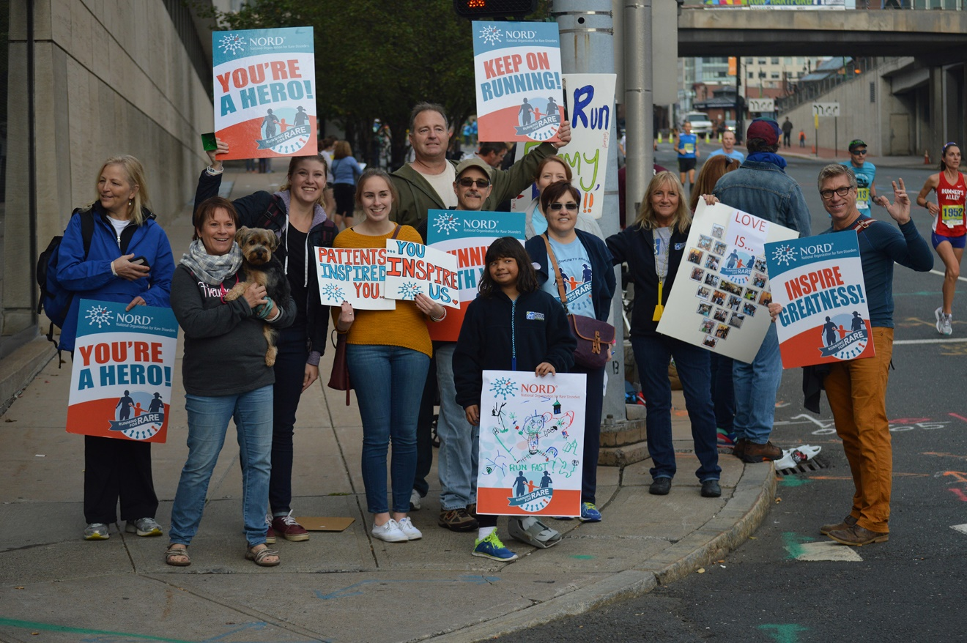
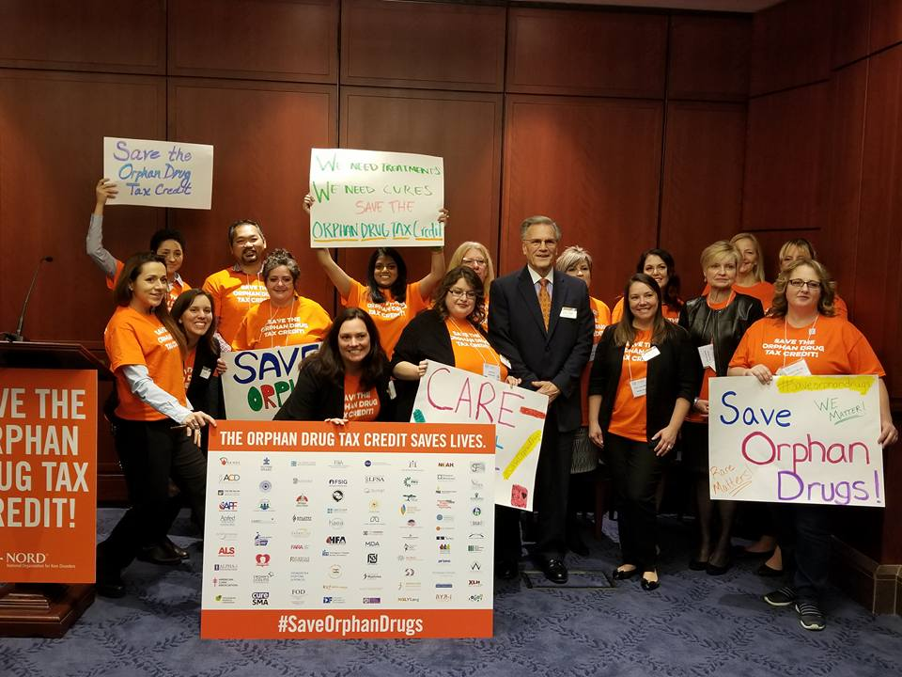
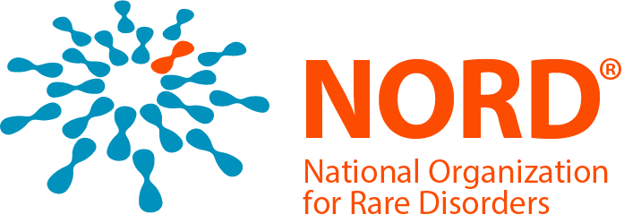
Alone we are rare, together we are strong.

Slide 11
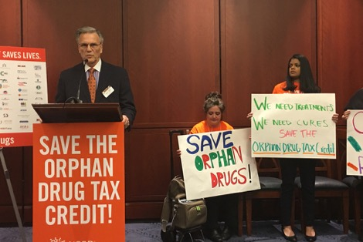
Federal Policy Efforts in 2019
Support the Orphan Drug Act
Newborn Screening Saves Lives Act
Medical Nutrition Equity Act
RARE Act
Patient Focused Drug Development and representation at FDA
Protect access to affordable health insurance
NIH & FDA Funding

Slide 12
State Policy Issues
Launched in 2015, our goal is to make the NORD State Report Card the essential policy and advocacy guide for the rare disease community
2019 will be the fourth release of the report
The report covers nearly every state policy topic NORD engages on throughout the country
Includes detailed appendices for every state
rareaction.org

Slide 13
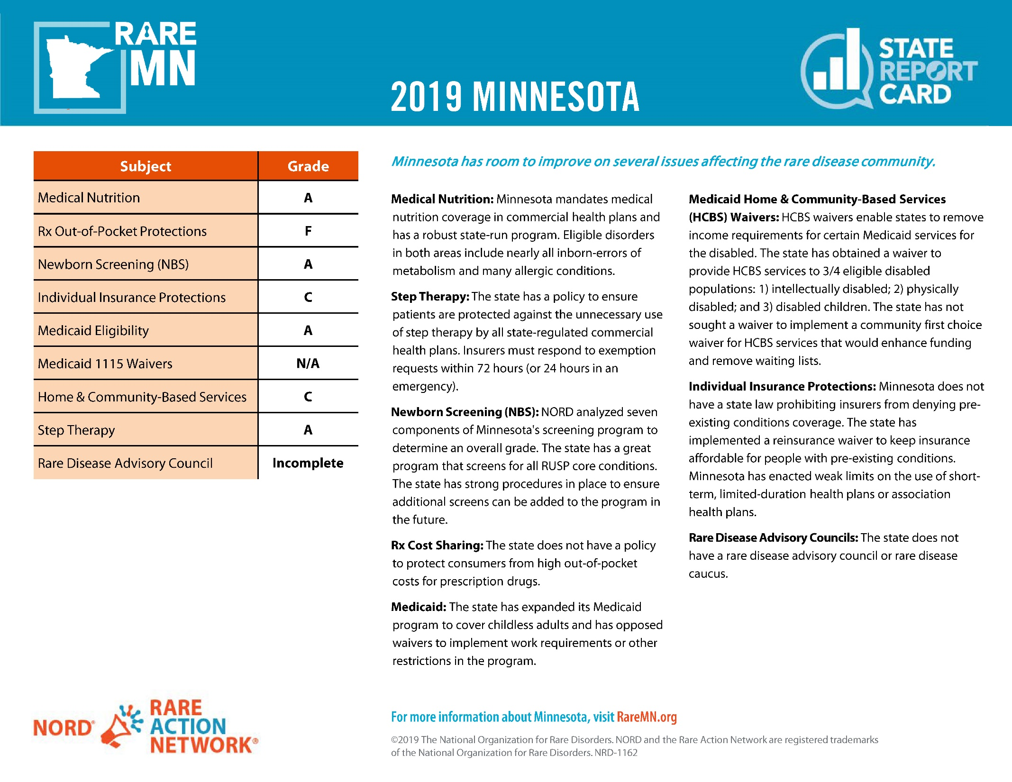
Notes:
Maria to present on her work and her work in Minnesota

Slide 14

Questions?

Slide 15
Kristen Angell
Associate Director of Advocacy
National Organization for Rare Disorders (NORD)
kangell@rarediseases.org
p: 203-304-7251
RareAction.org
RareDiseases.org
Maria Null
Volunteer Community Engagement Liaison
NORD Minnesota Rare Action Network
Maria.null@rareaction.org
RareMN.org

