Slide 1
Myositis 101 for PM/DM/NM/ASyS
Steven R. Ytterberg, M.D.
Emeritus , Division of Rheumatology
Mayo Clinic, Rochester, MN
The Myositis Association Annual Conference
Bloomington, MN
Sept. 5 & 6, 2019

Slide 2
Disclosures
Consulting:
Pfizer
Corbus
Univ. of Pittsburgh
Off-label use:
Nothing is FDA approved other than steroids

Slide 3
I hope to answer some common questions:
What is myositis?
What causes myositis?
What does myositis do to patients?
How is myositis diagnosed?
How is myositis treated?

Slide 4
I hope to answer some common questions:
What is myositis?
What causes myositis?
What does myositis do to patients?
How is myositis diagnosed?
How is myositis treated?

Slide 5
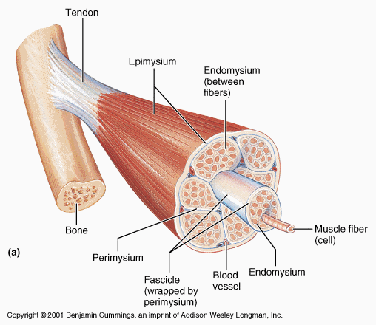
Muscle
http://www.nooruse.ee/e-ope/opiobjektid/lihasfysioloogia/lihasfsioloogia_alused.html

Slide 6
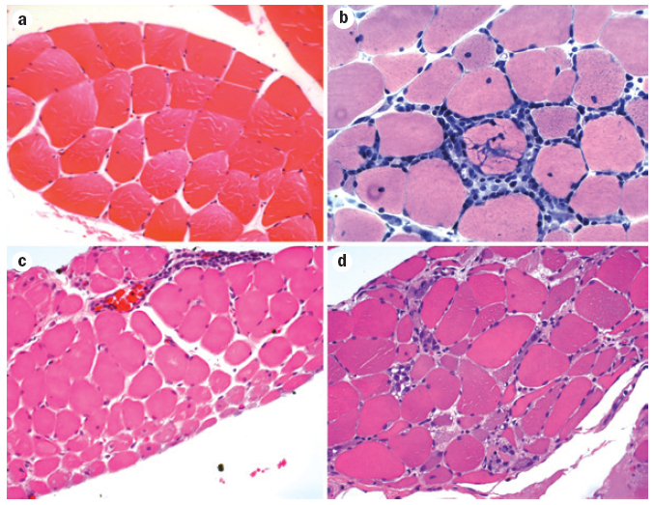
Myositis = muscle inflammation
Normal muscle
PM – endomysial inflammation
DM – perifascicular atrophy
Mammen, Nat Rev Neurol 2011; 7:343-54

Slide 7
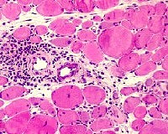
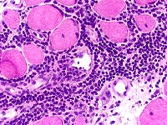
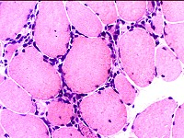
Myositis = muscle inflammation
http://www.neuro.wustl.edu/neuromuscular/pathol/inflammation.htm

Slide 8
Myopathy = muscle abnormality
Myopathy: general term for muscle abnormality
Myositis: muscle inflammation
Most of the muscle disorders discussed are caused by abnormality of the immune system
Autoimmune: immune system directed toward self
Sometimes immune system abnormality causes myopathy without inflammation

Slide 9
Idiopathic Inflammatory Myopathies
Polymyositis (PM)
Dermatomyositis (DM)
Isolated, adult
Juvenile
Malignancy
Overlap
Bohan & Peter, N Engl J Med 292: 344, 405, 1975 Bohan et al., Medicine 56: 255, 1977

Slide 10
Idiopathic Inflammatory Myopathies
Polymyositis (PM)
Dermatomyositis (DM)
Inclusion body myositis (IBM)
Antisynthetase syndrome (ASyS)
Necrotizing myopathy (NM or IMNM)
Isolated, adult
Juvenile
Malignancy
Overlap

Slide 11
Idiopathic Inflammatory Myopathies
Immune-mediated
Polymyositis (PM)
Dermatomyositis (DM)
Inclusion body myositis (IBM)
Antisynthetase syndrome (ASyS)
Necrotizing myopathy (NM or IMNM)
Isolated, adult
Juvenile
Malignancy
Overlap

Slide 12
I hope to answer some common questions:
What is myositis?
What causes myositis?
What does myositis do to patients?
How is myositis diagnosed?
How is myositis treated?

Slide 13
I hope to answer some common questions:
What is myositis?
What causes myositis?
What does myositis do to patients?
How is myositis diagnosed?
How is myositis treated?

Slide 14
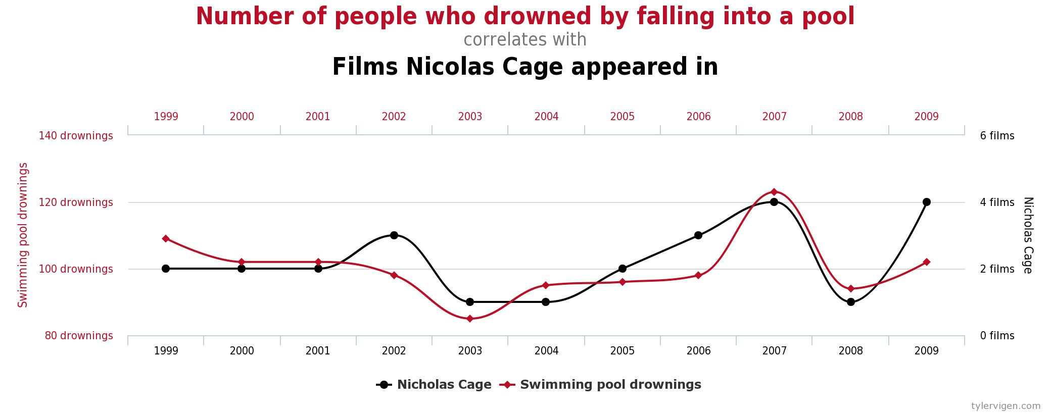
“Cause” is a difficult term
Correlation or association ≠ Causation!
http://www.benchtobmore.com/wp-content/uploads/2015/09/Chart-Tiff-copy.png

Slide 15
“Cause” is a difficult term
Disease triggers
Genetic factors
Environmental factors
Muscle fiber change
Disease mechanisms
Immune system
Inflammation
Muscle damage
Others?

Slide 16
Myositis is likely triggered by genetic and environmental factors
Genetic
factors
Environmental
factors

Slide 17
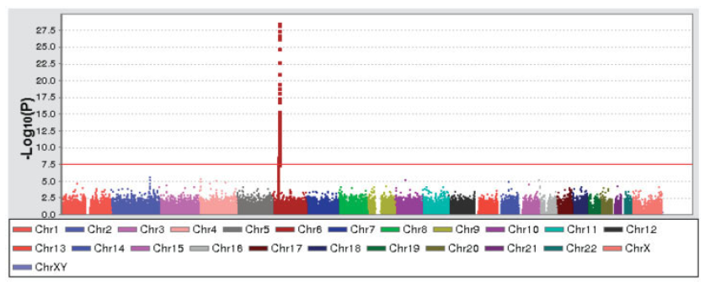
Genome-wide association study (GWAS) in DM/JDM
Genes related to the immune system’s recognition of foreign proteins are most highly associated with DM/JDM
Strongest association with MHC
Non-MHC SNPs:
PLCL1
BLK
CCL21
Miller et al., Arthritis Rheum 2013; 65: 3239-47

Slide 18
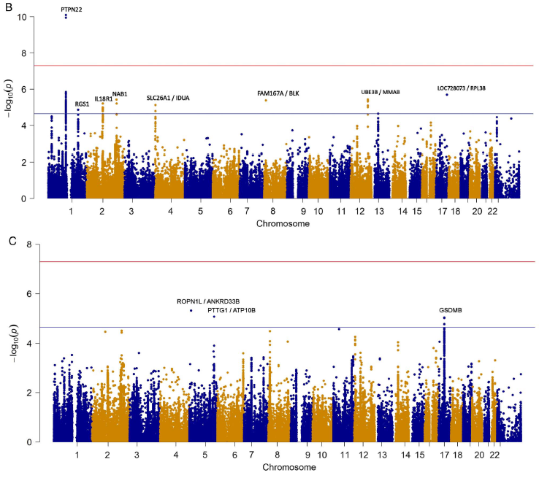
GWAS in PM and DM
Adult PM
Adult and juvenile DM
Rothwell et al., Ann Rheum Dis 2016; 75: 1558-66

Slide 19
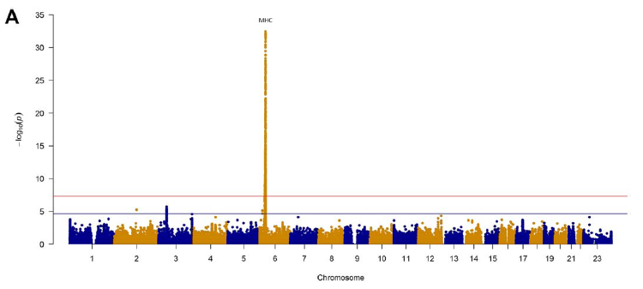
HLA-DRB1 in IBM
Rothwell et al., Arthritis Rheumatol 2017; 69: 1090-9

Slide 20
Classes of environmental exposures
Chemical factors
Silica
Asbestos
Metals
Pesticides
Industrial chemicals and solvents
Air pollution
Smoking
Personal care products
Physical factors
Ionizing radiation
UV radiation
Electric and magnetic fields
Biologic factors
Infectious agents
Foods and dietary contaminants
Molds
Mycotoxins
Other toxins
Miller, et al., J Autoimmun 2012; 39: 259-71

Slide 21
Pathogenesis of IIM
Feature DM PM IBM
Increased MHC I + + +
B-cell mechanisms + - -
T-cell mechanisms + + +
Inclusions - - +
Autoantibodies + + + (Myositis specific antibodies)

Slide 22
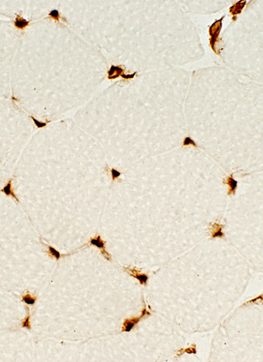
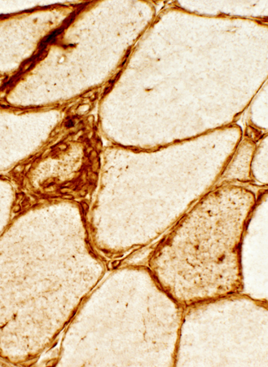
MHC I expression in muscle
Normal
IBM
http://neuromuscular.wustl.edu/pathol/ibm.htm

Slide 23
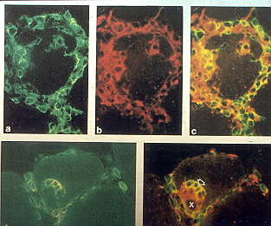
Activated T cells (T lymphocytes) invade and damage muscle in IBM and PM
Arahata & Engel, Ann Neurol 1984; 16:193

Slide 24
I hope to answer some common questions:
What is myositis?
What causes myositis?
What does myositis do to patients?
How is myositis diagnosed?
How is myositis treated?

Slide 25
I hope to answer some common questions:
What is myositis?
What causes myositis?
What does myositis do to patients?
How is myositis diagnosed?
How is myositis treated?

Slide 26
What does myositis to do patients?
It depends
On the specific disorder
On the individual patient
Muscle weakness is the hallmark but not always present
Many other things can occur

Slide 27
Assessment of Muscle Weakness
Patient report of effect on activities
Manual muscle strength testing
Physiologic testing
Functional tests
Timed stands
6 minute walk
Functional Index-2

Slide 28
Evaluation of Muscle Disease: Laboratory Tests
CK – Creatine kinase (CPK)
Aldolase
LDH – Lactate dehydrogenase
AST – aspartate aminotransferase
ALT – alanine aminotransferase

Slide 29
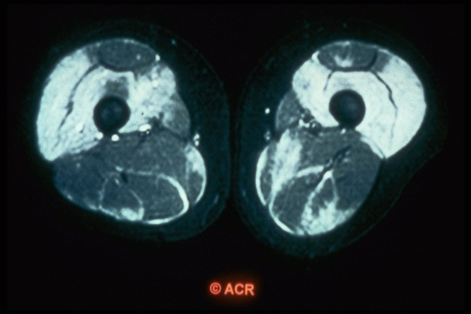
Muscle MRI can show inflammation or scarring

Slide 30
Resting EMG
Normal muscle - no resting activity
Positive waves
Fibrillation potentials and occasional positive waves
Complex repetitive discharges
Myotonic discharge

Slide 31
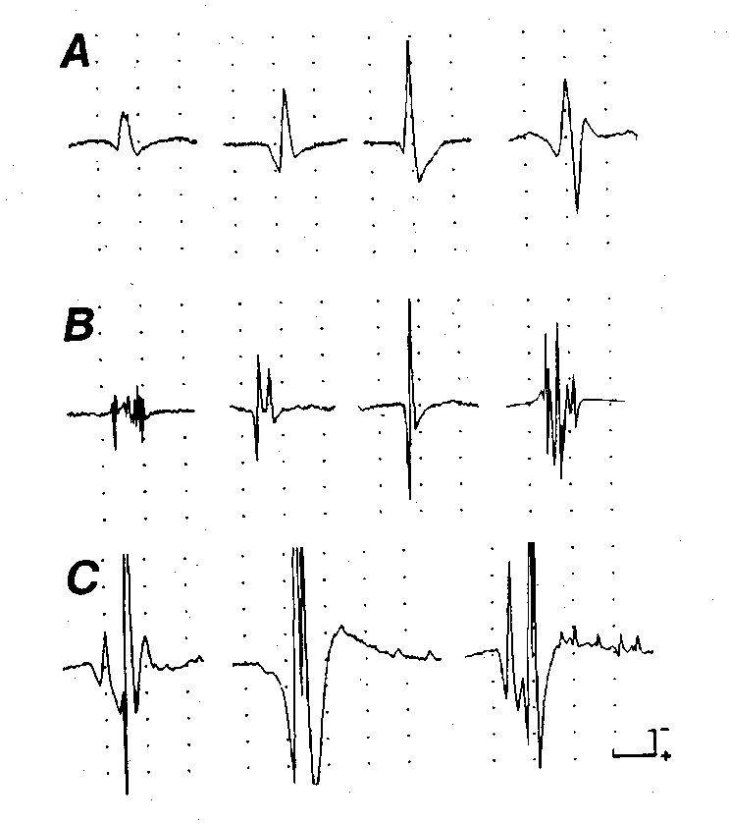
Motor Unit Action Potentials (MUAPs)
Normal MUAPs
Myopathy: Low amplitude, short, polyphasic MUAPs
Neuropathy: Large, long duration, polyphasic MUAPs

Slide 32
Dermatomyositis: characterized by rash
Heliotrope
Gottron’s papules
Shawl sign & others
Calcinosis cutis

Slide 33
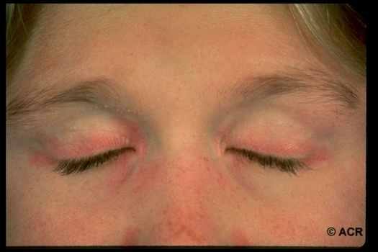
Heliotrope

Slide 34
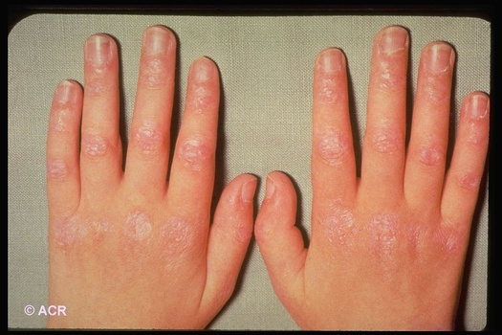
Gottron’s papules

Slide 35
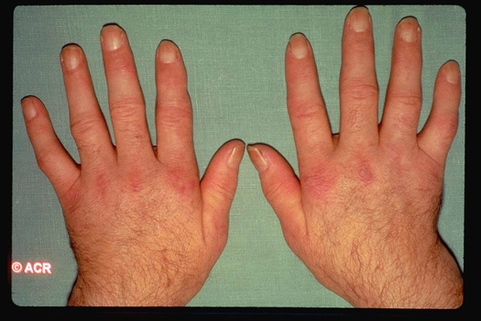
Gottron’s sign

Slide 36
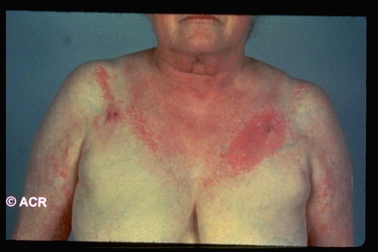
Shawl sign

Slide 37
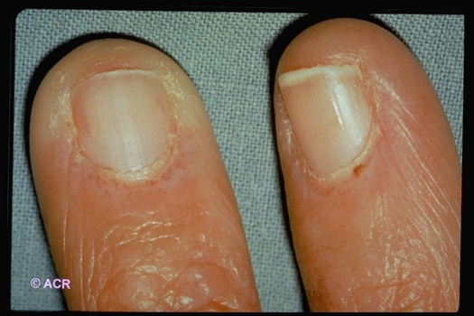
Periungual erythema

Slide 38
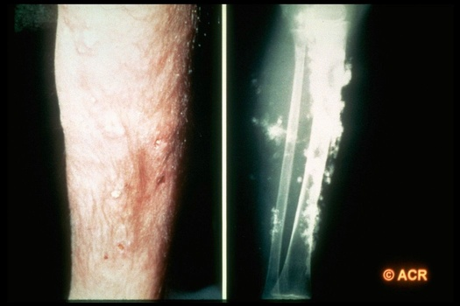
Calcinosis cutis

Slide 39
Amyopathic Dermatomyositis (Dermatomyositis siné myositis)
Cutaneous features of DM
No muscle weakness
Maybe elevated muscle enzymes or EMG, but not weak
Gerami et al., J Am Acad Dermatol 2006;54:597-613

Slide 40
Other organ system problems
Lung – interstitial lung disease
Gastrointestinal – dysphagia, anorexia, reflux
Heart – inflammation, fibrosis, rhythm
Joints – arthritis, arthralgia, morning stiffness
Raynaud’s phenomenon
Constitutional – fatigue, fever

Slide 41
Autoimmune Connective Tissue Diseases
Other terms:
Overlap CTD
Undifferentiated CTD
Mixed CTD
Rheumatoid arthritis
Lupus
Sjogren’s
MCTD
PM/DM
Scleroderma

Slide 42
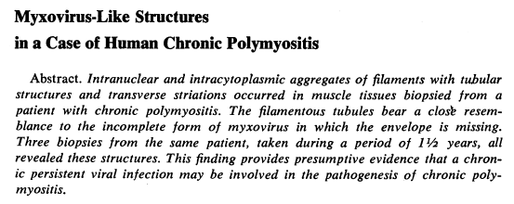
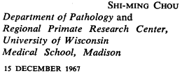
Inclusion body myositis
Muscle biopsy findings define the disorder

Slide 43
Inclusion Body Myositis
First description 1967
“IBM” term coined 1971
Sporadic form (s-IBM)
Several hereditary forms (h-IBM)
Clinically similar:
Weakness: insidious, distal, atrophy
CK minimally to moderately elevated
EMG: myopathic +/- neurogenic
Hereditary: younger; no inflammation

Slide 44
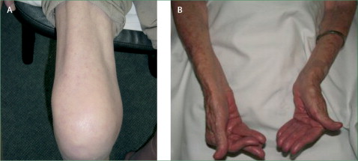
Clinical Features of sIBM
Insidious onset
~6 years to diagnosis
Weakness generalized or localized to limbs; may be asymmetric
Reflexes normal initially, eventually diminished in 40%
Dysphagia in 2/3 – late
Myalgia uncommon but aching in thighs and knees in some
Typical involvement:
Finger flexors
Wrist flexors
Knee extensors
Ankle dorsiflexors
Needham & Mastaglia, Lancet Neurol 6: 620-31, 2007

Slide 45
Anti-synthetase Syndrome
Anti-synthetase antibody – Jo-1, others
PM/DM
Interstitial lung disease
Inflammatory arthritis
Raynaud’s phenomenon
Mechanic’s hands
Fever

Slide 46
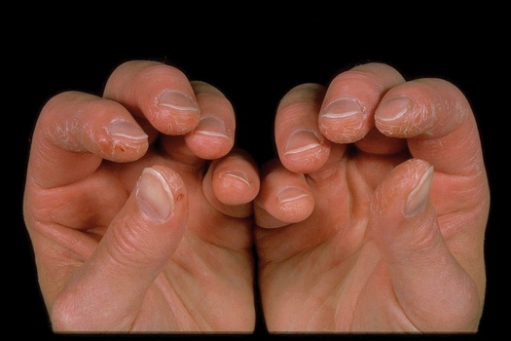
Mechanic’s hands

Slide 47
Necrotizing myopathy
Characterized by muscle biopsy with necrotic muscle fibers without inflammation
Specific autoantibodies
Anti-SRP
Anti-HMGCR
Often associated with statin use
Christopher-Stine, et al. Arthritis Rheum 2010; 62: 2757-66
Mammen, et al. Arthritis Rheum 2011; 63: 713-21

Slide 48
IIM: Epidemiology
Incidence - 0.5 to 8/million
Polymyositis/ Inclusion Body Dermatomyositis Myositis
Age Bimodal, >50 10-15 in kids 45-60 in adults
Female:male 2:1 1:2

Slide 49
Epidemiology of IBM and PM Olmsted County, 1981-2000*
IBM PM
Incidence 0.79 0.41 (0.24-1.35) (0.08-0.73)
Prevalence 7.06 3.45 (0.87-13.24) (0.00-7.35)
*Age- and sex-adjusted rates per 100,000 population; (95% CI)
Wilson et al., J Rheumatol 2008; 35:445-7

Slide 50
Epidemiology of DM Olmsted County, 1976-2007*
DM CADM
Incidence 0.96 0.21 (0.61-1.32) (0.04-0.38)
Prevalence 2.14 (1.31-2.98)
*Age- and sex-adjusted rates per 100,000 population; (95% CI)
Bendewald et al., Arch Dermatol 2010; 146: 26-30

Slide 51
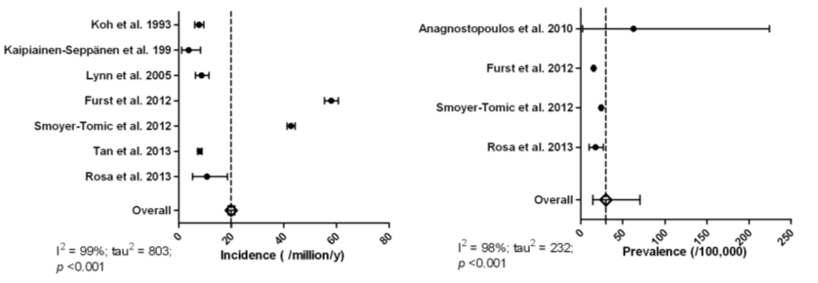
Systematic Review: Adult IIM
Meyer et al., Rheumatology 2015; 54: 50-63

Slide 52
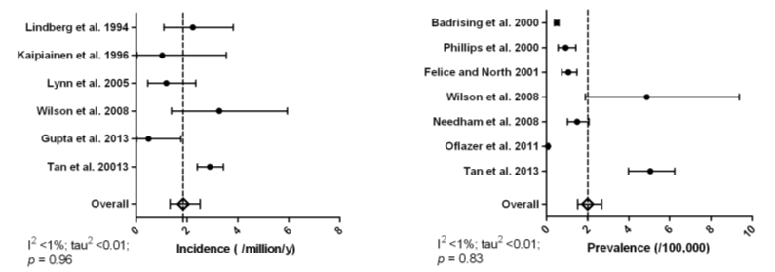
Systematic Review: sIBM
Meyer et al., Rheumatology 2015; 54: 50-63

Slide 53
I hope to answer some common questions:
What is myositis?
What causes myositis?
What does myositis do to patients?
How is myositis diagnosed?
How is myositis treated?

Slide 54
I hope to answer some common questions:
What is myositis?
What causes myositis?
What does myositis do to patients?
How is myositis diagnosed?
How is myositis treated?

Slide 55
PM/DM Classification Criteria
Proximal muscle weakness
Elevated serum levels of skeletal muscle enzymes
Myopathic changes on EMG
Muscle biopsy evidence of inflammation
Skin rash
Definite PM or DM: 4 criteria
Probable PM or DM: 3 criteria
Possible PM or DM: 2 criteria
Bohan & Peter, N Engl J Med 292: 344, 405, 1975 Bohan et al., Medicine 56: 255, 1977

Slide 56
PM/DM Classification Criteria
Lundberg article/slide
Bohan & Peter, N Engl J Med 292: 344, 405, 1975 Bohan et al., Medicine 56: 255, 1977

Slide 57
Muscle histopathology
Normal muscle
PM – endomysial inflammation
DM – perifascicular atrophy
Necrotizing myopathy
Mammen, Nat Rev Neurol 2011; 7:343-54

Slide 58
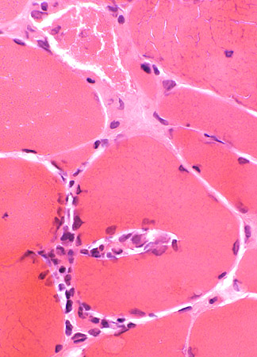
Myositis = muscle inflammation
http://www.neuro.wustl.edu/neuromuscular/pathol/inflammation.htm

Slide 59
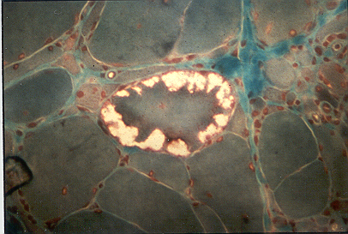
IBM: Vacuoles

Slide 60
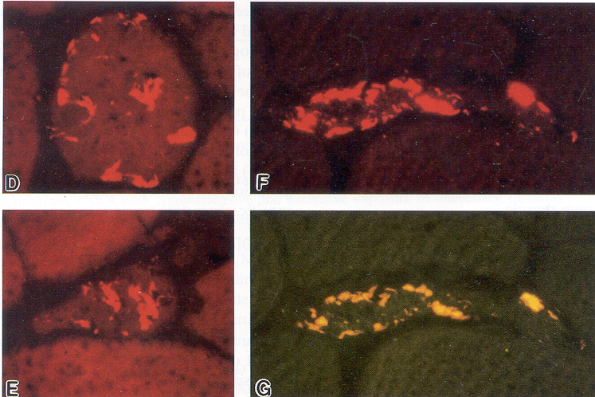
IBM Congo red staining
Askansas & Engel, J Neuropathol Exp Neurol 60:1, 2001

Slide 61
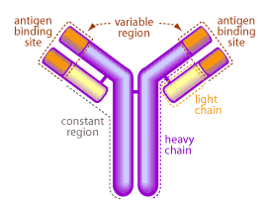
Antibodies
Immunoglobulin
Produced by plasma cells in the immune system
Identify and neutralize viruses and bacteria
Each recognizes a unique protein (antigen)

Slide 62
Autoantibodies
Autoantibody | Target | Disorder
Antinuclear antibodies (ANA) | Contents of cell nuclei | Lupus and related conditions
Rheumatoid factor (RF) | IgG | Rheumatoid arthritis
Anti-Jo-1 | Histidyl tRNA synthetase | Anti-synthetase syndrome
Anti-PR-3 (c-ANCA) | Neutrophil proteinase-3 | Granulomatosis with polyangiitis
Anti-thyroid antibodies | TPO Thyroglobulin | Hashimoto’s thyroiditis
Anti-AChR | Acetylcholine receptor on muscle | Myasthenia gravis
Anti-TTG | Tissue transglutaminase | Celiac disease
Antibodies directed toward an individual’s normal proteins
Autoantibodies may:
Cause disease
Simply be markers of disease

Slide 63
Non-specific Autoantibodies in Myositis
Percent of Patients with Various Autoantibodies
Antibody | All (n=212) | PM (n=58) | DM (n=79) | CTM (n=36) | CAM (n=13) | IBM (n=26)
ANA | 52 | 40 | 62 | 77 | 31 | 23
ds-DNA | 5 | 3 | 3 | 11 | 8 | 4
SSA/Ro | 12 | 12 | 11 | 17 | 0 | 12
SSB/La | 8 | 5 | 6 | 19 | 8 | 8
Sm | 3 | 0 | 1 | 17 | 0 | 0
U1RNP | 11 | 7 | 13 | 25 | 0 | 0
PM/Scl | 2 | 0 | 4 | 3 | 0 | 0
RF | 6 | 5 | 8 | 8 | 0 | 4
Love et al, Medicine 1991; 70: 360-74

Slide 64
Myositis-Specific Antibodies
Feature Synthetase SRP Mi-2
Clinical Arthritis, ILD Cardiac Classic DM fever, myalgias; Raynaud’s black women
Rate Acute Very acute Acute
Severity Severe Very severe Mild
Season Spring Fall Unknown
Response Moderate Poor Good
Prognosis Poor (70%) Terrible (25%) Good (~100%)
Frequency 20-25% <5% 5-10%

Slide 65
Antisynthetase antibodies
Frequency (%)
Antigen tRNA synthetase JDM* ADM* Non-white
Any 1-5 30 AA 29
Jo1 Histidyl- 2-5 25-30 AA13
PL12 Alanyl- 1-3 <5
PL7 Threonyl- <1 <5 Japanese 17
EJ Glycyl- <1 <5
OJ Isoleucyl- <1 <5
KS Asparagynyl- NA <1
HA Tyrosyl- NA <1
ZA Phenylalanyl- NA <1
*Caucasian
Robinson & Reed, Nat Rev Rheumatol 2011; 7: 664-75

Slide 66
Serologic Subgroups in IIM 2
Anti-TIF-1γ (anti-transcription intermediary factor 1γ; anti-p155): DM, including JDM, malignancy Targoff et al., Arthritis Rheum 2006; 54: 3682-3689
Trallero-Araguas et al., Medicine 2010; 89: 47-52
Anti-MDA-5 (anti-melanoma differentiation-associated protein 5; anti-CADM): CADM, rapidly progressive ILD Sato et al., Arthritis Rheum 2005; 52:1571-6
Anti-NXP2 (anti-nuclear matrix protein 2; anti-MJ): JDM, especially with calcinosis, malignancy
Gunawardena et al., Arthritis Rheum 2009; 60: 1807-14
Gunawardena et al., Rheumatology 48: 607-12, 2009

Slide 67
Autoantibodies in IBM
Anti-cytoplasmic 5’-nucleotidase 1A
Initially detected as 43 kd autoantibody
13/25 (52%) IBM + vs 0/40 controls
Antigen identified as cN1A
Most abundant in skeletal muscle
Catalyzes nucleotide hydrolysis to nucleosides
Perinuclear and vacuole accumulation of cN1A
Salajegheh, et al., PLoS One 2011; 6(5): e20266
Larman, et al., Ann Neruol 2013; 73: 408-18

Slide 68
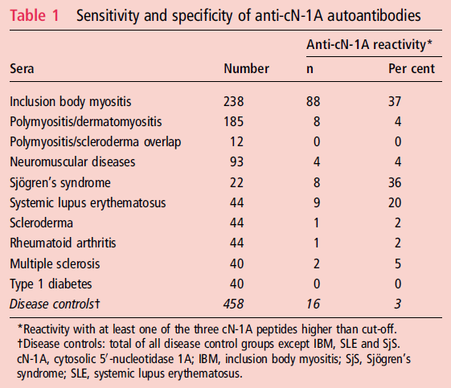
Anti-cN1A Verification
Herbert, et al., Ann Rheum Dis 2016; 75:696-701

Slide 69
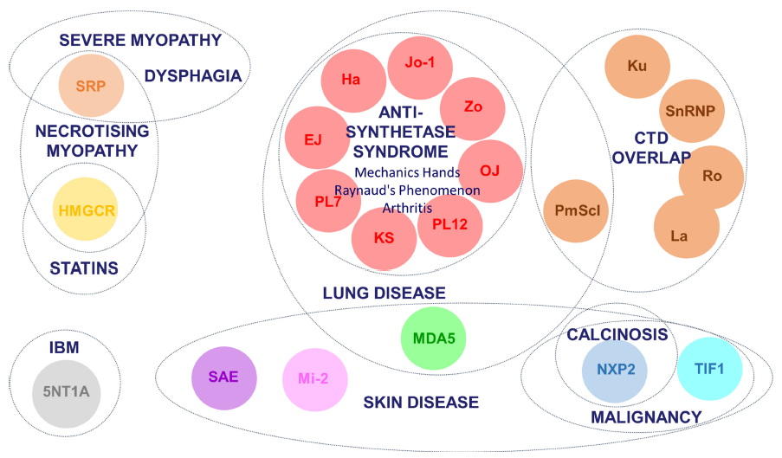
Myositis Specific Autoantibodies
Betteridge & McHugh, J Intern Med 2015; Epub

Slide 70
I hope to answer some common questions:
What is myositis?
What causes myositis?
What does myositis do to patients?
How is myositis diagnosed?
How is myositis treated?

Slide 71
I hope to answer some common questions:
What is myositis?
What causes myositis?
What does myositis do to patients?
How is myositis diagnosed?
How is myositis treated?

Slide 72
General Approach to Treatment of Myositis PM, DM, ASyS, Overlap myositis
Auto-immune process
Inflammation
Symptoms

Slide 73
General Approach to Treatment of Myositis PM, DM, ASyS, Overlap myositis
Damage
Auto-immune process
Inflammation
Symptoms

Slide 74
General Approach to Treatment of Myositis PM, DM, ASyS, Overlap myositis
Damage
Auto-immune process
Inflammation
Symptoms
Immune suppressing agents
Steroids

Slide 75
General Approach to Treatment of Myositis Immune-mediated necrotizing myopathy
Damage
Auto-immune process
Mechanism?
Symptoms
Immune suppressing agents
Steroids

Slide 76
General Approach to Treatment of Myositis Cancer-associated myositis
Cancer
Damage
Auto-immune process
Inflammation
Symptoms
Immune suppressing agents?
Steroids?

Slide 77
General Approach to Treatment of Myositis Inclusion body myositis
Inclusions
Damage
Auto-immune process
Inflammation
Symptoms
Immune suppressing agents?
Steroids?

Slide 78
Approach to Management
Start with high-dose prednisone (e.g., 1 mg/kg/day)
Consider IV to begin
Consider split daily dose
Continue about 1 month with slow taper
Use an immunosuppressive agent
Attention to side effects of therapy (e.g., osteoporosis, infection)

Slide 79
My Approach to Prednisone
Begin 1 mg/kg/d (usually max 80 mg/d)
Continue 1 month
2 weeks each:
40 mg/d
30 mg/d
25 mg/d
20 mg/d
17.5 mg/d
15 mg/d
12.5 mg/d
10 mg/d and then decide what next

Slide 80
My Approach to Immunosuppressives
First-line agents
Methotrexate
Azathioprine (Imuran)
Mycophenolate mofetil (CellCept)
Severe disease
Cyclophosphamide (Cytoxan)
Studies
Abatacept (Orencia)
Tocilizumab (Actemra)
Belimumab (Benlysta)
Second-line agents
IVIg
Rituximab (Rituxan)
Tacrolimus (Prograf)
Cyclosporine A (Neoral, Sandimmune)
Leflunomide (Arava)
Never used
ACTHAR gel

Slide 81
Also remember
Pneumocystis pneumonia prophylaxis when on high dose prednisone
Influenza, pneumococcal, and other immunizations
Osteoporosis attention: calcium and vitamin D; bone density
Mobility and assistive devices; fall prevention
Dysphagia
Exercise

Slide 82
I hope to answer some common questions:
What is myositis?
What causes myositis?
What does myositis do to patients?
How is myositis diagnosed?
How is myositis treated?

Slide 83
I hope to answer some common questions:
What is myositis?
What causes myositis?
What does myositis do to patients?
How is myositis diagnosed?
How is myositis treated?

Slide 84
Questions?

