Slide 1
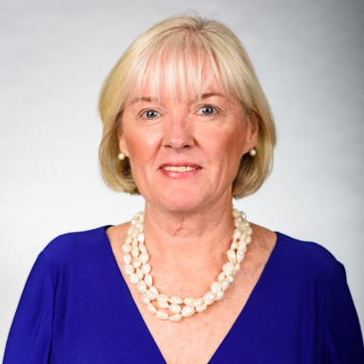
The Myositis Association’s Mission:
To improve the lives of persons affected by myositis, fund innovative research and increase myositis awareness and advocacy
Welcome and Year in Review
Mary McGowan
The Myositis Association Executive Director Email: mcgowan@myositis.org www.myositis.org

Slide 2
Who We ARE?

Slide 3
What conditions we are living with

Slide 4
Where are we from?

Slide 5
2019 Annual Patient Conference
Over 480 conference registrants
New Theme
96 sessions
75 speakers
17 Completely New sessions
Annual Patient Conference Webinar
Over 400 views

Slide 6
New Sessions at 2019 Conference
Mental health and myositis
Learning how to share your myositis story
Clinical trials from pharmaceutical perspective
Specialty pharmacy and access panel
Adaptive clothing panel with Target Corporation
Caring for the care partner with national care partner organizations
Insurance denial support with national insurance support organizations
Advocacy and Myositis
Wheelchair escapes on adaptive travel

Slide 7
What to expect
Make life-long friendships and learn from others with similar experiences

Slide 8
What to expect
Opportunity to hear from and speak to the world's leading experts in myositis

Slide 9
What to expect
Engage with and learn from our sponsors and exhibitors

Slide 10
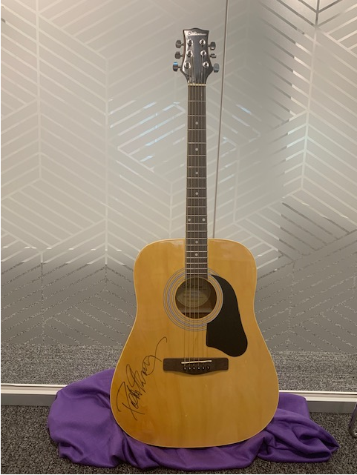
What to Expect
Get the opportunity to bid on extraordinary silent auction items like...
Peter Frampton’s Autographed Guitar

Slide 11
A YEAR IN REVIEW WORKING TOGETHER!

Slide 12
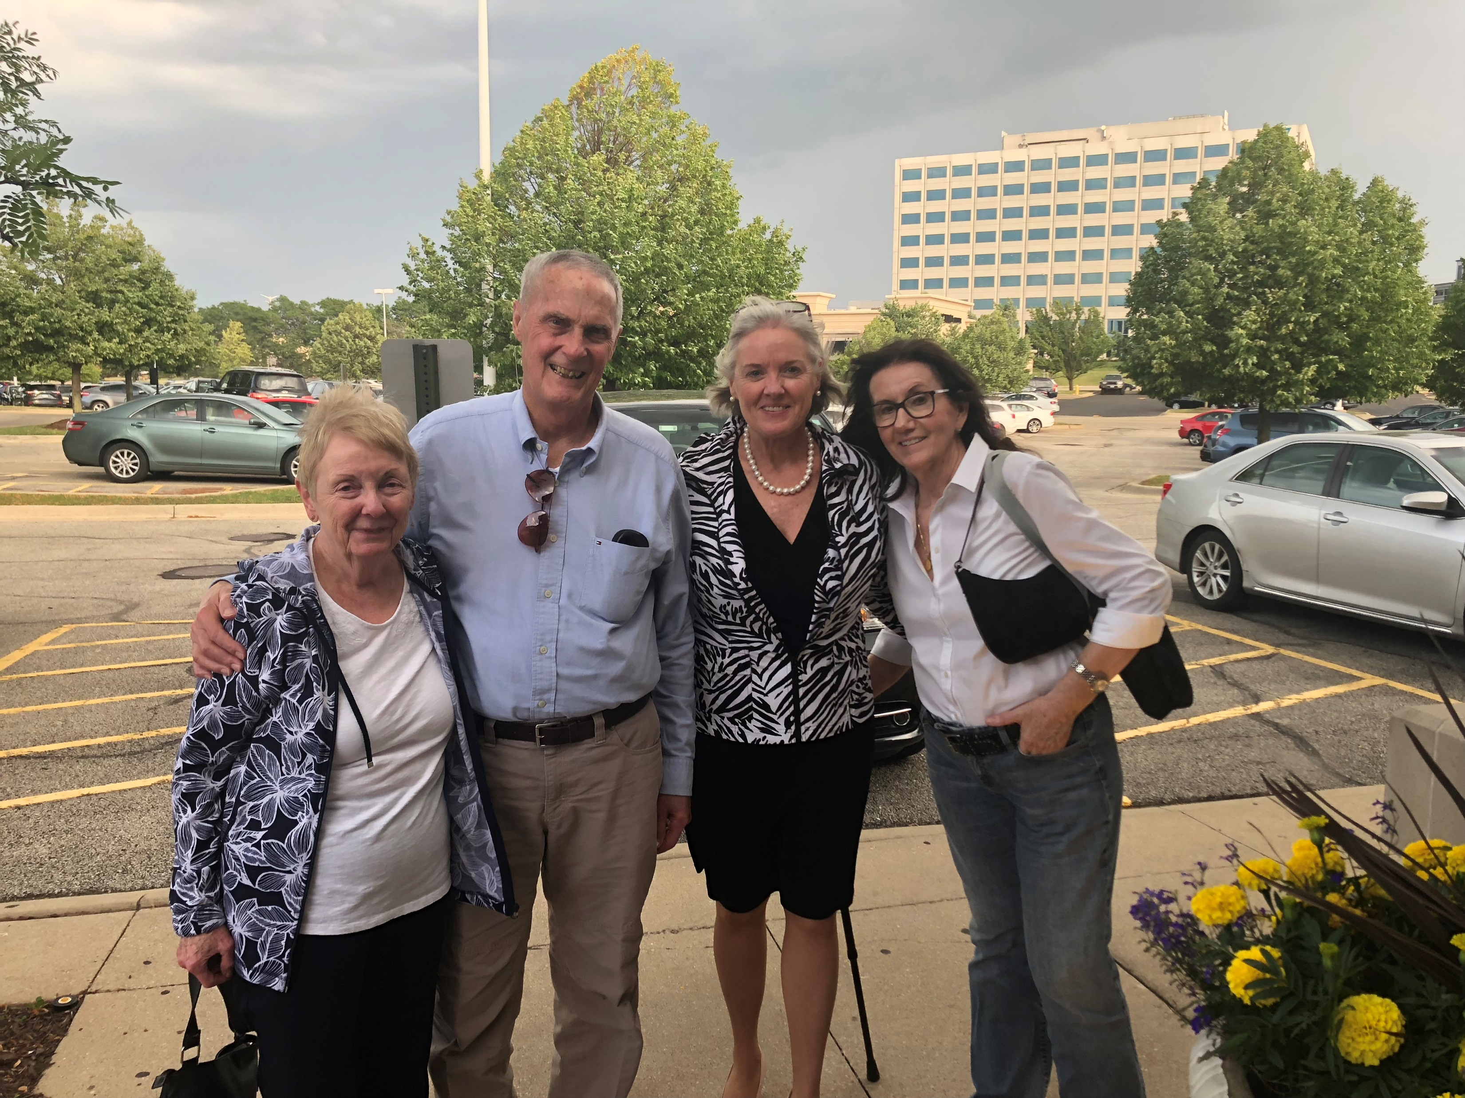
Support Groups and Patient Advisory Council
25 support group meetings this year
7 group mtgs attended by TMA staff
9 new support group leaders
12 member patient advisory council for Women of Color and Myositis Campaign

Slide 13
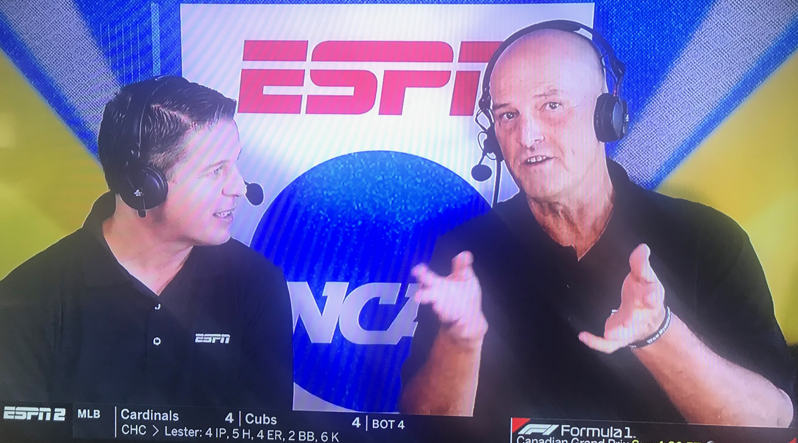
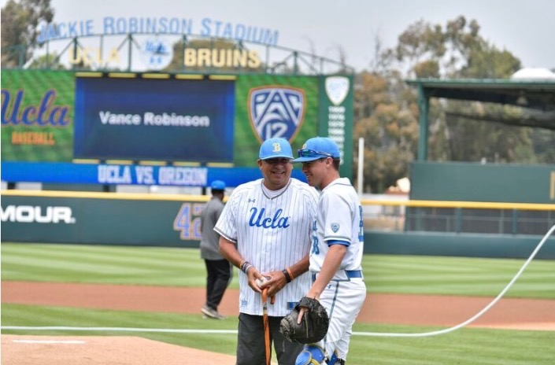
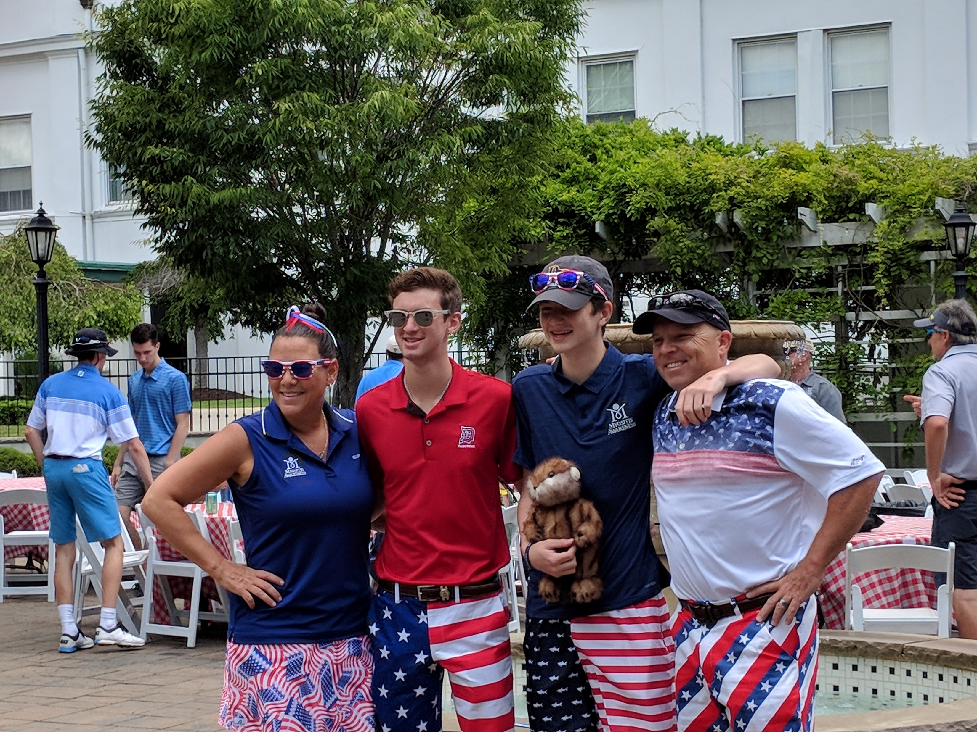
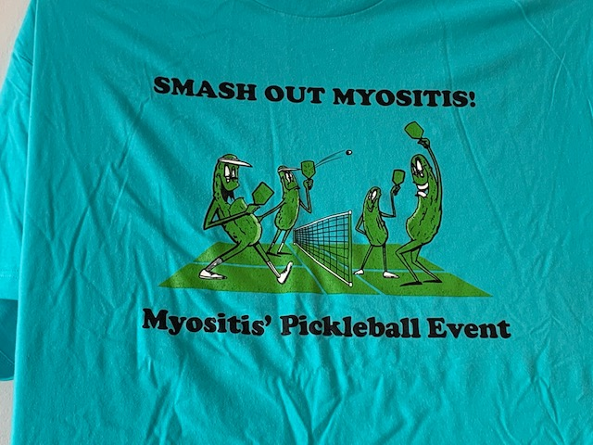
Select Member Activities
TMA Awareness Events
Pedano Pickleball, Bowling & Golf Events
Over $65,000 raised
Vance Robinson’s First Pitch
Covered by local TV - Santa Barbara and ESPN
Reading of Myositis Awareness Month Proclamation provided by The Mayor of Nashville, TN - David Briley- May 22
SW FL Awareness Symposium for local PTs and OTs-May 23
Over 60 Physical and Occupational Therapists received CEU Credit
Roller Derby Awareness Events
Forthcoming Event
10th Annual Walk n’ Roll – October 19

Slide 14
Webinars
6 Webinars
Topics: Heart Disease, Research funding, TMA Conference, Women of Color, FDA and Drug Development and Reproductive Health
Total Registrants: 892
Total Live Views: 437
Total View After Posted to Website: 566
Total Webinar Views:1,895

Slide 15
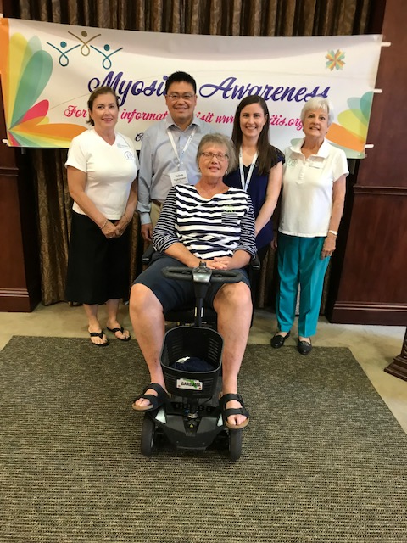
Myositis Awareness Month
13 in-person support group meetings
The Mayor of Nashville declared May Myositis Awareness Month
CEU accredited educational forum for 60 Physical and Occupational Therapists hosted by SW Florida Support Group
TMA Website visited increased by 23.4% from the previous month
TMA’s Myositis Awareness Month Guide downloaded 267 times

Slide 16
Women of Color and Myositis Campaign
Outcome Measures
Engagement Measures
11 earned media articles in traditional press, 1 podcast, 1 Live Radio interview with a total of 5,034,893 people reached
39,028 impressions on FaceBook,13,337 impressions on Twitter, 4,286 views on LinkedIn
13 partner organizations amplified our messaging (distribution of nearly 1500 physical copies of educational infographic)
1 Exhibit booth with national conference for medical providers who treat women of color
Action Measures
458 views of patient story video (in May)/695 views since May 1st
107 downloads of educational infographic from TMA’s website
154 downloads of social media graphics from TMA’s website
159 Webinar registrants, 52 attended live webinar, 60 views once loaded up to TMA website

Slide 17
Support Group Community Engagement-San Francisco Giants
Over 1000 TMA Awareness bracelets distributed
$14,000 raised for TMA in one day

Slide 18
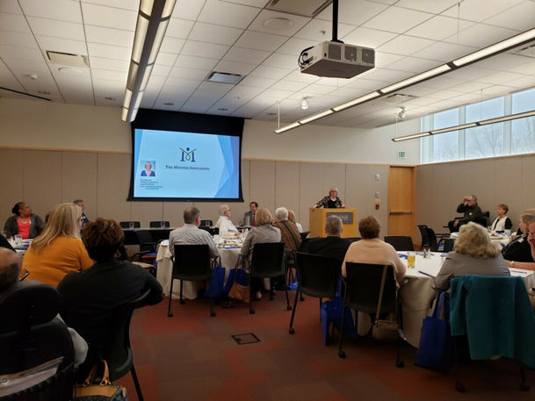
KU Medical Center and TMA Midwest Regional Conference
62 patients and care partners traveled to participate in day-long regional conference on myositis

Slide 19
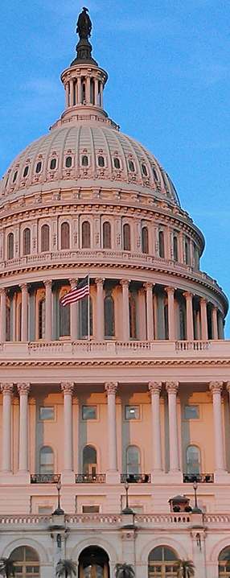
TMA Advocates
Joined 8 Advocacy Coalitions
Participated in Rare Disease Day on Capitol Hill
Attended 4 Hill Briefings
Attended FDA Hearing on Rare Disease
Attend FDA Annual Meeting
Signed on to 4 Advocacy Letters

Slide 20
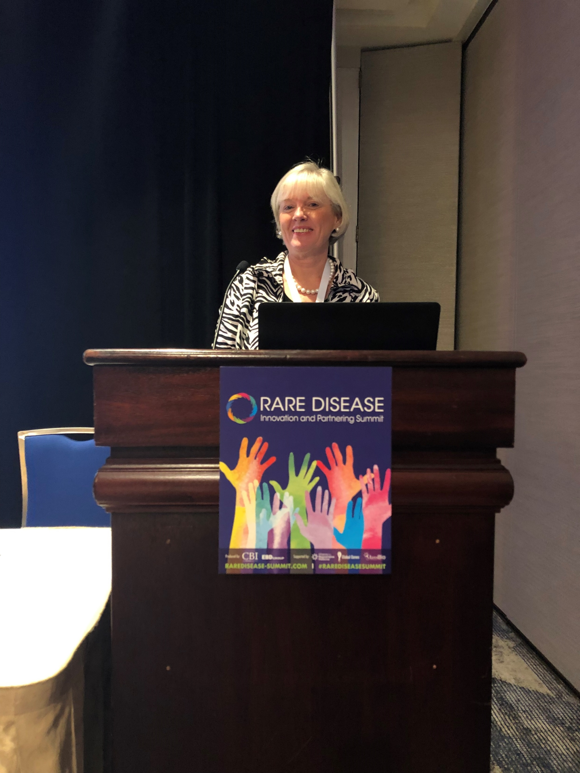
2019 Speaking Opportunities
Global Conference on Myositis in Berlin 2019
Rare Disease Innovation and Partnership Summit
BriovaRX June Sales Meeting
Global Genes Patient Advocacy Summit
(Poster Session)
Muscle Study Group
NORD Rare Disease Summit (Session and Poster)
SCOPE 2020
IMACS 2019
World Orphan Drug Congress 2020
Global Skin/RareDerm –Participant in GRIDD Survey
Speaking Opportunities and posters under consideration:
Rare Disease and Clinical Development Access Summit 2019
NIAMS Coalition Meeting 2019 (Poster)
EyeforPharma Patient Summit USA 2019
AARDA Coalition Presentation 2019

Slide 21
Research Grants
33 Letters of Intent which is a 40% increase over last year
29 applications approved to submit full application
26 applications submitted for review which is a 25% increase over last year

Slide 22
2019 – Social Media and Website
Organic search (keywords in search engine) increased traffic to website by 76.9% in December-July as compared to the previous period
More than 43,000 pageviews of blog content on TMA website
Over 460,000 pageviews of About Myositis page and Content
Increased reach through Facebook by nearly 1.5 Million during Myositis Awareness Month over previous month
Increased reach through Twitter by over 18K during Myositis Awareness Month over previous Month

Slide 23
Peter Frampton Outreach

Slide 24
www.myositis.org
Mary McGowan
The Myositis Association Executive Director mcgowan@myositis.org

