Slide 1
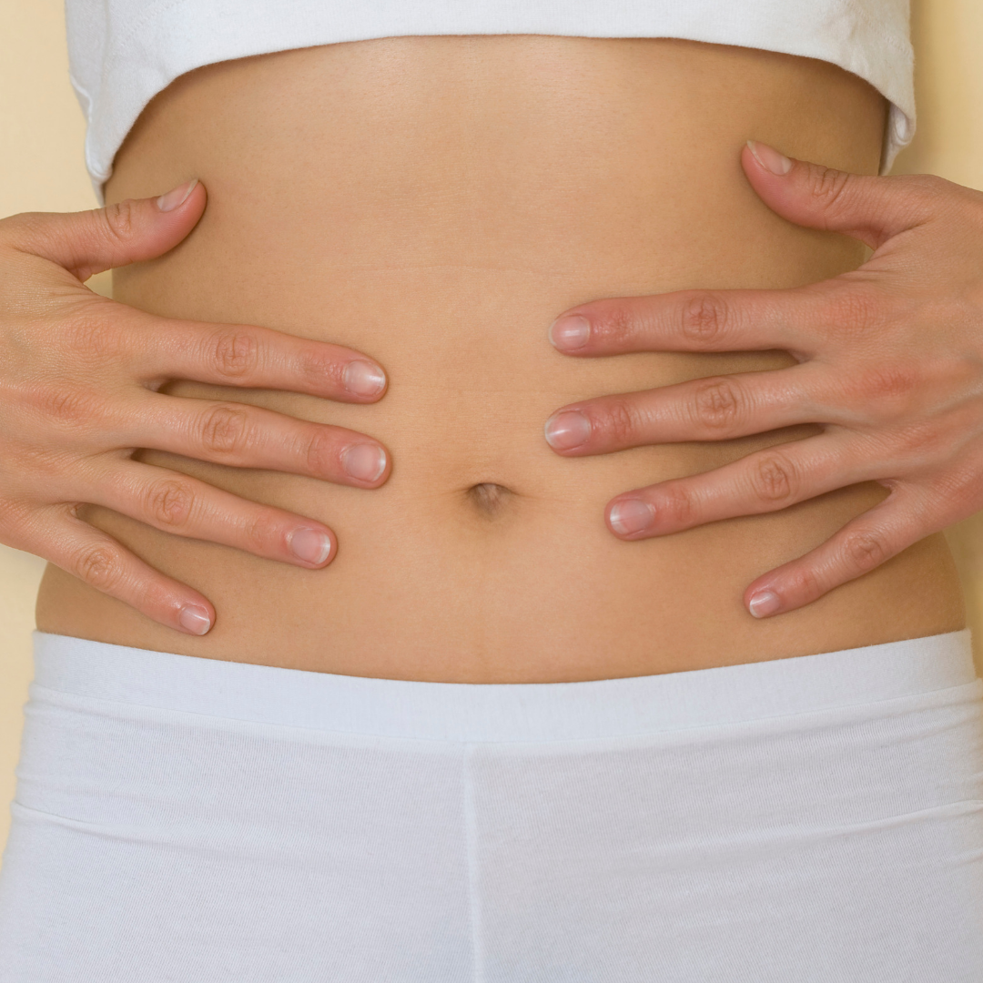

Follow Your Gut
How does the gut microbiome effect autoimmune diseases
Jacilyn Mikels ARNP, FNP-C, IIN Health Coach
Co-Founder of FollowYourGutMDNP

Slide 2
Disclaimer: The information I am supplying is evidenced-based and for educational purposes only. Any suggestions I make today please discuss and review with your physicians/medical team prior to incorporating into your daily routine.

Slide 3
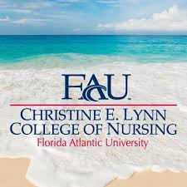

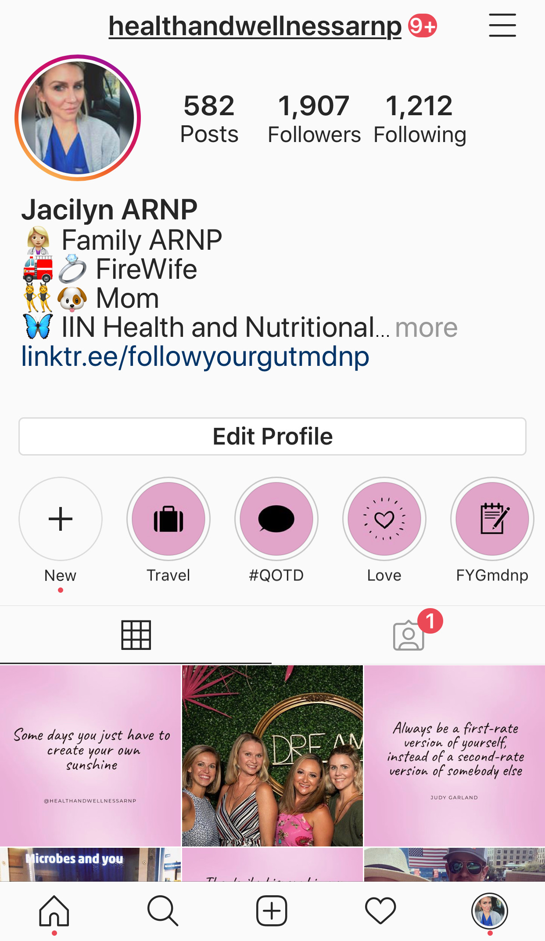
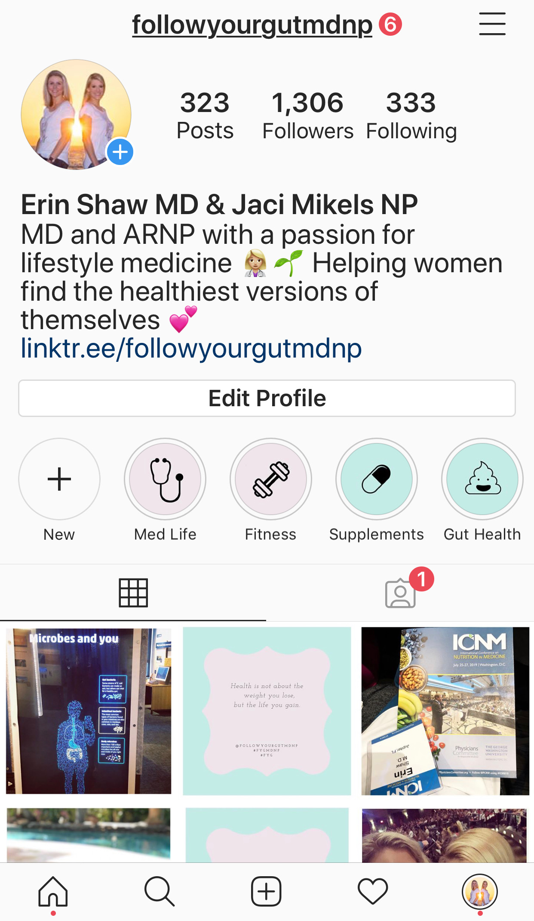

A little bit about me….

Slide 4
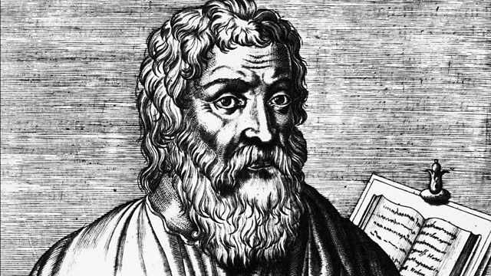
“All disease begins in the gut”
–Hippocrates
Father of Medicine
Picture credit: https://www.bbc.co.uk/programmes/b014gdqq

Slide 5
What is “The Gut”?
Refers to the entire gastrointestinal tract
  Begins in the mouth and ends at the rectum
Small intestines—largest section of the GI tract
  Important section of GI tract for absorption and protection
More than a “gut feeling”
  Gut-brain axis
  Intestinal permeability

Slide 6
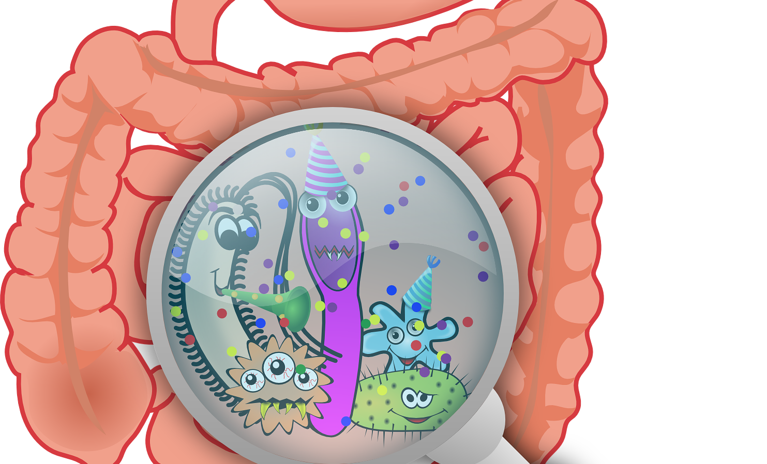
What is the “Gut Microbiome”?
www.medicalexpress.com

Slide 7
Microbiome versus Microbiota
Is there really a difference?
Microbiome
Microbiota
Genetic makeup
Categories
How they live
Microbes
Bacteria, Fungi, Viruses OH MY!
Important for immunity, nutritional absorption and mental health.

Slide 8
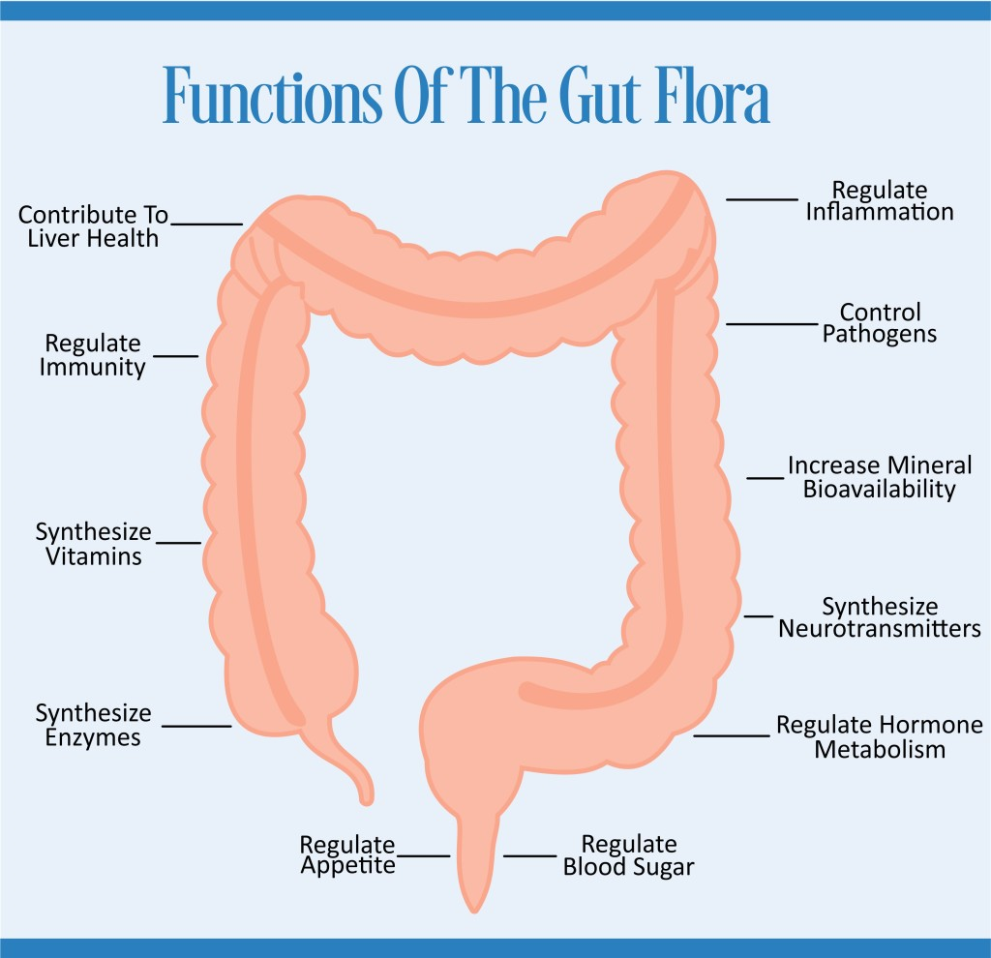
What effects the gut?
Negatively
Highly refined processed foods
Obesity
Stress/Mental status
Lack of sleep
Certain medications—PPIs, ABX
Lack of exercise
Chronic illnesses (see below)
Positively
Whole food plant based diet
Exercise
Maintaining normal body weight
Certain supplements
Breast feed versus bottle fed
Normal sleep pattern
Stress management
Mental health management
https://embeeplantphysicians.org/health-and-wellness-gut-bacteria/

Slide 9
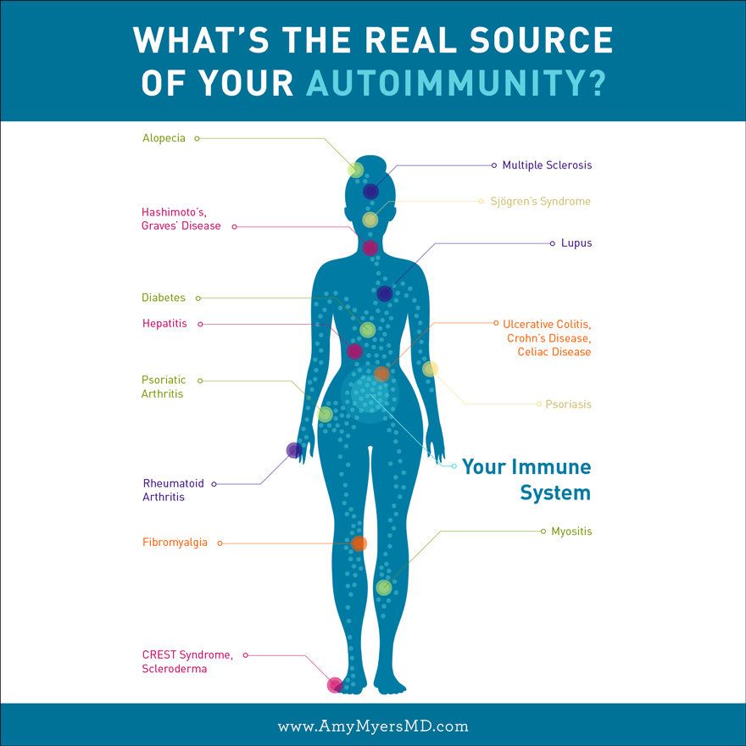
What diseases are associated with the Gut?
Chronic illnesses
Autoimmune diseases including Myositis
Diabetes
GERD
Anxiety/Depression
Parkinson’s disease
Multiple Sclerosis
Certain types of cancers (Colon & Breast)
Autism
Celiac
Acute Illnesses
Pneumonia
Cellulitis
Diverticulitis
Colitis
Gastritis
Trauma
https://www.amymyersmd.com/2017/10/leaky-gut-autoimmune-connection/

Slide 10
What is an Autoimmune disease?
“An autoimmune disease is an illness that causes the immune system to produce antibodies that attack normal body tissues. Autoimmune is when your body attacks itself. It sees a part of your body or a process as a disease and tries to combat it.” American Academy of Allergy, Asthma and Immunology
TMA states “Inflammatory myopathies are rare diseases. All forms combined affect an estimated 50,000 to 75,000 people in the United States.”
Other autoimmune diseases: Hashimoto’s thyroiditis, Multiple Sclerosis, Rheumatoid Arthritis, Lupus (of many forms), Alopecia Areata, Psoriasis, Vitiligo, Crohn’s disease and many more to list

Slide 11
What is an Autoimmune disease?
Common element in autoimmune diseases is the presence of several pre-existing conditions that lead to an autoimmune process or reaction
Genetic susceptibility of host immune system to recognize, and eventually misinterpret, an environmental antigen in the GI tract
Host must be exposed to the antigen
Antigen must be presented to host GI mucosal. Travels from intestinal lumen lining to gut submucosa. Process can be prevented by a competent intercellular tight junction.
“In many cases, increased intestinal permeability seems to precede disease and causes an abnormality in antigen delivery that triggers the multiorgan process leading to the autoimmune response”
(Fasano, A. Clinic Rev Allerg Immunol (2012) 42: 71. https://doi.org/10.1007/s12016-011-8291-x)

Slide 12

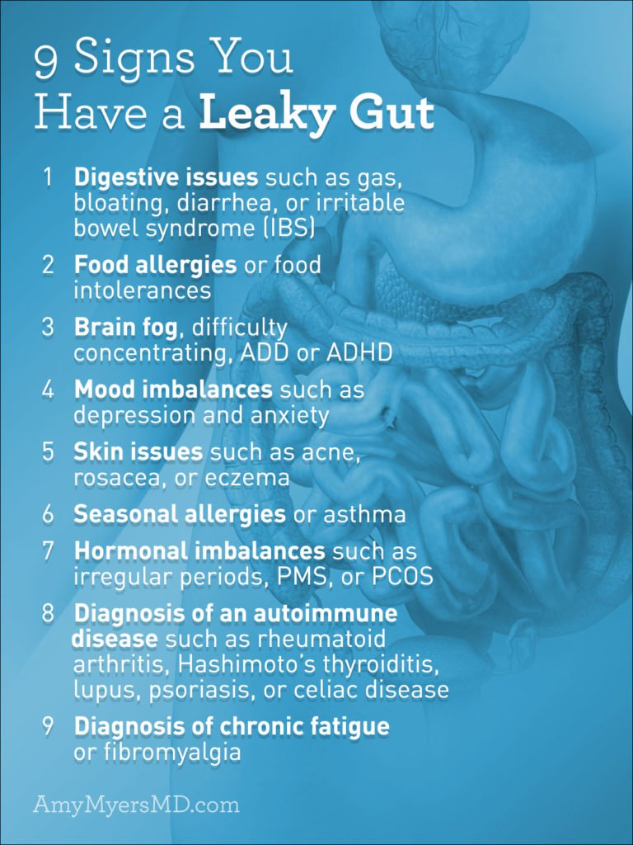
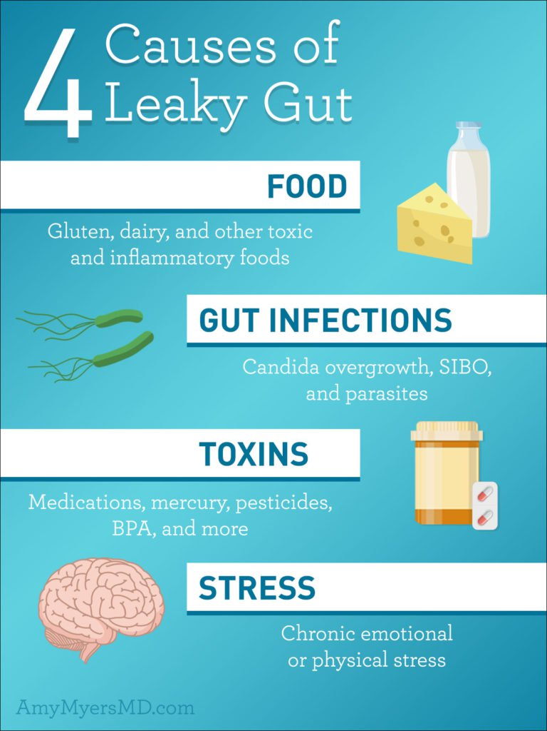
Leaky Gut Syndrome
9 Signs You Have a Leaky Gut
Dr. Amy Myers
https://www.amymyersmd.com/2019/02/9-signs-you-have-leaky-gut/
July 1st, 2019

Slide 13
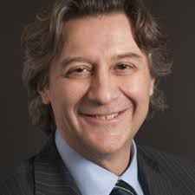
“The gut is not like Las Vegas; what happens in the gut does not stay in the gut.”
–Dr. Alessio Fasano
Division Chief, Pediatric Gastroenterology and Nutrition at Massachusetts General Hospital
Director, Center for Celiac Research and Treatment
Discovered the inflammatory protein, Zonulin

Slide 14
Dr Alessio Fasano’s Theory on Leaky Gut Syndrome
Classical paradigm of autoimmune pathogenesis
Genetic makeup
Environmental triggers
Loss of intestinal permeability function
Loss of this function is necessary for autoimmunity to develop
Celiac disease primarily validates this addition to the new paradigm proposed by Dr Fasano but also included Type 1 Diabetes, Rheumatoid Arthritis and Multiple Sclerosis.

Slide 15
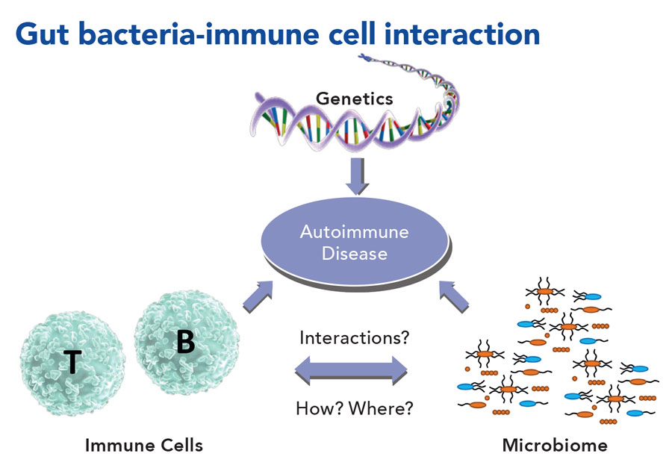
https://researchfeatures.com/2018/05/31/gut-bacteria-key-treating-autoimmune-disease/

Slide 16
What can you do NOW to start repairing your gut?

Slide 17
Lifestyle modifications
Dietary changes
Exercise/ Managing obesity
Supplementation
Stress management
Sleep
Environmental exposures
Antibiotic use

Slide 18
Dietary changes
“The nutritional value of food is partly derived from the composition and function of a consumer’s gut microbial composition. Vice versa, food significantly changes the composition of the gut microbiota and its genetic makeup (the gut microbiome).”
Remove/Reduce
Increase
Gluten
Dairy
Processed sugars
Soda
Alcohol
Animal proteins
Water
Fiber
Fruits
Legumes
Plant-based choices
Healthy fats

Slide 19
Nutrition for
Autoimmune Diseases
Tomorrow at 7am
Bloomington Room

Slide 20
Exercise and Obesity Management
Clinical studies show differences between the gut microbiome in obese patient and lean patients (rat studies)
I usually recommend 30-45 mins daily of cardiovascular/resistance training daily but this varies from patient to patient
Increases more diversity in gut microbiota
Higher good strains and lower bad strains
Leads to better absorption of micronutrients (B12, Folic acid etc), healthier gut-brain axis, decreased overall inflammatory processes etc.
Gut microbiota reduces oxidative stress and inflammatory response while improving metabolism and energy expenditure during intense exercise
Mach, N., & Fuster-Botella, D. (2017). Endurance exercise and gut microbiota: A review. Journal of sport and health science, 6(2), 179–197. doi:10.1016/j.jshs.2016.05.001

Slide 21
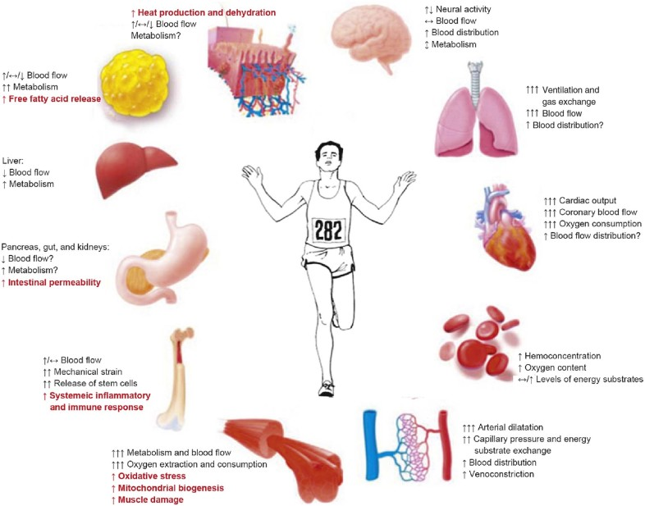
Exercise and Obesity Management
Mach, N., & Fuster-Botella, D. (2017). Endurance exercise and gut microbiota: A review. Journal of sport and health science, 6(2), 179–197. doi:10.1016/j.jshs.2016.05.001

Slide 22


Supplementation
Bio-individuality is key when considering supplements for the gut
Recommend speaking with your primary care provider/specialist prior to starting any new supplementation
Supplements are medications! Remember as much as they can help they can hurt with
Probiotic therapies are tricky but are important. Recommend choosing a product that is efficacious, has multiple strains and is catered to your needs. Many different brands are out there—BUYER BEWARE!
Prebiotics
Vitamins (D, B12, Folic acid, Magnesium, Curcumin, etc)

Slide 23
Stress management
Exercise
Imagery
Positive affirmations
Yoga/Deep breathing
Meditation
Journaling/coloring

Slide 24
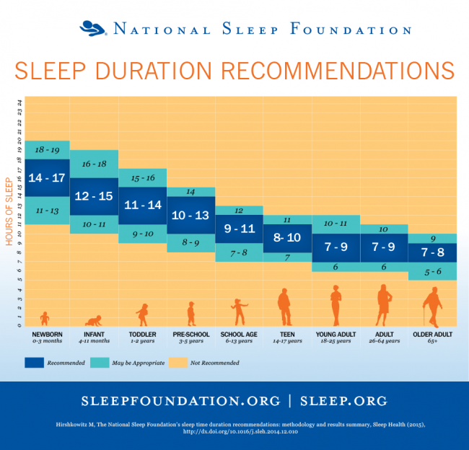
Sleep
Notes:
Study August 2018 questions less than 7 hours of sleep may promote transition to SLE

Slide 25
Sleep
Set a bedtime routine
Exercise in the mornings vs afternoon (this does vary though between patients)
Adjust temperature—Clinical studies show colder temperatures allow for more sound sleep
Avoid alcohol or caffeine at least 2 hours before bedtime
Turn off electronics—Blue light depletes melatonin
Use blue light blocking glasses with electronics
Journal/Imagery

Slide 26
Environmental exposures
Mercury
Cigarette smoking
Occupational hazards
Where do you live?
UV exposure

Slide 27
Antibiotic use
Unfortunately very common for overuse of antibiotics and/or not finishing out antibiotic as prescribed
Majority of time URI/Sinusitis (most common reasons for prescribing antibiotics) are 80-85% viral—this percentage range varies.
Obviously antibiotics needed at times (ex: cellulitis and/or positive culture from abscess, UTI culture)

Slide 28
What if you need an antibiotic?
Take and Complete as prescribed
Probiotics with antibiotic? After completing?
Rest
Hydration
Healthy diet—more prebiotics

Slide 29
Review
Autoimmune disease and the gut most definitely have a correlation
Certain factors can either positively or negatively effect the gut microbiome
Leaky gut syndrome is a real thing!
Classic paradigm for autoimmune disease to come into fruition: genetic makeup, environmental triggers and loss of intestinal permeability function
There are ways you can start healing your gut today!

Slide 30
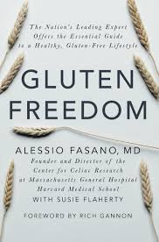
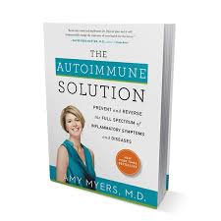
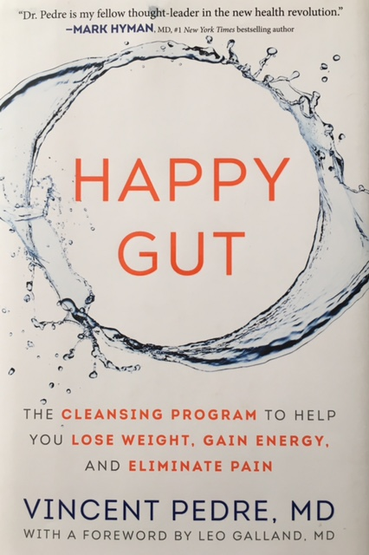

Books I recommend

Slide 31


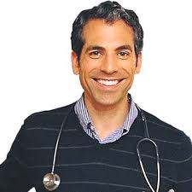

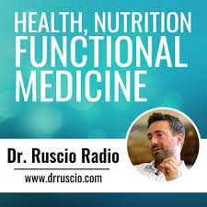

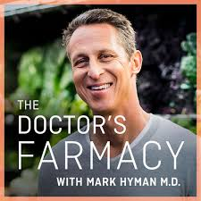
Social media and Podcasts
@amymyersmd
@drterrywahls
@drpedre
@guthealthmd
@drruscio
@theveggiemd
@drmarkhyman

Slide 32
“Having a healthy gut means more than just not being annoyed by a little bloating or heartburn. It is the central of your entire health. It is connected to everything that happens in your body”
–Dr Mark Hyman
Director, Cleveland Clinic Functional Medicine Department
Social media: @drmarkhyman

Slide 33



@followyourgutmdnp
@FYGMDNP
@healthandwellnessarnp
Email: info@followyourgutmdnp.com
www.followyourgutmdnp.com

