Slide 1
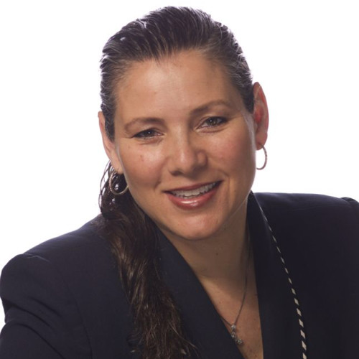
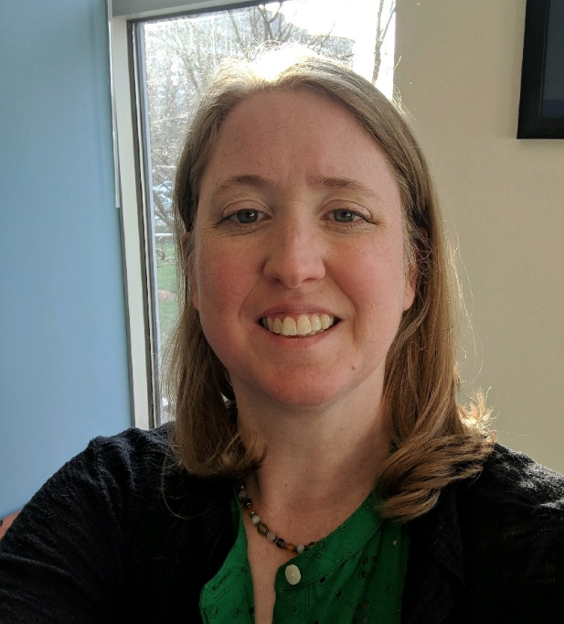
Monica Pedano
The Philadelphia Group Partner
Director of Development Email: mapedano@comcast.net
Tricha Shivas
The Myositis Association Director of Development and Strategic Partnerships Email: tricha@myositis.org
www.myositis.org

Slide 2
Why fundraise
Makes it possible for TMA to do the things you care about
Research
Support
Education
Awareness
Helps to raise awareness
Fundraising is a way to do more for something YOU believe in

Slide 3
Why don’t people fundraise

Slide 4
The Rule of 7
Notes:
The Rule of 7- in marketing, people need to see or hear something 7 times before they make a decision about it or say no
Why don’t people give? Because they’re not asked.

Slide 5
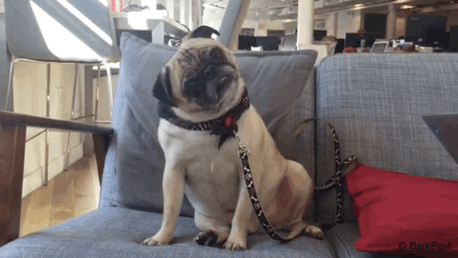
Why Don’t People Give?
Because they’re not asked!

Slide 6
Giving is GOOD and Good For You!
Notes:
Time magazine: Generous people tend to have better health than those who don’t give, and experience more happiness
(http://time.com/4857777/generosity-happiness-brain/)

Slide 7
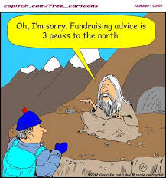
FUN HISTORY FACT: The oldest recorded fundraising request was written by St. Paul around A.D. 55- an appeal to a group of church members in Greece to help impoverished church members in Jerusalem.
Notes:
Time magazine: Generous people tend to have better health than those who don’t give, and experience more happiness
(http://time.com/4857777/generosity-happiness-brain/)

Slide 8
Fundraising Ideas!
Notes:
In 2014, Giving USA estimated that individual giving accounted for 72 percent of all contributions- $258.51 billion (National Center for Charitable Statistics)
Very important!!

Slide 9
Start Small
Amazon Smile
Amazon donates 0.5% of the price of your eligible AmazonSmile purchases to the charitable organization of your choice. AmazonSmile is the same Amazon you know. Same products, same prices, same service.
Facebook Birthday or Holiday Donation Request
To create a fundraiser for a charitable organization, click here or follow these steps:
Click Fundraisers in the left menu of your News Feed.
Click Raise Money.
Right now TMA comes up Myositis Association of America (this is in the process of being corrected)
Select a charitable organization, choose a cover photo and fill in the fundraiser details.
Click Create.

Slide 10
Holiday-Themed Events
Notes:
Community costume, holiday sweater, and pet dress up contests- pay $5-10 to enter and receive a prize for the best costume or sweater
In springtime, charge $5-10 to enter a gardening contest- winner has the tallest or best-looking plants

Slide 11
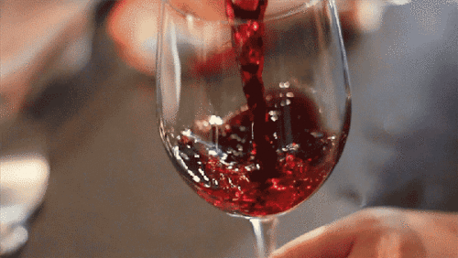
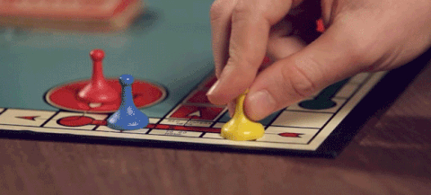
Painting, Board Game, & Wine Nights
Notes:
Host an event at your home or at a discounted/ free venue- charge people a fee for painting supplies
Wine nights- paint or watch a TV show for $5-10
Board game or trivia nights

Slide 12
What has worked for you?

Slide 13
Bowling
5th Annual
Local Sponsors
Teams
Local location
Give aways
Silent Auction
Results
$5,000 raised!

Slide 14
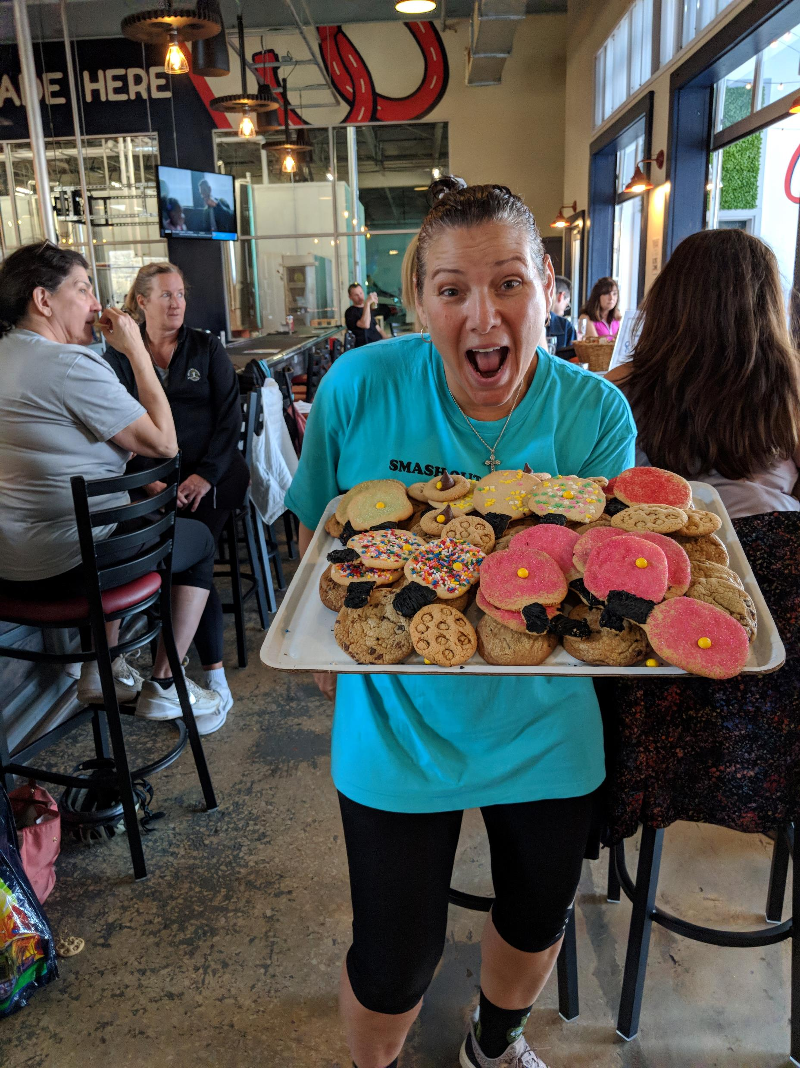
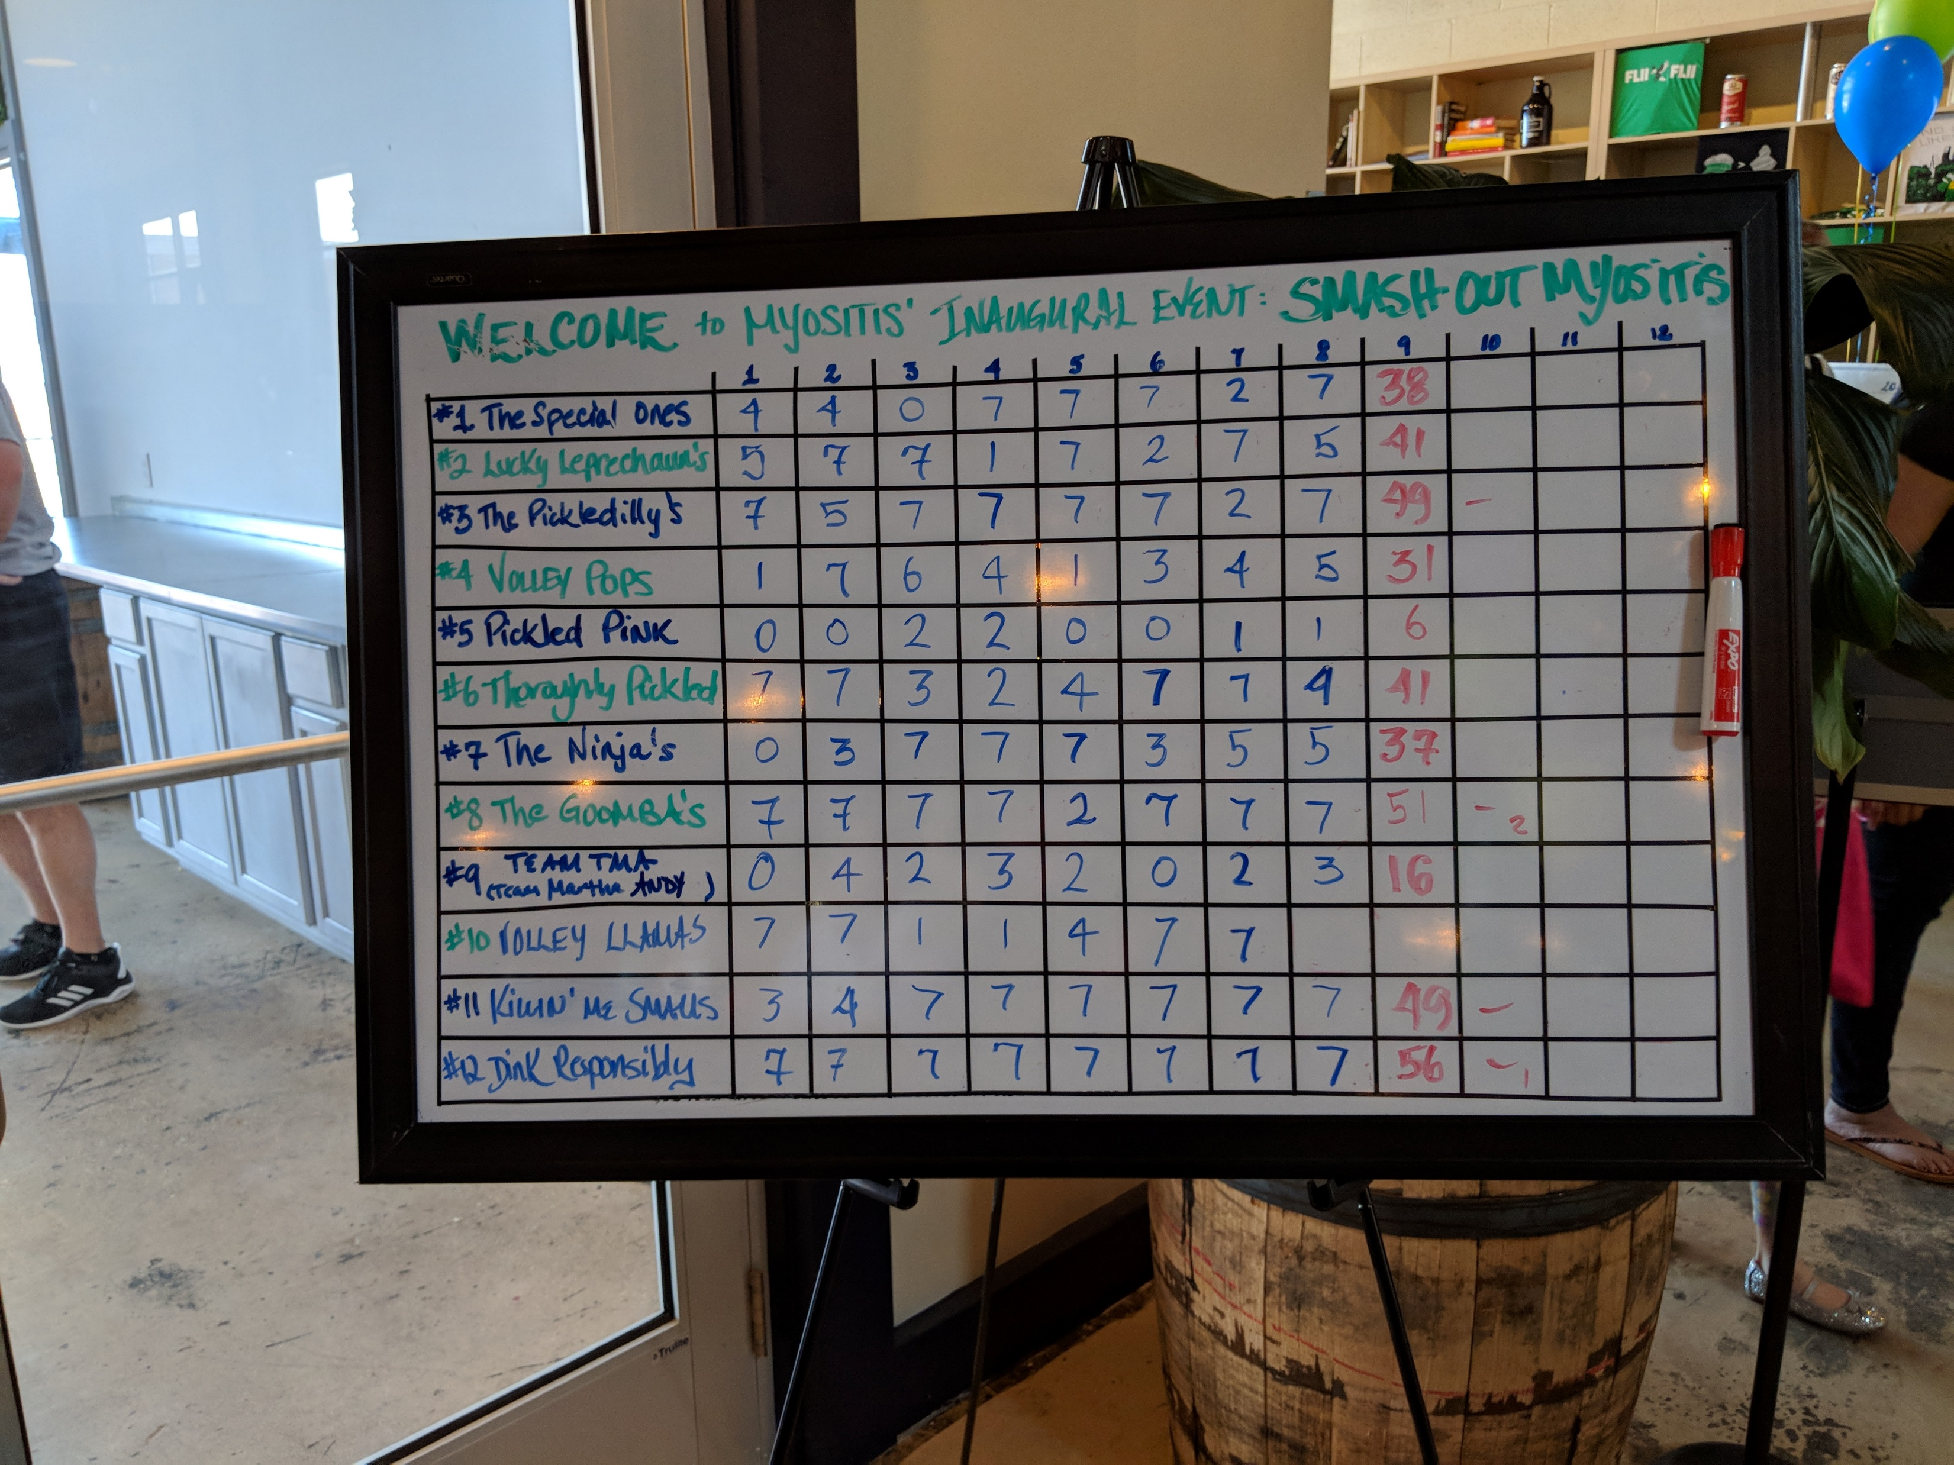
Pickleball
1st Year
Local Sponsors
Teams
Local pub location
Give aways
Results
50 attendees
$3,000 raised!

Slide 15
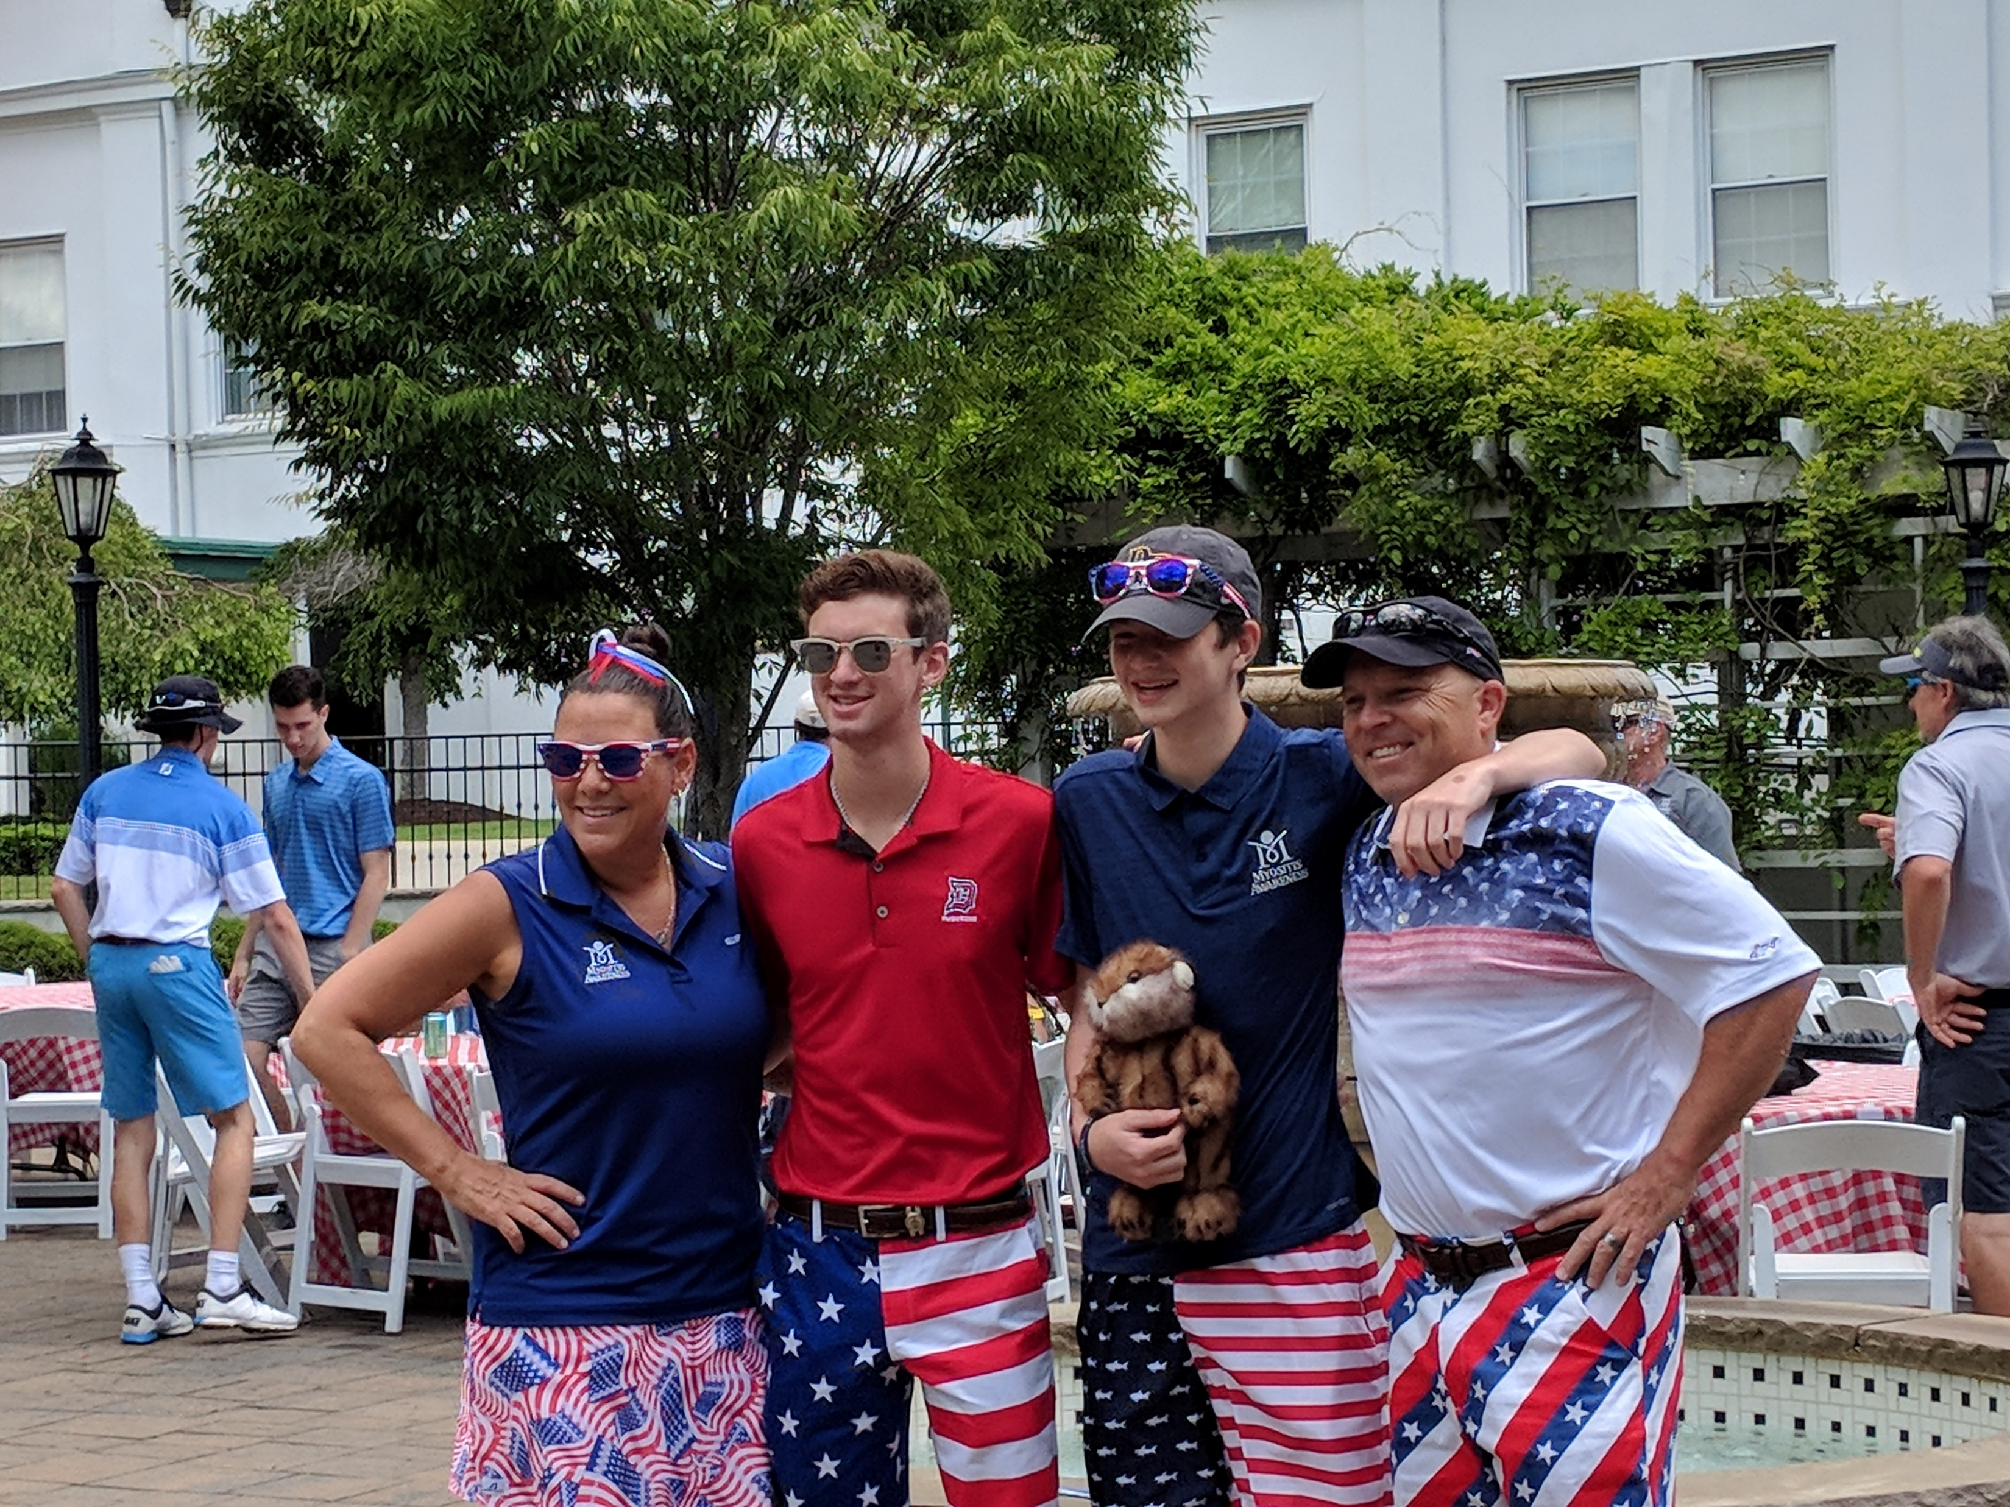
Golf Tournament
17 years
Dinner
Sponsors-Local and Corporate
Give Aways
Silent and Live Auction
Results
125 attendees
$56,847 raised

Slide 16
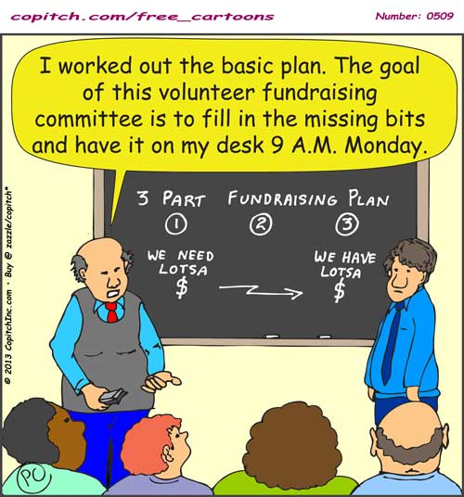
Planning
Create a Timeline
6-9 Months Out
Fundraising Committee
Build Budget
Goals
List Potential Sponsors/Donors
6 Months Out
Finalize Contracts
Send Save the date
Solicit Donors/Sponsors
Solicit Silent Auction Items
Begin Choosing Give-Aways
3 Months Out
Order Give-Aways
Continue Soliciting Donors/Sponsors
Continue Soliciting Silent Auction Items
Plan day of event
Identify Volunteers
1 Month Out
Prepare Onsite Registration List
Finalize Sponsor Thank Yous
Send confirmation to attendees
Create Bid Sheets
Continue soliciting donors/sponsors
Prepare Signage
7 Days Out
Pack for onsite (office supplies
Organize signage and auction items
Confirm registration information
Notes:
Get in touch with local vendors to see if they will sponsor an event for free or for a discounted rate
Don’t forget to spread the word to community members- call your mayor’s office and see if they would be interested in attending any of your events, too!

Slide 17
Create Fundraiser
What are you passionate about?
What is popular/hot/ has your friends really excited right now?
Where could you hold your event?
Who could you invite?
Write down at least 10 names
What local companies could you go to for silent auction items
Write down at least 3 companies

Slide 18
Monica Pedano
The Philadelphia Group Partner
Director of Development Email: mapedano@comcast.net
Tricha Shivas
The Myositis Association Director of Development and Strategic Partnerships Email: tricha@myositis.org
www.myositis.org

