Slide 1
Dermatomyositis
Floranne Ernste, MD
The Myositis Association Annual Conference
Bloomington, MN
September 2019

Slide 2
Disclosures
Octapharma: clinical trial support
Genentech: clinical trial support
Off-label use:
Almost all medications discussed here for treatment are not FDA-approved.

Slide 3
Learning Objectives
Gain an understanding of the definition of dermatomyositis and how we diagnose it
Appreciate how different groups of people are affected
Recognize varied treatment options
Discuss short and long term prognosis

Slide 4
Dermatomyositis: what is it?
An autoimmune disease that causes inflammation in your skin and muscle tissue
Take a step back: what is autoimmune disease?
When the immune system goes awry.
How? Your immune system loses “tolerance” to your body’s tissues and certain cells such as your “B cells” and “T cells” and other cells start fighting against your tissues by mounting an inflammatory response.

Slide 5
How it may all start...
Trigger(s): UV light exposure, certain infections, cancer
Abnormal Immune System Response (your genes inherited
determines your immune response)
Organ/Tissue Damage: i.e. skin, muscle, lung, heart, joints
Clinically manifests as rashes, muscle weakness, joint pain/swelling

Slide 6
Dermatomyositis: what is it?
3 main types of DM:
Amyopathic dermatomyositis
Rashes without muscle involvement for 6 mos. or longer
Hypomyopathic dermatmyositis
Rashes with minor abnormalities in muscle testing, but not clinically weak
Dermatomyositis
Rashes and muscle weakness
Juvenile Dermatomyositis
Dermatomyositis in patients who are diagnosed at 16 years or younger

Slide 7
How Common is IT?
Not very common
Olmsted County Data, population based study
Incidence of 9.63 per million; Prevalence of 21.42 per 100,000
Peak age is 45 to 65 years for adults; 5 to 15 years for juvenile DM
Female-to-male ratio is 2-3:1
In US, African Americans may be more commonly affected than Caucasians in a ratio of 3-4:1
Bendewald MJ, Wetter DA, et al. Arch Dermatol. 2010

Slide 8
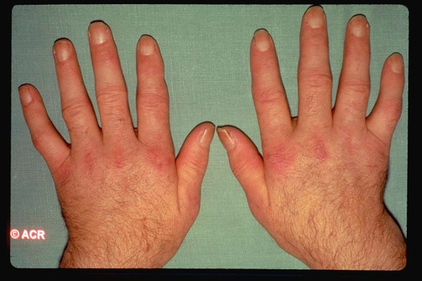
Skin manifestations of dermatomyositis
Heliotrope rash: this is a lilac or purple rash affecting the eyelids mainly, but also above and below the eyes
Gottron’s papules: purple flat or raised bumps over knuckles, fingers, elbows, knees

Slide 9
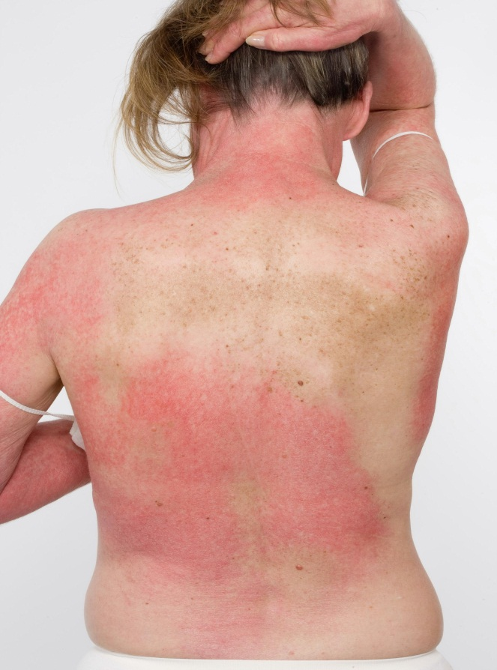
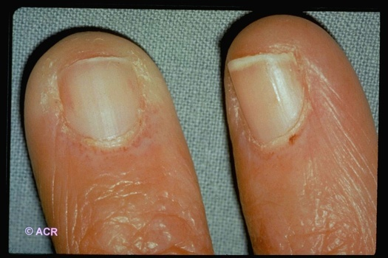
Skin manifestations of dermatomyositis
V-sign: violaceous rash over neck and chest
Shawl-sign: violaceous rash over shoulders, upper arms
Nailfold abnormalities: cuticule overgrowth, dilated capillary loops

Slide 10
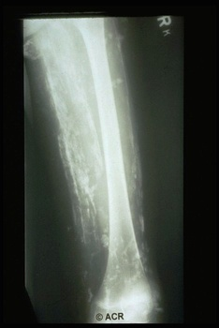
Skin manifestations of dermatomyositis
Calcinosis: hard skin lumps under skin, subcutaneous tissues, intramuscular tissue: more common in juvenile DM and a small percentage of adult DM

Slide 11
Muscle manifestations of dermatomyositis
Weakness of proximal muscles (neck/upper arms/thighs/hips) occurs gradually over several months.
Can start with difficulty getting in/out of vehicles, climbing stairs, raising your arms overhead with a heavy object in hand, lifting a gallon of milk, carrying your groceries, getting up off the toilet, can’t get up quickly after sitting on floor without help
Might feel a soreness in your muscles, rarely severe pain
Might notice less muscle tone/bulk, sometimes progresses to “atrophy”
You might start to notice difficulty swallowing bulky/dry foods, also known as “dysphagia”

Slide 12
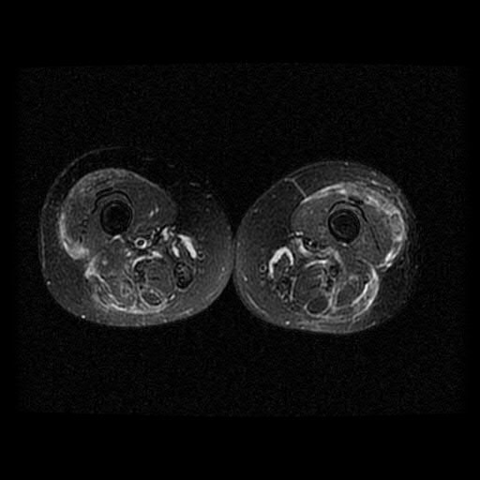
What is happening at muscle tissue level?
T2 weighted MRI of thighs

Slide 13
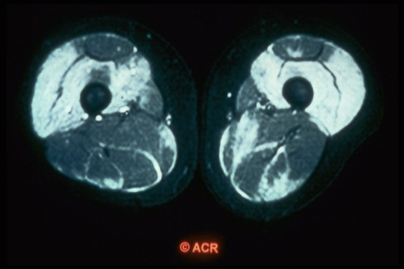

Slide 14
How do physicians diagnose dermatomyositis?
Physical exam: are there DM rashes present, muscle weakness?
Lab tests: Do you have elevated muscle enzymes such as creatine kinase, aldolase, AST (SGOT), ALT (SGPT), LDH
Electromyogram (EMG)
MRI of muscles (sometimes used)
Muscle biopsy

Slide 15
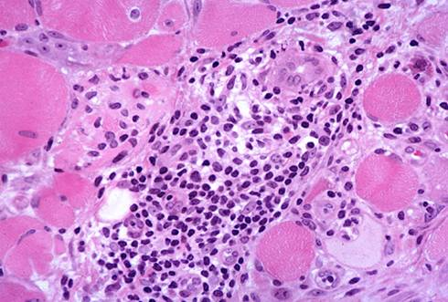
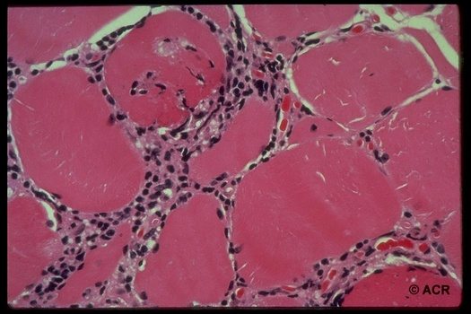
What do these test results look like?
Muscle biopsy
Perivascular infiltrate (inflammation) around muscle fascicle
Perifascicular atrophy*
Muscle microvasculature often involved
Necrotic and regenerating fibers seen
http://www.neuro.wustl.edu/neuromuscular/pathol/inflammation.html

Slide 16
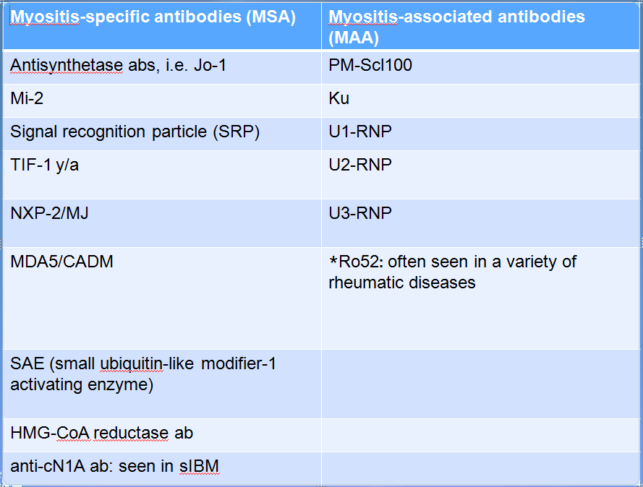

Slide 17
Learning Objectives
Gain an understanding of the definition of dermatomyositis and how we diagnose it
Appreciate how different groups of people are affected
Recognize varied treatment options
Discuss short and long-term prognosis

Slide 18
Muscle antibodies in dermatomyositis
In myositis patients, approximately 60-70% of adults and children have a myositis autoantibody
There are myositis specific antibodies and myositis associated antibodies
MSA are usually specific for PM/DM
MSA are usually mutually exclusive (not always in my experience).
Definition of MAA is broad: found in PM/DM, yet also found in other autoimmune rheumatic diseases.
May be part of an overlap syndrome such as SLE and scleroderma.
Can co-exist with other MSAs

Slide 19
How does DM affect different people? Patient 1
32 year old Hispanic male with itchy red rashes over face, neck,upper chest, arms, hands, fingernails, hips and thighs for 2 years.
Presented with significant hand arthritis with swelling of knuckles and wrists
Minimal muscle involvement, no significant weakness. Normal CK and other muscle enzymes.
Work-up revealed a positive MDA-5 (a myositis antibody)

Slide 20
Hand rashes

Slide 21
MDA-5 positive antibody
Inflammatory arthritis may be severe, often appears “rheumatoid-like.”
Mild myositis.
Unique cutaneous characteristics
Mucocutaneous ulcerations
Tender palmar/digital papules, i.e. “inverse Gottron’s papules”
Fiorentino D, Chung L, Zwerner J. J Am Acad Dermatol. 2011;62:25-34.

Slide 22
MDA-5 antibody
First described 2009 in Japanese/South Korean cohorts of CADM, “clinically amyopathic dermatomyositis”
Targets melanoma differentiation association gene 5 protein, a cytoplasmic, viral RNA-specific helicase involved in innate immune response
Functions as an “anti-viral” sensor
Induces type I interferon responses
Can infection trigger this?
Associated with rapidly progressing ILD: 50% in Japanese cohort and 22% in USA
Sato S, Hoshino K, Satoh T, et al. Arthritis Rheum 2009;60:2193
Sato S, Hirakata M, Kuwana M, et al. Arthritis Rheum 2005;52:1571-76.
Fiorentino D, Chung L, Zwerner J, et al. J Am Acad Dermatol. 2011;65:25-34.

Slide 23
How does DM affect different people? Patient 2
65 yo white male with fevers and weight loss for 6 months develops weakness and difficulty with swallowing.
His work-up was notable for high muscle enzymes, abnormal EMG. A muscle biopsy revealed dermatomyositis.
Additional work-up included a PET scan and then an upper endoscopy (EGD).

Slide 24
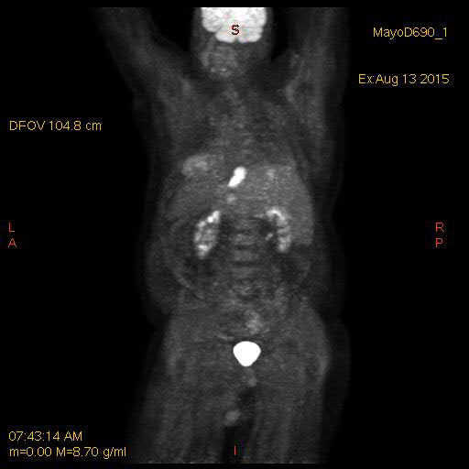

Slide 25
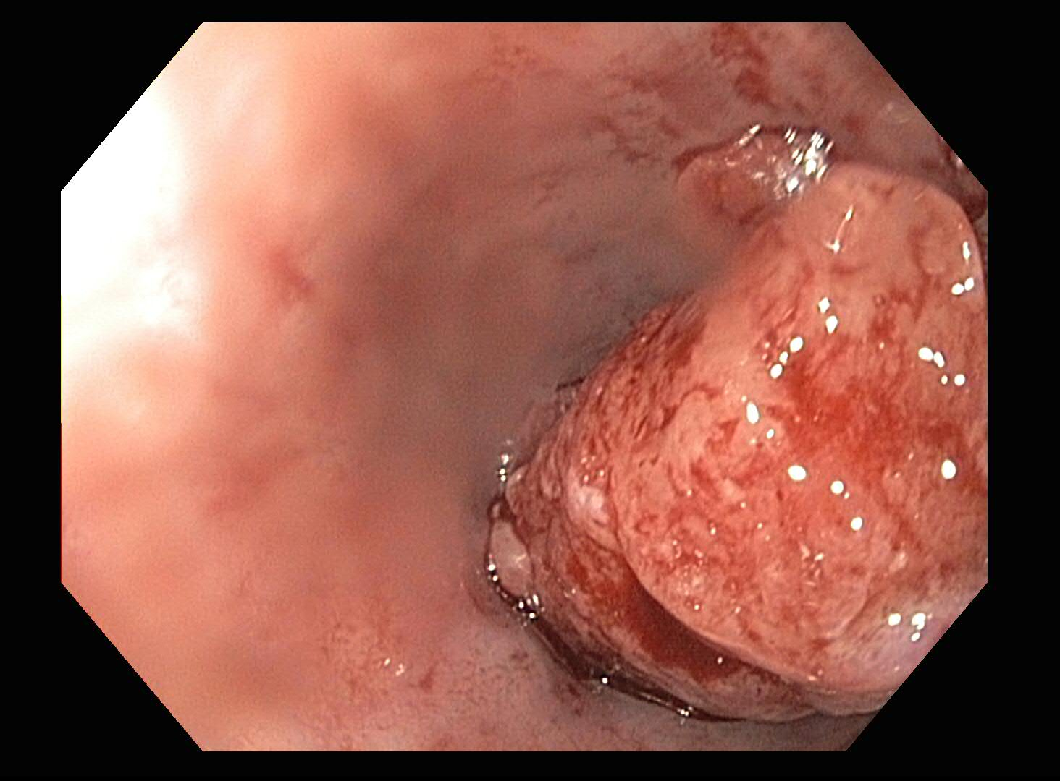

Slide 26
Cancer and Dermatomyositis
Cancer and myositis first reported in 1916 with DM and stomach cancer.
25% of DM patients over age 50 may have cancer.
Cancer risk is greater in first 3 years of diagnosis (really highest in 1st year of dx).
Patients will usually have features of unusual weight loss, maybe fevers, rapid decline in physical function
Some cancers: Lung, breast, ovarian, colon, bladder
Stertz G. Polymyositis. Berl Klin Wochenschr. 1916;53:489.
Gerami P, Schope J, McDonald L, et al. J Am Acad Dermatol. 2006;54(4):597-613.
Callen JP. Dermatomyositis and malignancy. Clin Rheum Dis. 1982;8:369-81.
Oldroyd et al. Clinical Medicine 2017.

Slide 27
How are different people affected? Patient 3.
57 yo white woman presented to clinic with rashes over face, chest, hands inflammatory arthritis involving small joints of hands and dyspnea
Skin biopsy revealed “vacuolar interface dermatitis”
Chest x-ray showed bi-basilar infiltrates
Within 2 weeks of presentation, admitted to ICU with acute respiratory failure
Intubated, started on treatment for myositis and lung disease, and after 2 weeks hospitalization, died

Slide 28
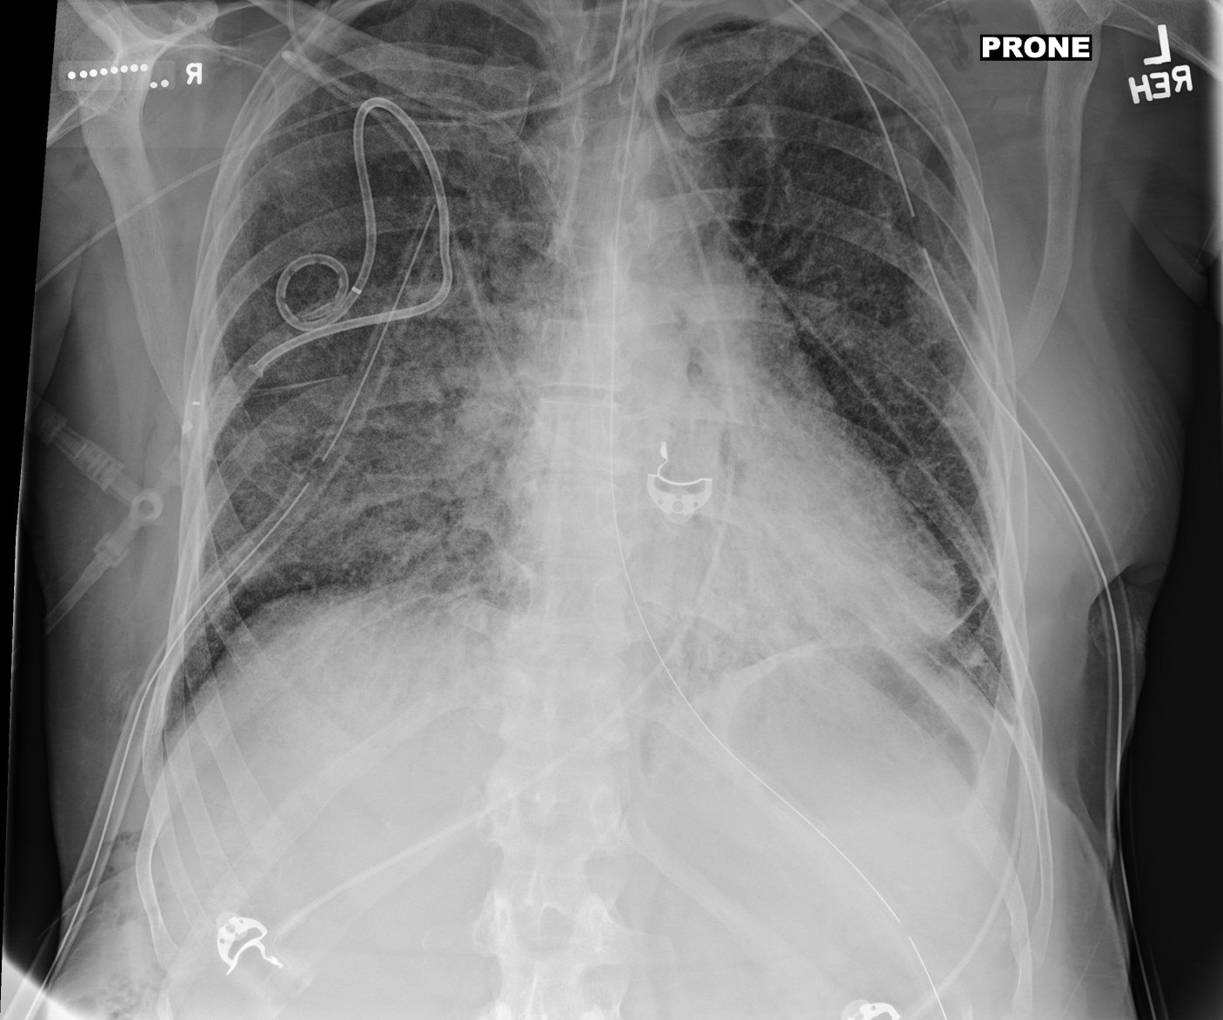

Slide 29
Dermatomyositis and pulmonary manifestations
At least 30% myositis patients have interstitial lung disease (ILD)
This may manifest as fatigue and dry cough, shortness of breath that gets worse with minimal activity
Patients also may have respiratory muscle weakness
Anti-Jo-1 antibody found in 50-75% myositis pts with ILD
Strong association of ILD with all anti-synthetase antibodies in myositis.
No correlation between extent and severity of muscle or skin disease and development of ILD.
Secondary pulmonary hypertension can occur due to chronic pulmonary vasoconstriction from hypoxemia.

Slide 30
Dermatomyositis and pulmonary manifestations
Onset of ILD variable: most of the time occurs at the same time of myositis diagnosis.
Course ranges from acute and fulminant ILD, chronic progressive, or asymptomatic (subclinical).
Pulmonary function testing reveals restrictive physiology (i.e. FVC ≤ 80%).
ILD subtype classified as non-specific interstitial pneumonia (NSIP)—most common, cryptogenic organizing pneumonia (COP), and usual interstitial pneumonia (UIP).
Chest imaging shows basilar abnormalities: reticular and ground-glass opacities with loss of lung volume, traction bronchiectasis
ILD leads to poor functional status in 30% of patients.

Slide 31
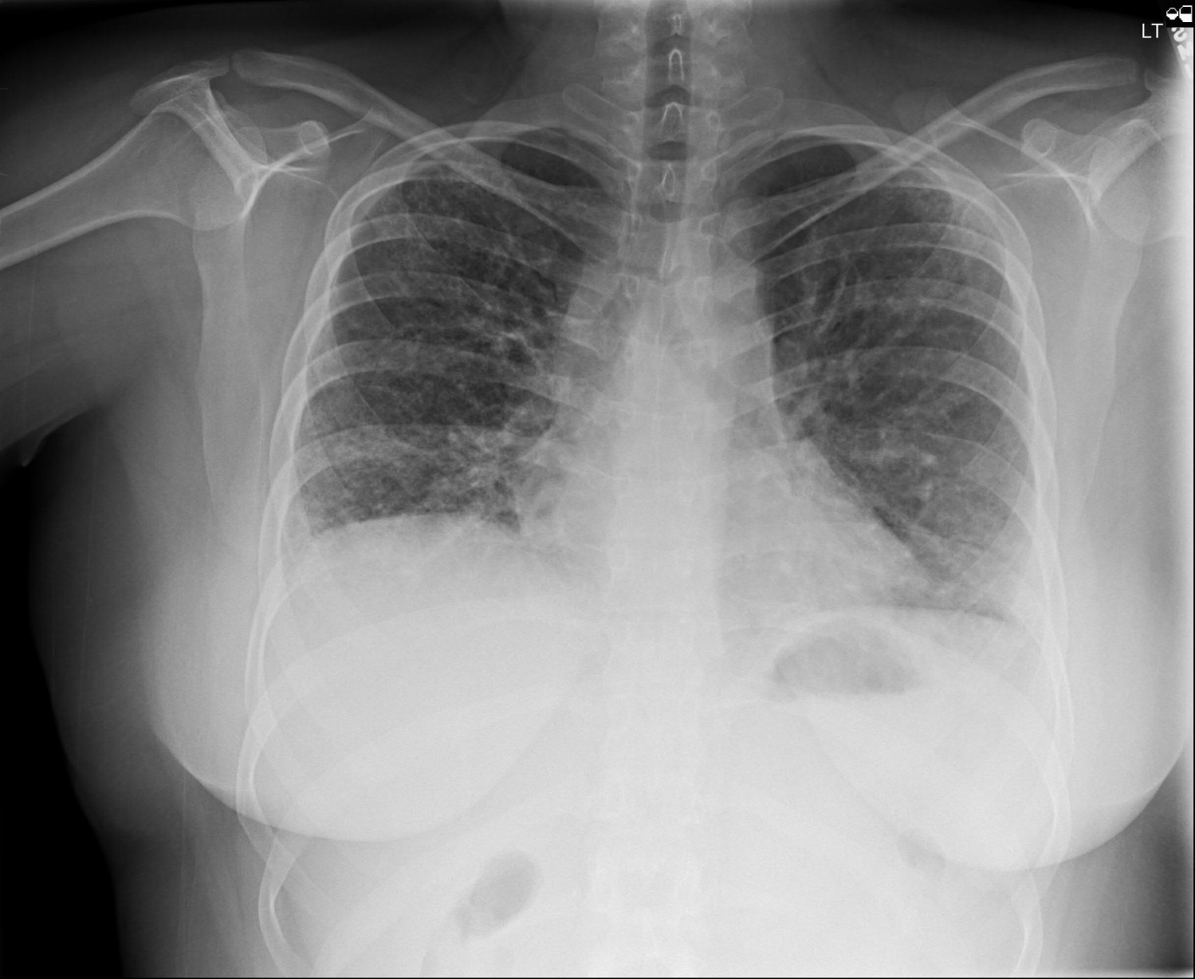

Slide 32
How are different people affected? Patient 4
7th grade girl with JDM since age 7 presents with painful subq calcinosis of posterior thighs, left forearm, antecubital fossa (elbow region), buttocks.
Hurts to sit down in class.
Past treatments: prednisone, methylprednisolone, IVIG, methotrexate, CellCept, rituximab, cyclosporine, and hydroxychloroquine.
Exam notable for indurated skin of bilateral thighs, hardened, painful.
Underwent several debulking surgeries to remove calcium deposits.

Slide 33
How are different people affected? Patient 4
T2 Weighted Coronal Image
CT Cross section views
Notes:
MRI of the thighs including gadolinium-enhanced images. There is diffuse edema and fluid tracking in the myofacial planes of both thighs. There are sheets of calcification surrounding the muscles in the thighs most prominently anteriorly around the rectus femoris muscles and posteriorly around the semimembranosus, tendinosus and biceps femoris muscles. There is relative sparing of the vastus muscles groups. There is mild edema and fluid around the neurovascular bundles bilaterally. There is moderate diffuse atrophy of all the the thigh muscles and increased subcutaneous fat. Moderate amount of subcutaneous fat with mild edema.

Slide 34
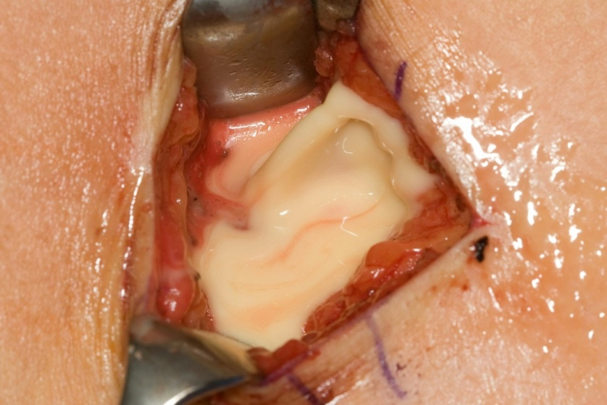
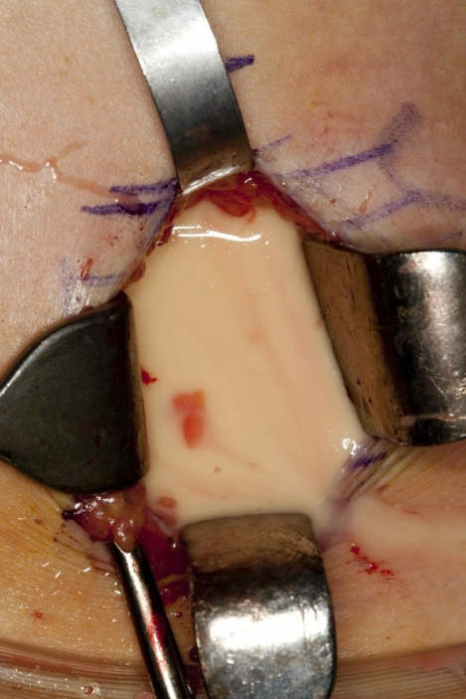
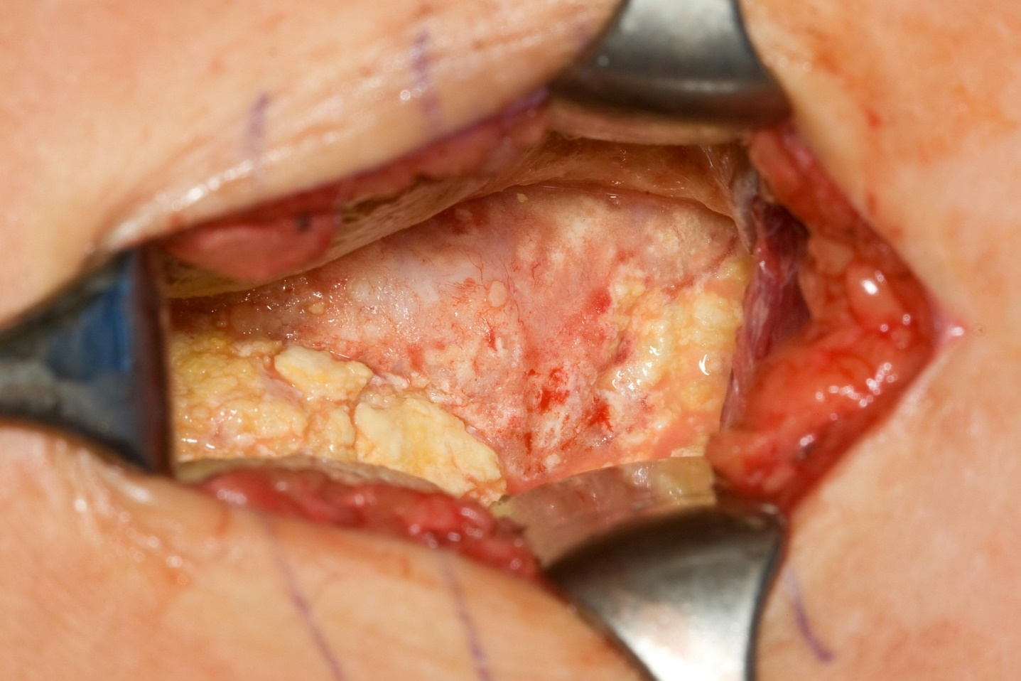

Slide 35
How are different people affected? Patient 4
Treated with ultrasound and CT-guided aspirations and resection of posterior calcific masses.
Developed complications (5-10 years’ worth):
Chronic, infected fluid collections with sinus drainage
Numerous hospitalizations with multiple aspirations, resections and antibiotics’ courses
Eventually went off all medications for several years, then recurrence in 20s of severe calcinosis in a leg, now back on therapy

Slide 36
Calcinosis and dermatomyositis
Calciniosis occurs from deposition of hydroxyapatite calcium phosphate in the soft tissues.
Calcinosis is more frequent in pediatric age groups, such as JDM, occurring 30-70% of time (associated with aggressive disease and delay in dx), and in adults about 15-20%.
Calcinosis believed to result from intracellular accumulation of calcium secondary to a disruption in cell membranes from trauma/chronic inflammation.
Multiple patterns include superficial papules or nodules, deeper nodules or tumors in the dermis or subcutaneous tissue, or diffuse deposits along the myofascial planes which may form an extensive exoskeleton.

Slide 37
Dermatomyositis: how does it affect non-white groups?
Clinical characteristics: rashes may be subtle and not classic in appearance.
Higher risk of calcinosis in non-white children with JDM
CK is often higher in African and African-American populations than in white groups
Organ involvement may be more severe in African, African-American and Hispanic populations.
For example, interstitial lung disease often is more severe and refractory to standard treatment than in white patients
Highest rates of hospitalization in non-white DM patients
Mortality rates may be higher in women of non-white groups
Pinal-Fernandez, Iago et al. 2017. Rheumatology, 56(6); 999-1007.
Hochberg, MC, et al. 1983. Arthritis & Rheumatism, 26 (12); 1465-1471.
Kwa, M., et al. 2017. Arthritis Care & Research, 69(9);1391-1399.
Hoeltzel, MF, et al. 2012. Pediatric Rheumatology, 10 (Suppl 1).

Slide 38
Learning Objectives
Gain an understanding of the definition of dermatomyositis and how we diagnose it
Appreciate how different groups of people are affected
Recognize varied treatment options
Discuss short and long-term prognosis

Slide 39
Treatment of DM
Should involve a multi-specialty approach with therapy targeted to skin and/or muscle, physical therapy, occupational therapy.
There is a lack of large randomized-controlled trials evaluating efficacy of treatments used by experts.
Management of extra-muscular organ involvement such as lungs, cardiac is important.
Involvement of specialists in multiple medical or surgical disciplines: neurologists, rheumatologists, dermatologists, physical medicine, pulmonologists, cardiologists, general surgeons, orthopedic surgeons is important.

Slide 40
My approach to treatment
First line: Glucocorticoids (topical +/- oral)+ a steroid sparing agent:
Azathioprine (2 mg/kg)
Methotrexate (if no severe ILD)
Mycophenolate mofetil (standard dosing or 1500 mg twice daily).
Glucocorticoid dosing: pulse intravenous daily (3 days) for severe disease (i.e. severe weakness, dysphagia, progressive ILD).
Oral glucocorticoids with taper: 1 mg/kg for 4 weeks, taper by 1-2.5-5 mg every 2-4 weeks pending treatment response and tolerability.
Oral taper may slow or stop ~5-10 mg daily.

Slide 41
My approach to treatment
Anti-malarials may help skin disease such as hydroxychloroquine, sometimes not adequate alone, and not effective for muscle disease
Intravenous immunoglobulin (IVIG) may be used initially or as “bridge therapy” until maintenance immunosuppressives kick in.
IVIG 1-2 gram/kg of ideal body weight.
Some patients do not tolerate due to headaches, aseptic meningitis
Lower doses may be used.

Slide 42
My approach to treatment for severe ILD or other severe organ disease
IV or oral cyclophosphamide.
Data exists for improvement in Jo-1+ pts with ILD in small series of patients.
Cyclosporine A or Tacrolimus
Data exists in several small series of patients.
I have more experience with tacrolimus, twice daily dosing targeting a trough level of 5-20 ng/mL.
Monitor for hypertension, renal insufficiency, electrolyte derangements, tremor, peeling rashes.
Marie I, Josse S, Hatron PY, et al. Arthritis Care Res (Hoboken); 2013; 65:800-8.
Oddis CV, Sciurba FC, Strazl TE. Lancet. 1999;353:1762-63.
Wilkes MR, Sereika SM, Fertig N, et al. Arth Rheum. 2005;52:2439-2446

Slide 43
My approach to treatment for refractory myositis disease
Rituximab 1000 mg X 2 and repeat every 6 months; doses may be reduced in subsequent infusions
“RIM” trial of refractory juvenile/adult IIM, didn’t meet endpoints, but 83% met definition of improvement.
Refractory IIM patients with strongly positive autoantibodies (i.e. Jo-1) may be more responsive to rituximab (shorter time to improvement).
Interestingly, autoantibody titers decrease after rituximab suggesting a correlation with clinical response.
Oddis CV, Reed AM, Aggarwal R, et al. Arthritis Rheum.2013;65:312-24.
Aggarwal R, Bandos A, Reed AM, et al. Arthritis Rheumatol. 2014;66:740-9

Slide 44
What about calcinosis?
Numerous therapies tried with varying or no success:
Calcium channel blockers (diltiazem, amlodipine)
Bisphosphonates (alendronate)
Colchicine
IVIG
Methotrexate
Steroids
Biologic medications
*Topical sodium thiosulfate (useful for small calcific deposits under skin)
IV sodium thiosulfate (experimental)
Surgical resection/debulking

Slide 45
Newer treatments on horizon
IL-6 blockers
JAK inhibitors
Tofacitinib-recalcitrant DM
Abatacept
Lenabasum for skin disease
Sifalimumab
Anti-IFN alpha monoclonal ab
Tjarnlund A, Tang Q, Wick C et al. Ann Rheum Dis 2018;77:55-62

Slide 46
Physical therapy
Beneficial.
Effective on muscle performance, aerobic capacity and overall health.
Exercise may downregulate genes related to inflammation.
“If you don’t use it, you lose it.”
I try to engage patients to meet with physical therapist early for stretching exercises and submaximal strengthening exercises.
Good to prevent muscle damage leading to muscle atrophy, preserve joint range of motion.
Safety assessment may be required if falls are common and gait aids may be appropriate.
Munters Alemo L, Alexanderson et al. Curr Rheumatol Rep 2014;16 (7) 429

Slide 47
How is treatment response assessed? Core set measures developed.
Manual muscle strength testing (MMT)
Functional assessment – HAQ,CHAQ, FI
Global assessment
Physician
Patient/parent
Assessment of extra-muscular activity - MDAAT/MITAX or CMAS
Muscle enzymes - CK, aldolase, AST, ALT, LDH
Miller FW, Rider LG, Chung YL, et al. Rheumatology 2001;40:1262-73

Slide 48
My assessment of treatment response
Improvement or stabilization of muscle strength on physical exam.
Normalization of muscle enzymes: CPK, aldolase, LDH, AST, ALT.
I may check serial EMGs or muscle MRIs.
Improvement of other organ systems such as pulmonary and cardiac:
Serial PFTs
Serial chest imaging, preferably high resolution CT imaging.
Echocardiogram to screen for heart failure and pulmonary hypertension

Slide 49
Management of side effects and other concerns.
If active skin disease, the sun is no longer your friend.
Concern for UV radiation exposure may trigger or exacerbate skin disease; increase risk for skin cancer
Certain medications may enhance sunlight effect
Wear protective clothing (wide brimmed hat, long sleeves if appropriate)
Some patients buy UV photo-protective clothes, expensive
Wear sunscreen and reapply at least every 2 hours even on a cloudy day (SPF of 50 or higher)

Slide 50
Management of side effects and other concerns.
Screen for latent TB, HIV, chronic hepatitis B and C infections.
Check vaccination status including influenza, Shingrix and pneumococcal vaccines (PCV-13, PPSV-23).
Screen for diabetes, hyperlipidemia, hypertension, osteoporosis at baseline.
Use calcium/vitamin D when on steroids.
If osteoporosis develops, use anti-resporptive agent or other agent if appropriate.

Slide 51
Management of side effects and other concerns.
Counsel women of childbearing age and recommend birth control as appropriate.
Consider using pneumocystis prophylaxis for all patients with moderate/severe ILD on immunosuppressives (expert opinion).
Treat infectious complications, i.e. herpes zoster, influenza, pneumonias, as they arise and stop or reduce immunosuppressives for short term, if needed.

Slide 52
Management of side effects and other concerns
If reflux is present, treat.
Emphasize lifestyle changes
Elevation of head of bed, avoidance of alcohol and smoking, no large meals late at night, etc…
Treatment with proton pump inhibitors/H2 blockers.
Uncontrolled GERD may affect underlying interstitial lung disease, i.e. “silent microaspiration,” may trigger cough and exacerbate underlying pulmonary disease.
If swallowing difficulty is present, arrange for swallowing studies and visit with a swallowing therapist

Slide 53
Management of side effects and other concerns
*Steroid myopathy
Thin skin and poor wound healing
Hypertension
High cholesterol
Significant weight gain
Some patients develop obstructive sleep apnea leading to fatigue
Your body changes: redistribution of fat

Slide 54
Learning Objectives
Gain an understanding of the definition of dermatomyositis and how we diagnose it
Appreciate how different groups of people are affected
Recognize varied treatment options
Discuss short and long-term prognosis

Slide 55
Short-term prognosis (1-5 years): what I have observed
Depends on severity of disease and number of organs involved.
Patients with greatest muscle reserve at baseline and who exercise tend to regain muscle strength faster
That being said, I generally tell patients it will take up to a year and longer to return back to baseline muscle strength
Some patients never regain muscle strength (older in age, have other organ systems involved such as lung, or experienced severe infections or cancer)
With treatment and compliance, you will get better.
But there may be periods where flares can occur

Slide 56
Long-term prognosis (after 5 years)
Generally, as long as you stay on treatment and you respond well, your life span is not generally shortened
However, if you have major and severe organ involvement such as lung or cardiac, your life span may be shortened
Your rheumatologist/neurologist will determine if medications need to be reduced/tapered, pending your response
I tend to keep patients on their medications with intent for lifelong therapy (most of the time, DM has a polyphasic course)
*Prognosis may be guarded if you have cancer-associated myositis

Slide 57
What do the studies show for prognosis?
Historical studies of IIM patients with ILD, 5 year survival rate 60% (similar to idiopathic pulmonary fibrosis).
The lower the %FVC at baseline, the likelihood of lung deterioration over long-term.
The more acute the lung disease, the more likely lung function deteriorates
UIP pattern of pneumonia associated with lower survival
Yet, recent studies suggest survival rate has improved.
One study in patients with ILD, after median of 53 mos. follow-up, 1 year survival (94.4%), 3 year survival (90.4%), 5 year survival 86.5%.
Relapses are common, usually seen if patients treated only with glucocorticoids
Douglas WW, Tazelaar HD, Hartman TE, et al. Am J Respir Crit Care Med. 2001;164:1182-5
Marie I, Hachulla E, Cherin P, et al. Arthritis Rheum. 2002;47:614-22.
Marie I, Josse S, Hatron PY, et. Al. Arthritis Care & Research.2013;800-808
Fujisawa T, Hozumi H, Kono M, et al. Respiratory Investigation.2017;130-137.

Slide 58
What do studies show for long-term prognosis?
Study in Italy looked at 91 patients (43 with PM and 48 with DM)
24% of the 91 patients died after a median follow up of 8.7 years
Predictors for higher mortality:
Males [HR 2.4], heart involvement [1.8], interstitial lung disease [HR 2.3], and arthritis [HR 1.8]
Higher mortality documented for patients treated with steroids [HR 2.3] or immunosuppressants [HR 2.1] when compared to patients treated with immunoglobulins
Danieli, MG, Gambini S, Pettinari L, et al.Impact of treatment on survival in polymyositis and dermatomyositis. A single-centre long-term follow-up study.
Autoimmunity Reviews 13 (2014);1048-54.

Slide 59
What do studies show for prognosis overall?
Good news: in this Italian population, the overall survival rate for DM patients were 95% at 5 years and 92% at 10 years
Higher mortality for cancer-associated myositis
5 year survival rate of 69.2% (CI 37.3-87.2)
10 year survival rate of 60.6% (CI 29.4-81.4)
Take home: There is an overall improvement in survival over several decades due to earlier diagnosis and treatment
Danieli, MG, Gambini S, Pettinari L, et al.Impact of treatment on survival in polymyositis and dermatomyositis.
A single-centre long-term follow-up study. Autoimmunity Reviews 13 (2014);1048-54.

Slide 60
Summary
Dermatomyositis is an autoimmune inflammatory muscle disease mainly characterized by skin rashes and muscle weakness
DM is heterogenous in presentation and affects people differently
Treatment should involve a multi-specialty approach with involvement of multiple specialists
Short and long term prognosis is affected by treatment response, number of organ systems involved, presence of cancer and severity of disease.

Slide 61
Questions? Thank you for your time and attention!

