Slide 1


Slide 2
Blood flow-restricted exercise for IBM
Notes:
Thank You for joining this session on blood flow resticted exercise for inklusion body myositis

Slide 3
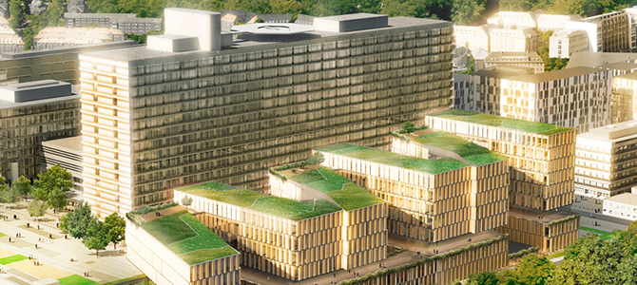
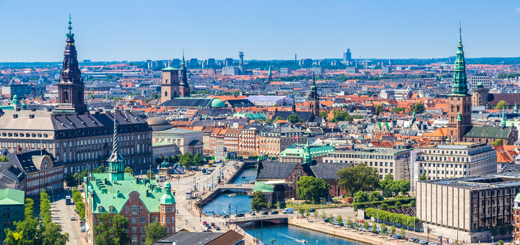
Louise Pyndt Diederichsen, MD, PhD
Center for Rheumatology and Spine Diseases
Copenhagen University Hospital, Rigshospitalet
Copenhagen, Denmark

Slide 4
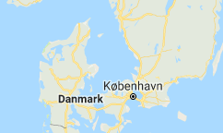
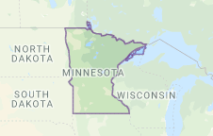
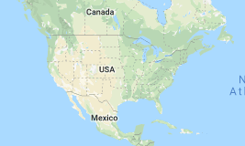
Size
Denmark: 42.933 km²
Minnesota: 225.181 km²
USA: 9.834.000 km²
Notes:
Kilometers squared

Slide 5
Sporadic inclusion body myositis - sIBM
Notes:
Briefly about the disease, which is in focus for this session, and this might be repetition for some of you
Sporadic In contrast to

Slide 6
Sporadic inclusion body myositis (sIBM)
Autoimmune disorder
Rare
Difficult to diagnose
White blood cells
Muscle cell
Notes:
This image pretty much covers the mechanism of autoimmune diseases including IBM
Attack
Some controversy exists about autoimmunity in IBM; however the recent discovery of an autoantibody related to IBM push the disease further in the autoimmun direction

Slide 7
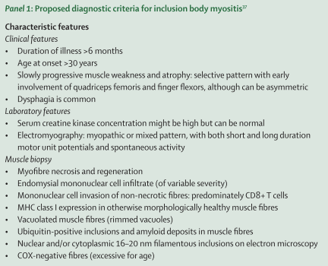
Diagnostic criteria - IBM
Clinical features
Laboratory features
Muscle biopsy observations
Griggs criteria (1995), modified by Dalakas in 2002
Needham, Lancet Neurol, 2007
Notes:
This is one of the diagnostic sets for IBM, consisting of some clinical features, som lab features and finaly som muscle biospy observations
Sporadic in contrast to hereditary

Slide 8
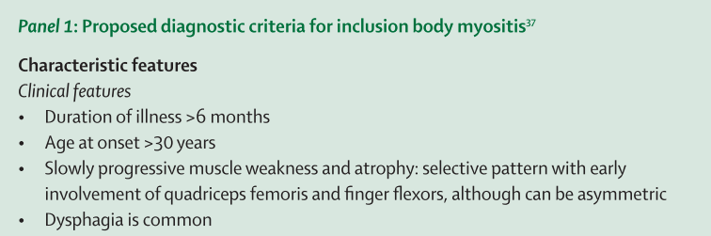
Clinical features - IBM
Needham, Lancet Neurol, 2007
Notes:
Starting with clinical features med something about duration of symptoms, age at onset and disease course
These images are examples of patients with IBM

Slide 9
Muscle involvement - IBM
Hand extensors/ flexors
Knee extensors
Foot extensors
Notes:
Typical muscle involvement of IBM

Slide 10
Biopsy –microscopy
Healthy muscle
sIBM muscle
Cellular inflammation
Muscle cells
Inclusion bodies
Notes:
Healthy muscle: Cross-sectional muscle biopsi showing the musle cells or muscle fibers, all the same size and shape
IBM muscle:

Slide 11
Blood-flow restricted resistance training - BFR
Notes:
That was briefly about IBM, now moving on to a promising specific training form

Slide 12
Blood-flow restricted resistance training
(BFR-training)
Resistance training performed with concurrent partial blood flow occlusion of the exercising leg, and using low external loads
Slide from Per Aagaard, University of Southern Denmark
picture courtsey Ben Rosenblatt, UK Sports
Notes:
This image demonstrates BFR training Please notice the discoloring of the leg

Slide 13
Why BFR training?
Normal heavy-load strength training: increases in muscle strength and size, but not doable for very weak people
Normal low-load strength training: No or only minor increases in muscle strength and size
BFR low-load strength training: increases in muscle strength and size with minor stress on muscles, joints and tendons and doable even for weak people
Notes:
Why
We know that
adding

Slide 14
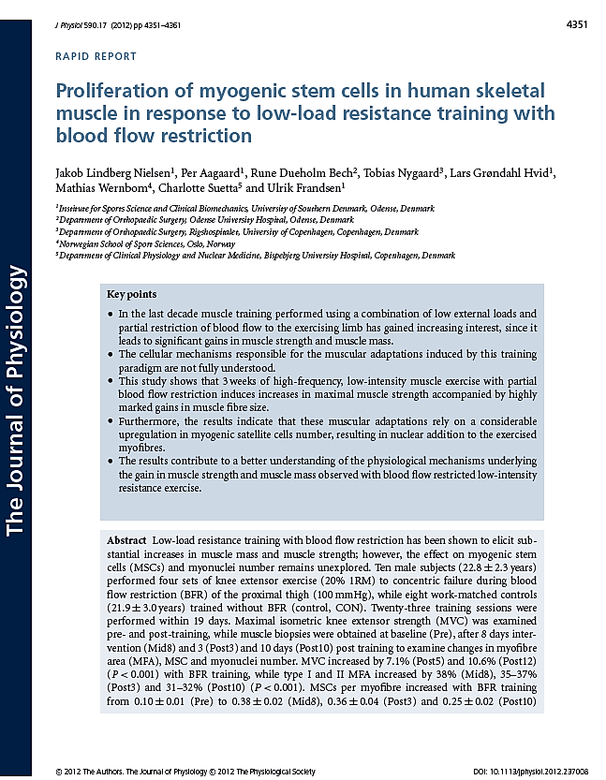
Professor Per Aagaard
Healthy young males
Slide from Professor Per Aagaard, University of Southern Denmark
Notes:
So what leed up to your IBM BFR study? 2 studies led to the BFR/IBM study
I will show you a study of One of my collaborators recently professor Per Aagaard and his group did a study on healthy young males doing low-load resistence training with BFR for 3 weeks
Explain the images

Slide 15
Effects of BFR training in healthy
CONCLUSIONS:
BFR-training can be used to induce marked
increases in:
muscle strength
muscle fibers (cells) size
BFR-training results in a markedly upregulated
myogenic stem cell (SC) content in the trained muscles
Slide from Professor Per Aagaard, University of Southern Denmark
Notes:
In conclusion: the effects of …..
Underlying mechanism of BFR

Slide 16
Effects of BFR training
PERSPECTIVES:
Will BFR training work for:
patients who is unable to perform heavy-load strength training due to loss in muscle mass?
Patients with IBM?
Slide from Professor Per Aagaard, University of Southern Denmark
Notes:
Is able to induce ….
Lead to
That was our motivation

Slide 17
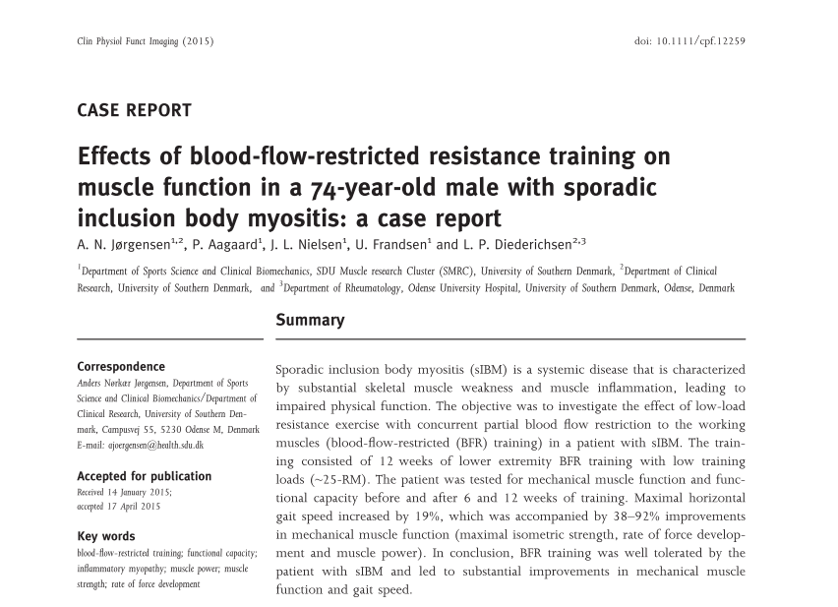
Pilot study
Jørgensen et al, Clin Physiol Funct Imaging, 2015
Notes:
We then did a a pilot study; one of my patients who agreed to participate

Slide 18
Case study - Methods
A case report
74-year-old male with sIBM
12 weeks of BFR-training, 2 sessions per week
3-4 sets of low-load resistance to exhaustion, 45 sec. rest with no release of cuff pressure:
  Leg press
  Knee extension
  Seated calf raise
Jørgensen et al, Clin Physiol Funct Imaging, 2015
Notes:
In that way incouraged, we did a pilot study prior to a PhD training study
This is the training setup, and obviously not our patient but a healthy, young mail
And this is the pneumatic device for the cuff

Slide 19
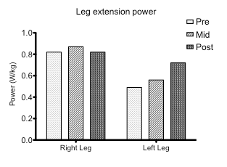
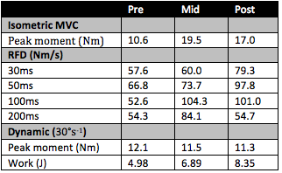
Case study - Results
48 - 60% increase in strength
19% increase in max gait speed
No side-effects
Leg extension power
48%
60%
Right leg
Left leg
~40-100%
68%
Jørgensen et al, Clin Physiol Funct Imaging, 2015
Notes:
Accomplished by …
This figure shows leg extension power of the right and left leg …..
Well tolerated
Clically important, we know that gait-speed influence tendence to fall

Slide 20
RCT study
Purpose:
To investigate the effects of BFR-training in patients diagnosed with sIBM in a randomised controlled trial
Hypotheses:
That 12wks of BFR-training will result in improvement in physical function and
That the magnitude of the improvement will be negatively correlated to duration of the disease, because patients with a long disease history have little functioning muscle tissue left to be trained
Jørgensen et al, Scand J Rheumatol. 2018
Notes:
In that way encouraged we launged a randomized controlled

Slide 21
Study design
Enrolment
Randomised trial
Analysis
Patients with no gait function or prevented from participating (n=11)
Patients with co-morbidities preventing participation in the study (n=1)
Drop-outs (n=2)
Participants allocated to training (n=11)
Defined sIBM patients located in the Region of Southern Denmark (n=40)
Patients invited to participate in the study (n=29)
Patients examined for eligibility (n=23)
Eligible patients willing to participate in the study performed baseline tests (n=22)
Effects of BFR-training.
Potential clinical implications for patients
Participants allocated to no training (n=11)
Patients declining to participate (n=6)
Biopsies
Blood tests
Training intervention
Biopsies
Blood tests
Drop-outs (n=5)
Jørgensen et al, Scand J Rheumatol. 2018
Notes:
Briefly, the study flow chart, i know it´s a bit of a buissy slide
Baseline tests, the next slide

Slide 22
Outcome ”layers”
HAQ
Self reported function
SF-36
(physical domain)
IBMFRS
Functional
capacity
2min walk
Balance (sway)
Timed Up & Go
Chair stand test
MVC
Neural activation
(twitch)
Neuromuscular function
Lean body mass
RFD/Power
CSA
Inflammation
Biopsy/blood
Satellite cells
Capillaries
Jørgensen et al, Scand J Rheumatol. 2018
Notes:
Effect parametres
IBMFRS, findes den på dansk, jeg spørger Nanna
Ellers bør vi bruge 2-min walk test

Slide 23





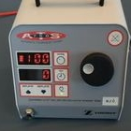
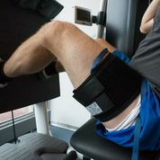
BFR-Training
Training periode
12wks (2x6wks, one week rest). 2 training sessions per week
Exercises
Unilateral; I) leg press, II) Knee extension (from wk4), III) Knee flexion, IV) Calf raise, V) Dorsal fleksion
Training load/volume
Week 1-8:
3 sets of approximately 25RM* (intentionally performed to contractile failure); load was adjusted when more than 20 repetitions were performed in second set.
(Week 1 and 2 was not performed to contractile failure)
Week 9-12:
4 sets of 25RM (intentionally performed to contractile failure)
Vascular occlusion
Obtained with a tourniquet system (Zimmer ATS 750; 100mm wide cuff).
Occlusion pressure was 110mmHg and continuous throughout each exercise before cuff was released
Cuff was placed on the proximal part of the thigh/shank
* A repetition maximum (RM) is the most weight you can lift for a defined number of exercise movements.
Jørgensen et al, Scand J Rheumatol. 2018
Notes:
A repetition maximum (RM) is the most weight you can lift for a defined number of exercise movements.

Slide 24
Results
Leg muscle strength decreased in the non-training control group during the 3-month intervention period, but was unaltered in the BFR-training group
In addition, increase in self-reported physical function in favor of the BFR-training group compared to the control group
The training protocol did not result in accelerated disease activity or severe side effects
Jørgensen et al, Scand J Rheumatol. 2018

Slide 25
Perspectives
The BFR training protocol demonstrated a preventive (retaining) effect on the disease related decline in leg muscle strength, which may aid the long-term preservation of physical function and postpone the need for healthcare assistance
In order to determine the optimal modality of physical training in sIBM patients, larger (i.e. multicentre) studies with longer intervention periods with various types of intervention exercise should be considered

Slide 26
Our next BFR RCT study
Patients with myositis except sIBM
BFR strength and BFR cycling training
Study schematics

Slide 27
Our next BFR RCT study
Overview over testing periods

Slide 28
Recommendations – BFR-training
Try it! Its safe and might help you, but ask your doctor and be aware of the exclusion criteria
  Co-morbidity contraindicating the use of BFR-training:
    previous deep vein thrombosis/pulmonary embolism or
    known peripheral ischemic disease
  Co-morbidity preventing resistance training:
    severe heart/lung-disease
    uncontrolled hypertension
    Severe knee/hip arthritis

Slide 29

Thanks to
Collaborators at
  Karolinska University Hospital
    Helene Alexanderson
    Ingrid Lundberg
  Rigshospitalet
    Kasper Yde Jensen
    Søren Jacobsen
  Odense University Hospital
    Henrik Daa Schrøder
  University of Southern Denmark
    Anders Nørkær Jørgensen
    Per Aagaard
    Ulrik Frandsen
    Jacob Lindberg Nielsen
  University of Copenhagen
    Charlotte Suetta
Funding
  The Danish Rheumatism Association
  Lundbeck Foundation
  University of Southern Denmark
  A.P. Møller Foundation
  Region of Southern Denmark

Slide 30
Thank you for your attention!
Louise Pyndt Diederichsen, MD, PhD
Center for Rheumatology and Spine Diseases
Copenhagen University Hospital Rigshospitalet
Copenhagen, Denmark

