Slide 2
Adaptive Living Through Technology
Amy Perron – MN STAR Program
September 6th, 2019
Notes:
Speaker introduction.
Thank you for allowing me to share information about Assistive technology with you today.

Slide 3
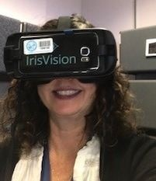
Introduction
Amy Perron
MN STAR Program
Federally Funded Program
Assistive Technology Specialist
Our program serves all Minnesota Residents
Let’s talk about Assistive Technology – AT!

Slide 4
What is Assistive Technology?
Notes:
The first question we need to ask is “What is Assistive Technology?” So, what do you think, is this assistive technology?! Let’s find out.

Slide 5
Assistive Technology is…
...any item, piece of equipment, or product system, whether acquired commercially off the shelf, modified, or customized, that is used to increase, maintain, or improve functional capabilities of individuals with disabilities.
[20 U.S.C. Chapter 33, Section 1401 (25)]
Notes:
The first word says it all.
Off the shelf: Dragon Naturally Speaking speech recognition software
Modified: tennis balls on a walker (or wood to move snow!)
Keep in mind - what might be a convenience for most could be considered assistive technology if it’s needed to perform a task or function.
Automatic doors openers are one example. For most of us, they are a convenience; but, for some, they are a necessity for independent access to buildings. Another example is speech to text software that lets the user dictate text using a computer, laptop or mobile device. Many computer users who are able to use a keyboard may also use speech to text software – for them the software may increase their productivity but it is not assistive technology. However, if someone is unable to use a keyboard, speech recognition software may be the most efficient way to input data.
Assistive technology is often referred to as AT.
Assistive technology service is any service that directly assists an individual with a disability in the selection, acquisition, or use of an assistive technology device.

Slide 6
Federal Assistive Technology Act
Legislation was originally passed in 1988 and was reauthorized in 2004
All 50 states, four US territories, the District of Columbia and Puerto Rico receive formula grant funding.
State AT Programs serve all individuals of any age and with any type of disability
Notes:
As I mentioned I am with the MN STAR Program.
STAR is funded through the FATA
This is a resource that is available across the country
-No referrals are needed
-Services may vary from state to state

Slide 7
Federal Assistive Technology Act Services
Information and Assistance
Device Demonstration
Device Loans
AT Reutilization
Services vary from state to state (these are the core services)
Notes:
Increase awareness of AT and the AT Act Programs

Slide 8
Find Your State Program
If you would like to learn more about your state AT Act Program go to:
www.at3center.net

Slide 9
Potential Barriers of AT Usage
Lack of awareness
Lack of training/skill
Fear
Technical problems
Notes:
So why aren’t more people, including older adults, using assistive technology?
Lack of awareness - If folks don’t know it exists, they can’t ask for it!
Lack of skill – some AT, like an adapted pen, requires little training – others, like screen reading software, are complex and may take years to master. Training can make or break an individual’s ability to successfully use AT.
Fear - Most of us know someone with technophobia or, at the very least, resistance to using technology. The best way to overcome this is to spend time becoming familiar with the technology.
Technical problems – these can be caused by lack of knowledge, user error, or equipment failure.

Slide 10
Let’s look at some Assistive Technology
Notes:
https://www.youtube.com/watch?v=aqoXFCCTfm4
Here is a video from Apple of a new feature called Voice Control (*available on iOS 13)
This is an example of High tech assistive technology

Slide 11
Types of Assistive Technology Available
Vision
Hearing
Speech Communication
Learning/Cognition
Mobility
Daily Living
Environmental Adaptions
Computers and related
Recreation, Sports and Leisure

Slide 12
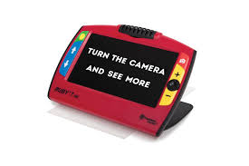
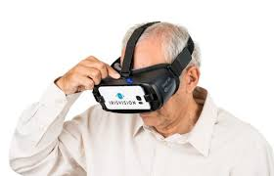
Vision Devices
Lighting
HD Magnifiers
Vision software
Vision Apps
Ruby 7 HD Magnifier
Iris Vision Glasses

Slide 13
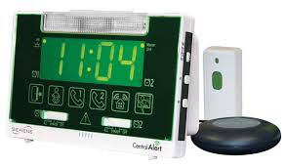
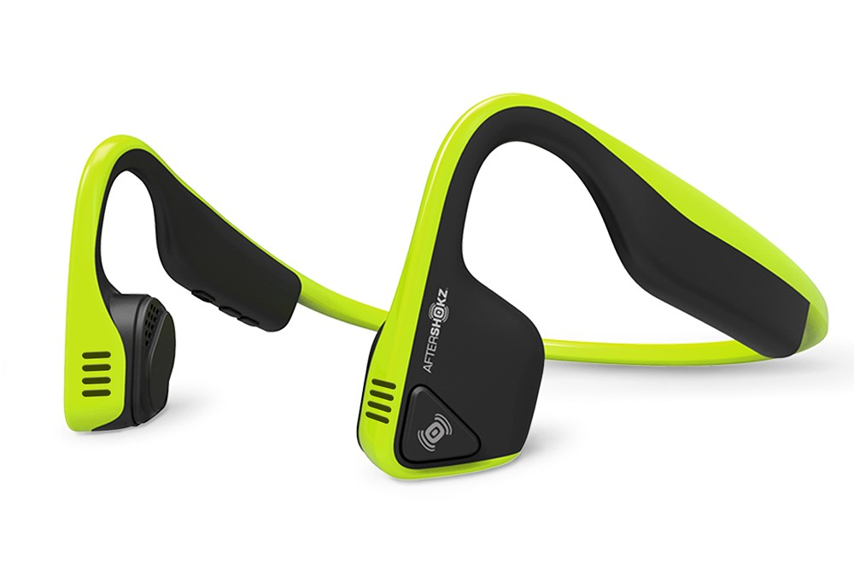
Hearing Devices
Personal Sound Amplifiers
TV Listening Systems
Home Alert Systems
Weather Alerts
Central Alert
Bone Conducting Headphones

Slide 14
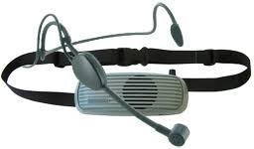
Speech Communication
Speech to text software
Text to Speech
Voice Amplifiers
Communication Devices
Chattervox Voice Amplifier

Slide 15
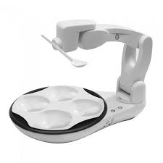
Daily Living Aids
Medication Dispensers
Tablet Stand
Couch Stander
Obi Self-feeder
Liftware
Obi Self-Feeding Device

Slide 16
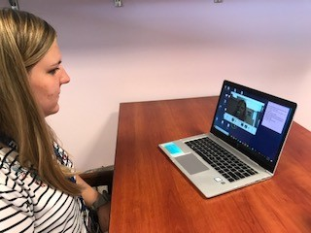
Computers and Related
Modified Keyboards
Modified Mice
Ergorest
Hands-free access
Smyle Mouse Software

Slide 17
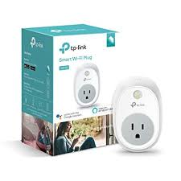
Environmental Controls
Smart Technology
Control Lights
Outlets
Doors
Thermostats
Make phone calls
Control TV
Smart Wi-Fi Plug
Notes:
Photo of TP-Link Smart Wi-Fi Plug. Works with a smartphone via an app.

Slide 18
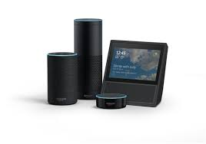
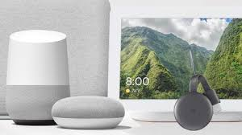
Popular Environmental Controls
Amazon Smart Devices
Google Smart Devices

Slide 19
Built in Accessibility
All computer systems offer built in accessibility features. Each may look a little different, but ultimately they are all offering much of the same features. These features can be accessed from the Settings screen.
Notes:
The newer operating systems offer more features. There are features for Vision, Hearing, Learning and

Slide 20
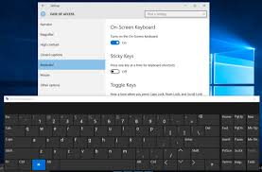
Built in Features for Mobility
On Screen Keyboard
Speech Recognition
Delegate digitally
Sticky Keys/Mouse/Filter Keys
Notes:
On Screen Keyboard can be of use for individuals with limited or no use of their hands. The keyboard can be controlled in many different ways, including fingers, mouse, joystick, pointers and Eyegaze
Speech Recognition is a powerful tool that can benefit people with or without a disability. This is definitely a feature that has a learning curve and will require practice. By learning a number of commands you are able to complete a number of tasks via your voice. The newer operating systems offer more robust dictation features than we have seen in past.
Delegate digitally Siri (Mac) and Cortana (Windows) can be your digital assistant. Helping with things like scheduling reminders, sending emails or opening apps.
Sticky Keys is a feature that is great for individuals who have a hard time or are unable to press multiple keys at one time ( such as Ctl+Alt+Delete) when sticky keys are enabled you can press one key at a time.
Mouse Keys for folks who have trouble using a mouse or a track pad Mouse keys give you the ability to control your computer with the number keys rather than using a mouse.
Filter Keys or Slow Keys on a Mac is a setting that allows you to adjust the sensitivity of the keyboard. This setting is helpful if an induvial hits keys repeatedly in error (an example would be if you have tremors).

Slide 21
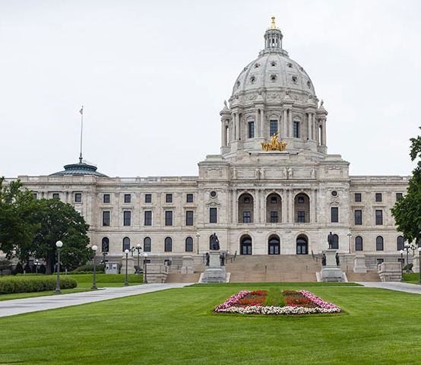
Thank You!
You can reach the STAR Program via:
Phone 651-201-2640
Fax 651-282-6671
Email star.program@state.mn.us
Website MN STAR (www.mn.gov/star/)

